Slide 1
The Power of Sport with Metro Blind Sport and Bloomsbury Football Foundation

Slide 2
A little bit of housekeeping
Live captions are available during the webinar
Slides, a transcript and a recording, will be made available post-webinar
Please use the Q&A window to ask questions
We’ll send you an email including a survey after the webinar

Slide 3
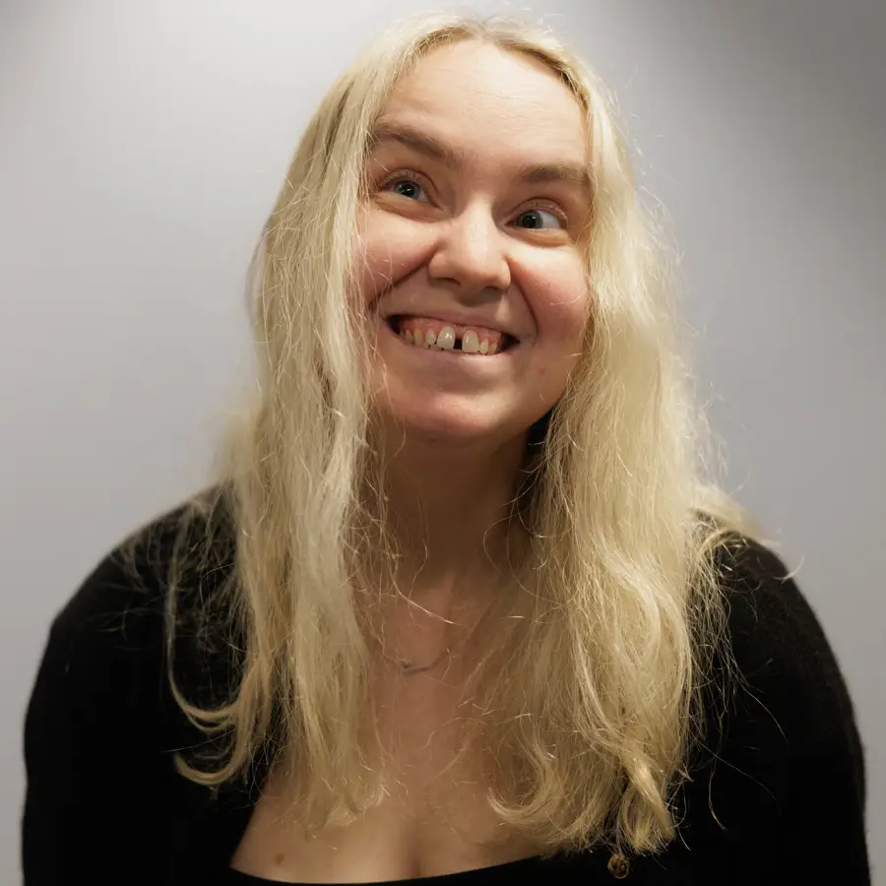
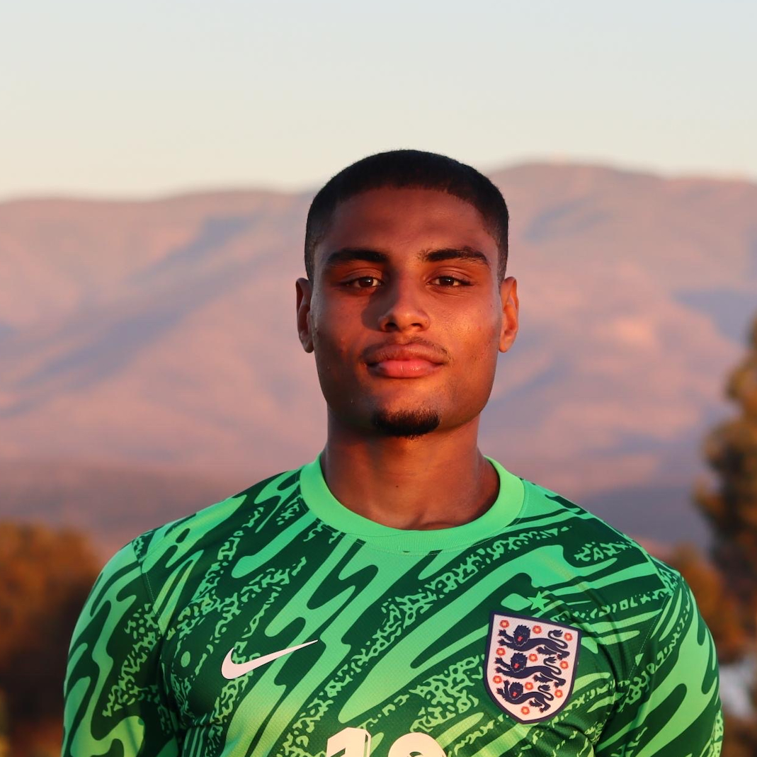
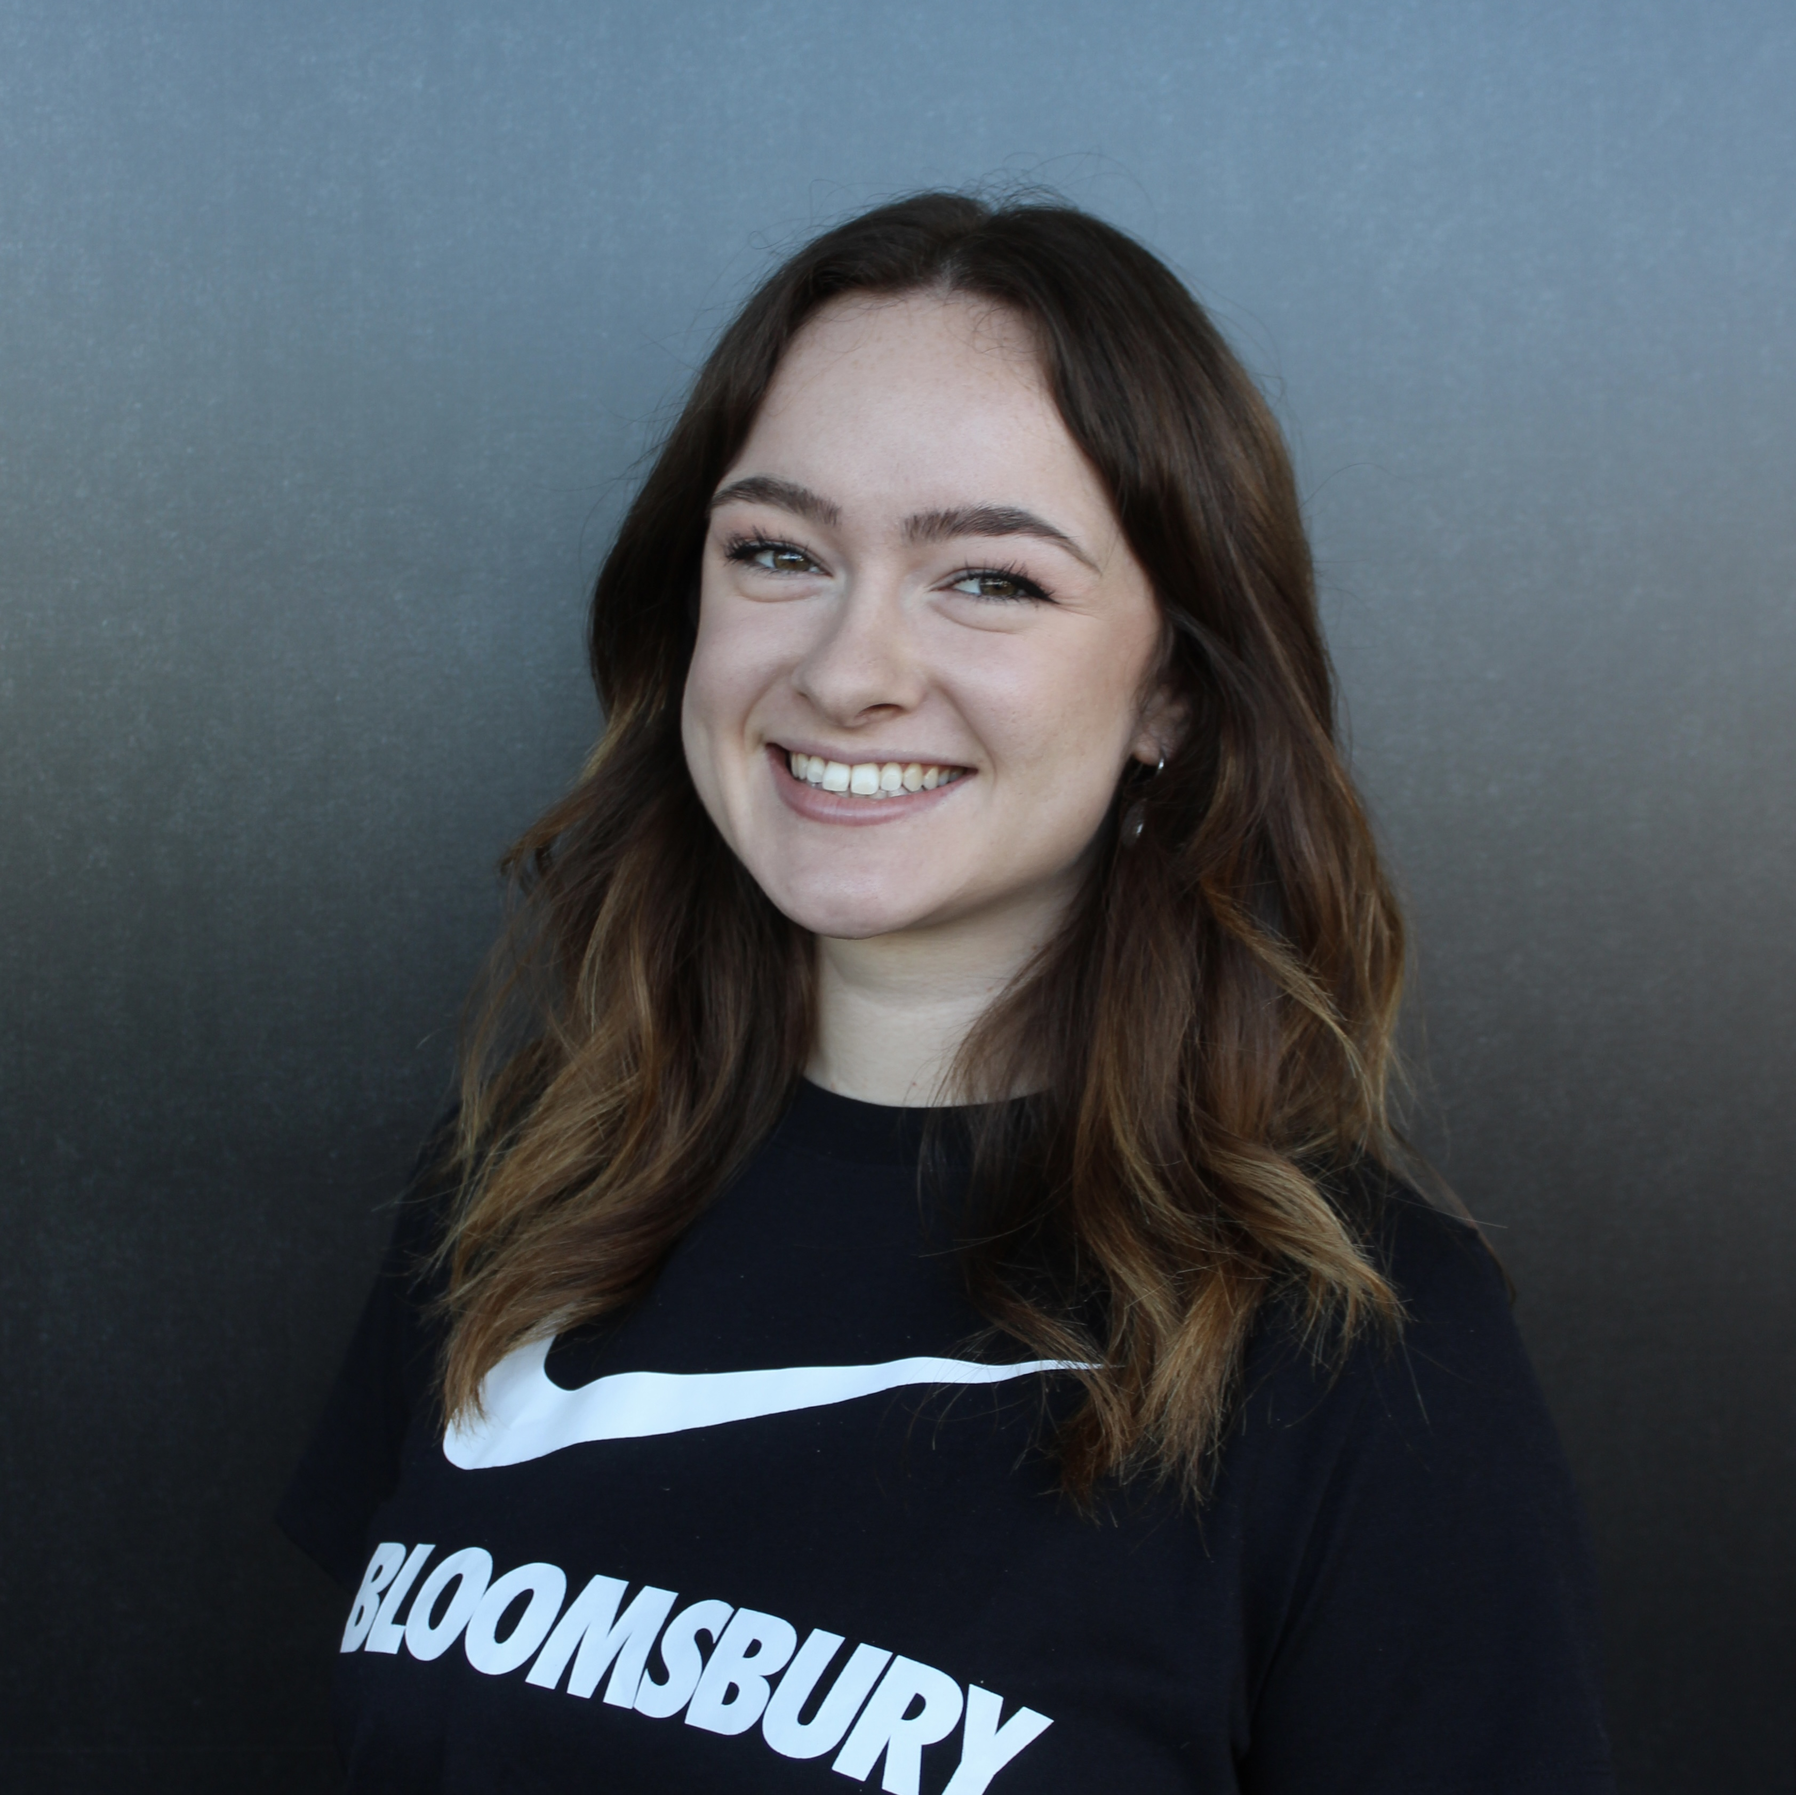
Our webinar today
Host: Kerry Firth
Grants Manager, Social Change, Fight for Sight
Speaker: Owen Locke
Coach at Bloomsbury, and England International and sighted goalkeeper for the national blind football team
Speaker: Rory Field
CEO, Metro Blind Sport
Speaker: Georgia Webster
Special Projects Coordinator, Bloomsbury Football Foundation

Slide 4

About Fight for Sight
We fund the brilliant minds and bright ideas that put change in sight.
Notes:
Explain that we are a funder

Slide 5
Our brand story, imagine…
Imagine being told that you, or someone you love, is losing their sight. At that moment, two profound questions present:
Can this be stopped? How do I live my life?

Slide 6
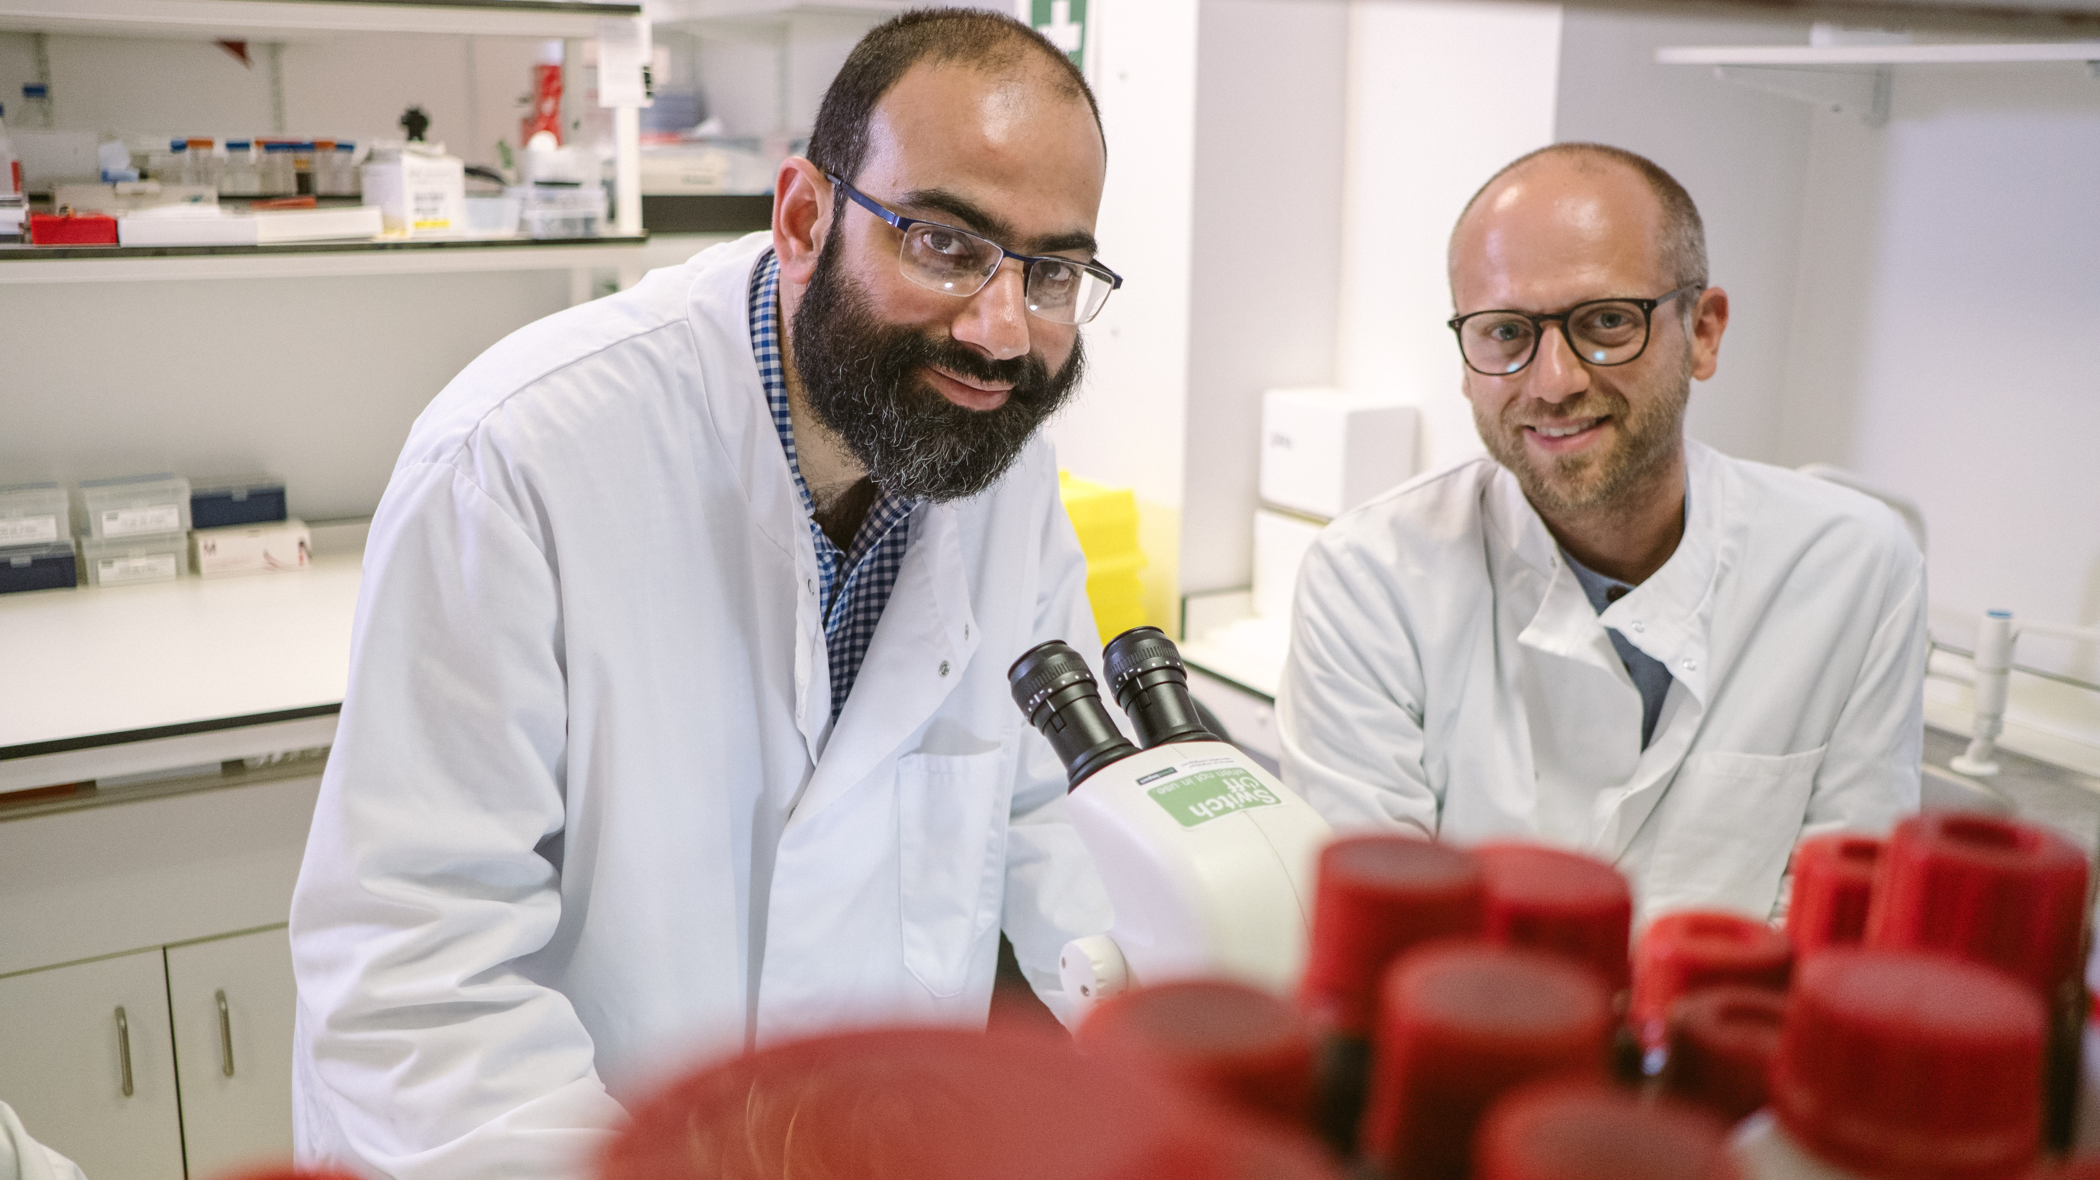
Research strategy
Our researchers are working to better understand, diagnose, prevent and treat vision loss.

Slide 7
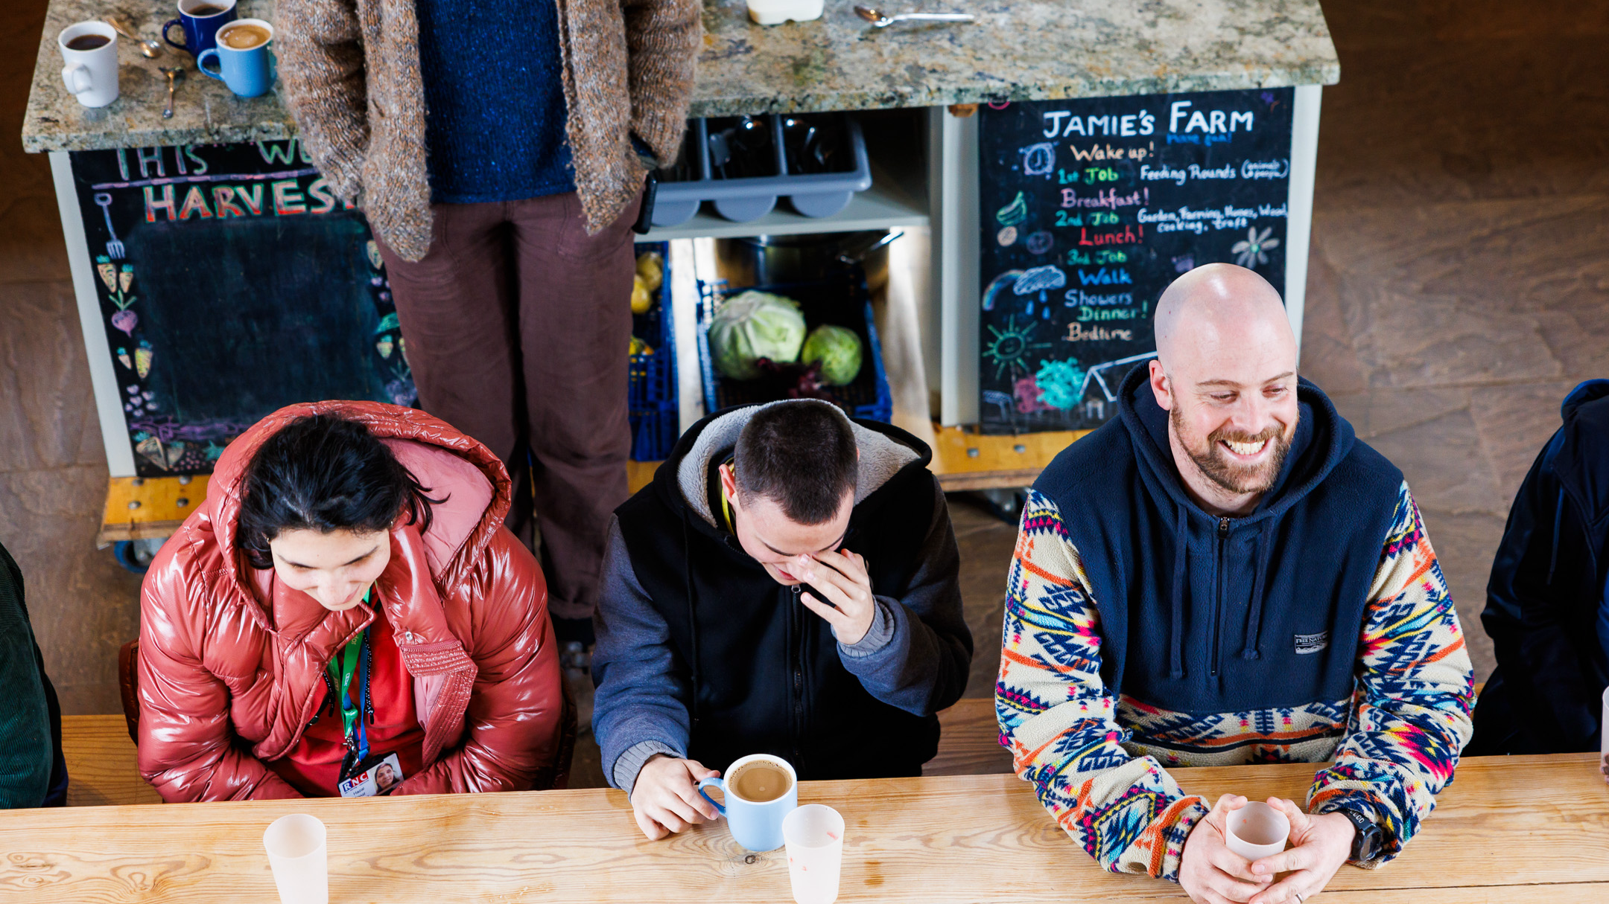
Social change
The partnerships we build and initiatives we support are changing lives for blind and vision impaired people.

Slide 8
Panel Discussion

Slide 9

Q & A

Slide 10
Useful resources
Find out more about Prof. Ted
Read more about the glaucoma research we’ve supported
Read more about our small grants
Discover more about eye conditions in our A to Z
Read more about the impact of the scientific research and social change we’re funding
Please donate and help us fund more scientific research
Find out how to apply for funding from Fight for Sight

Slide 11

Thank you
www.fightforsight.org.uk
#FightforSightPresents

