Slide 1

Why is a form of vitamin B3 being tested in glaucoma clinical trials?

Slide 2
A little bit of housekeeping
Live captions are available during the webinar
Slides, a transcript and a recording, will be made available post-webinar
Please use the Q&A window to ask questions
We’ll send you an email including a survey after the webinar

Slide 3
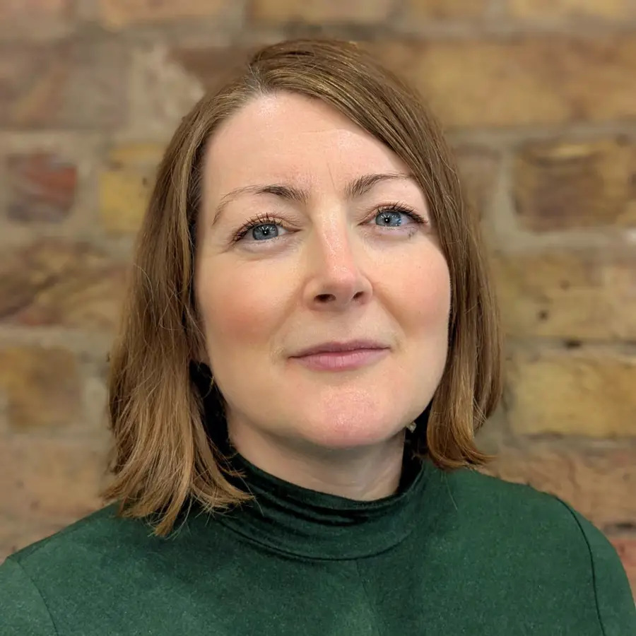
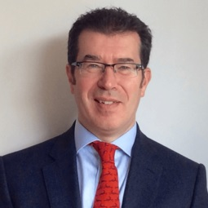
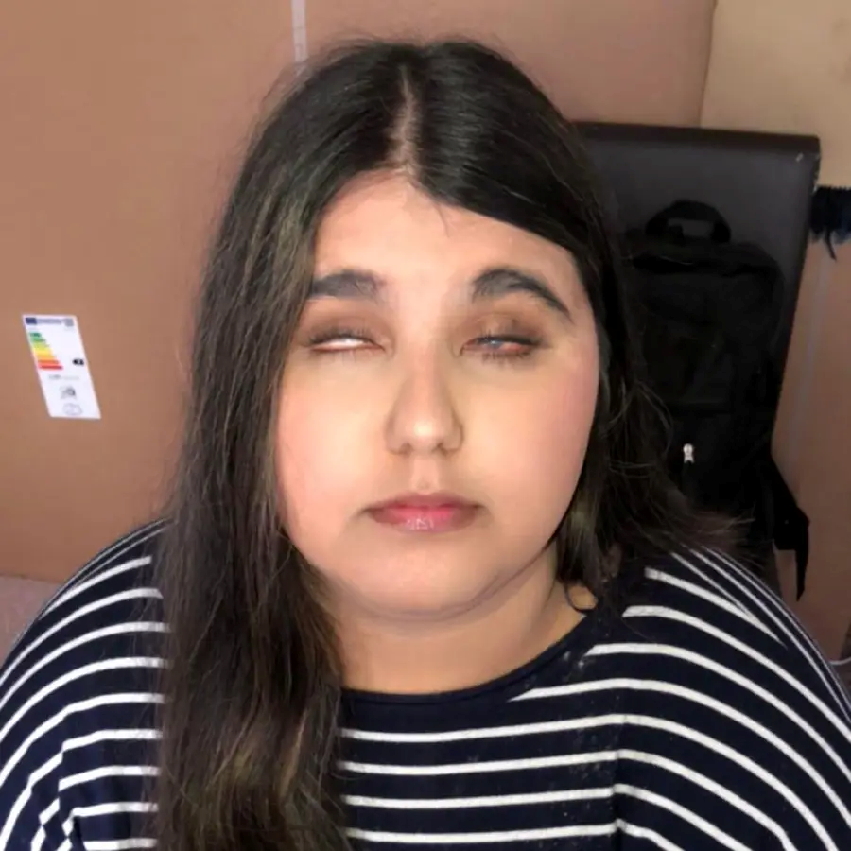
Our webinar today
Host: Emma Blamont, Head of Research and Programmes
Speaker: Professor Ted Garway-Heath, Professor of Ophthalmology at UCL, and consultant ophthalmic eye surgeon at Moorfields Eye Hospital
Speaker: Zaynab Rehman, Communications Assistant, Fight for Sight

Slide 4

About Fight for Sight
We fund the brilliant minds and bright ideas that put change in sight.
Notes:
Explain that we are a funder

Slide 5
Our brand story, imagine…
Imagine being told that you, or someone you love, is losing their sight. At that moment, two profound questions present:
Can this be stopped? How do I live my life?

Slide 6
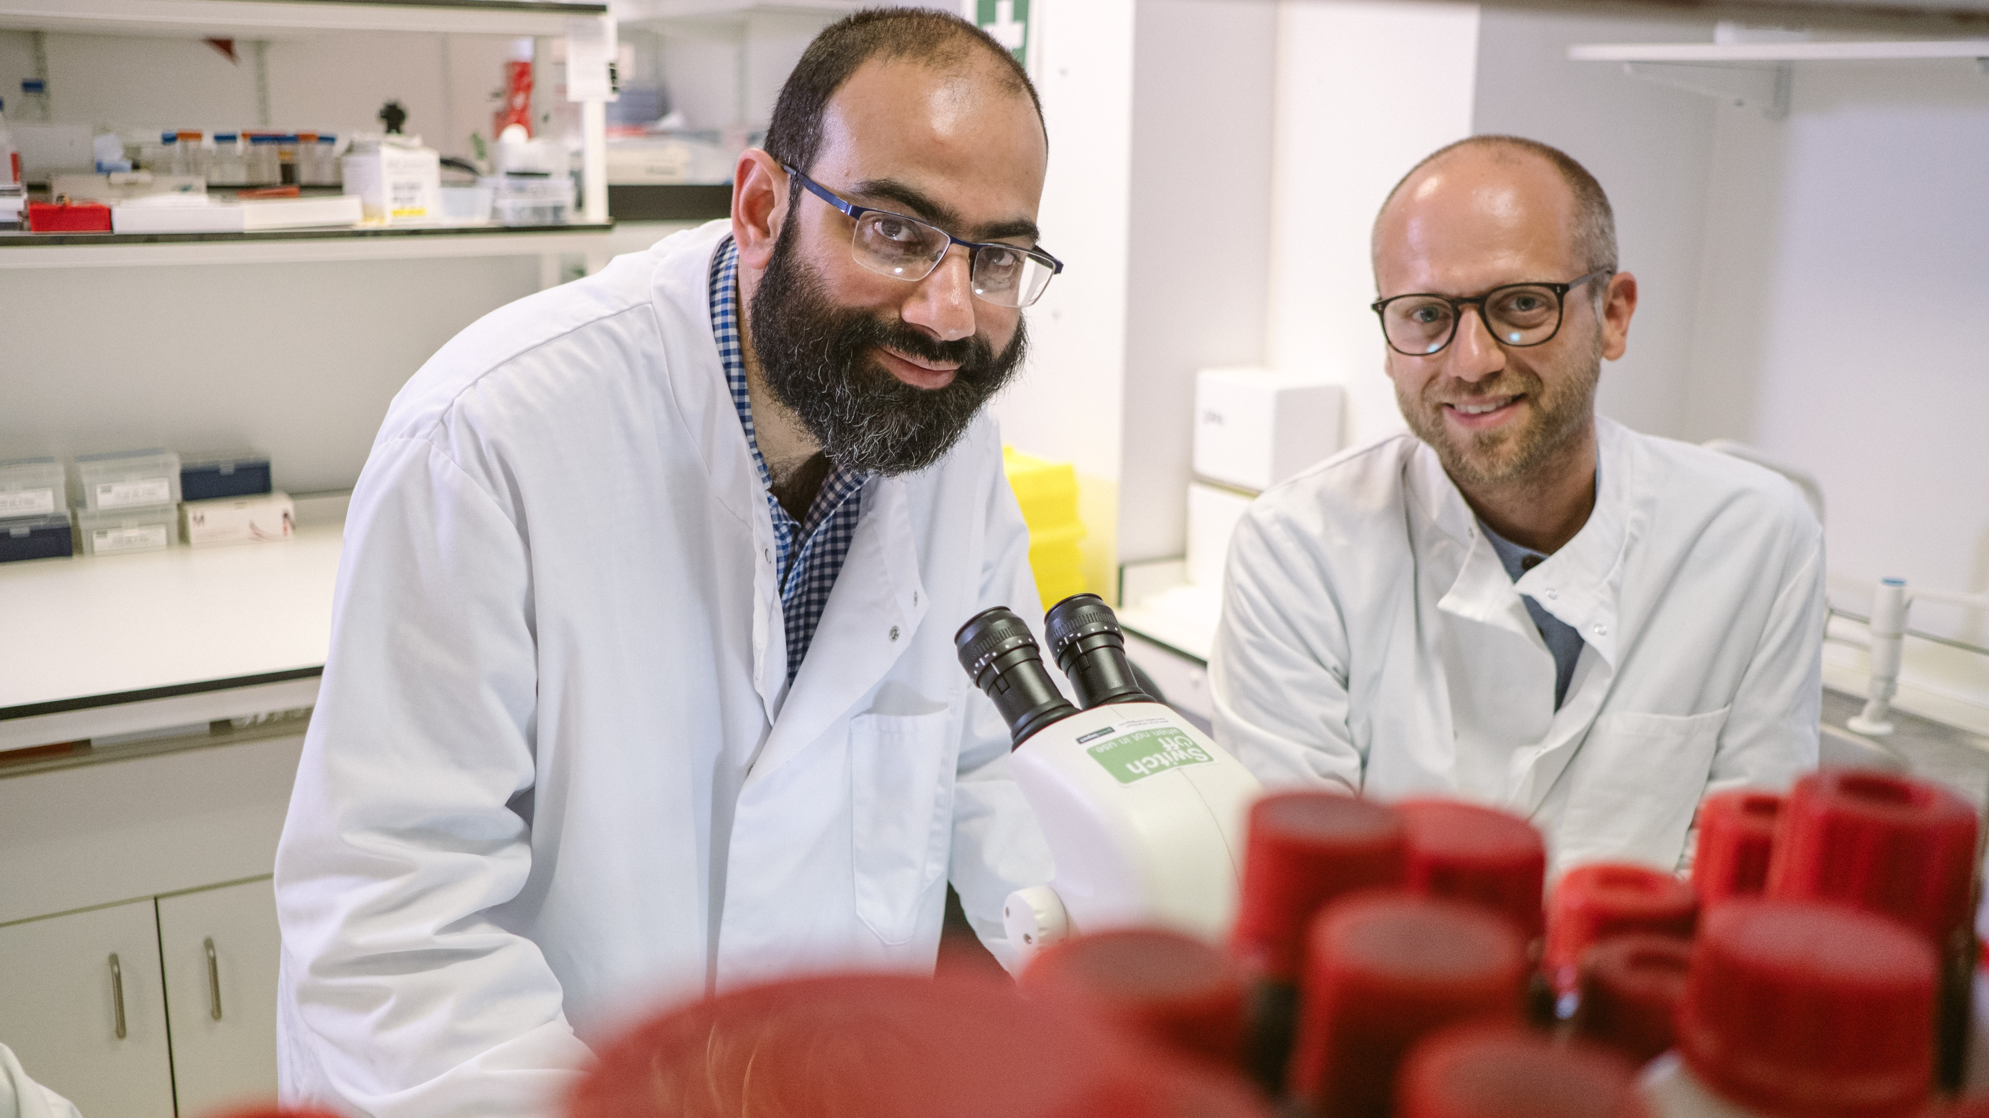
Research strategy
Our researchers are working to better understand, diagnose, prevent and treat vision loss.

Slide 7
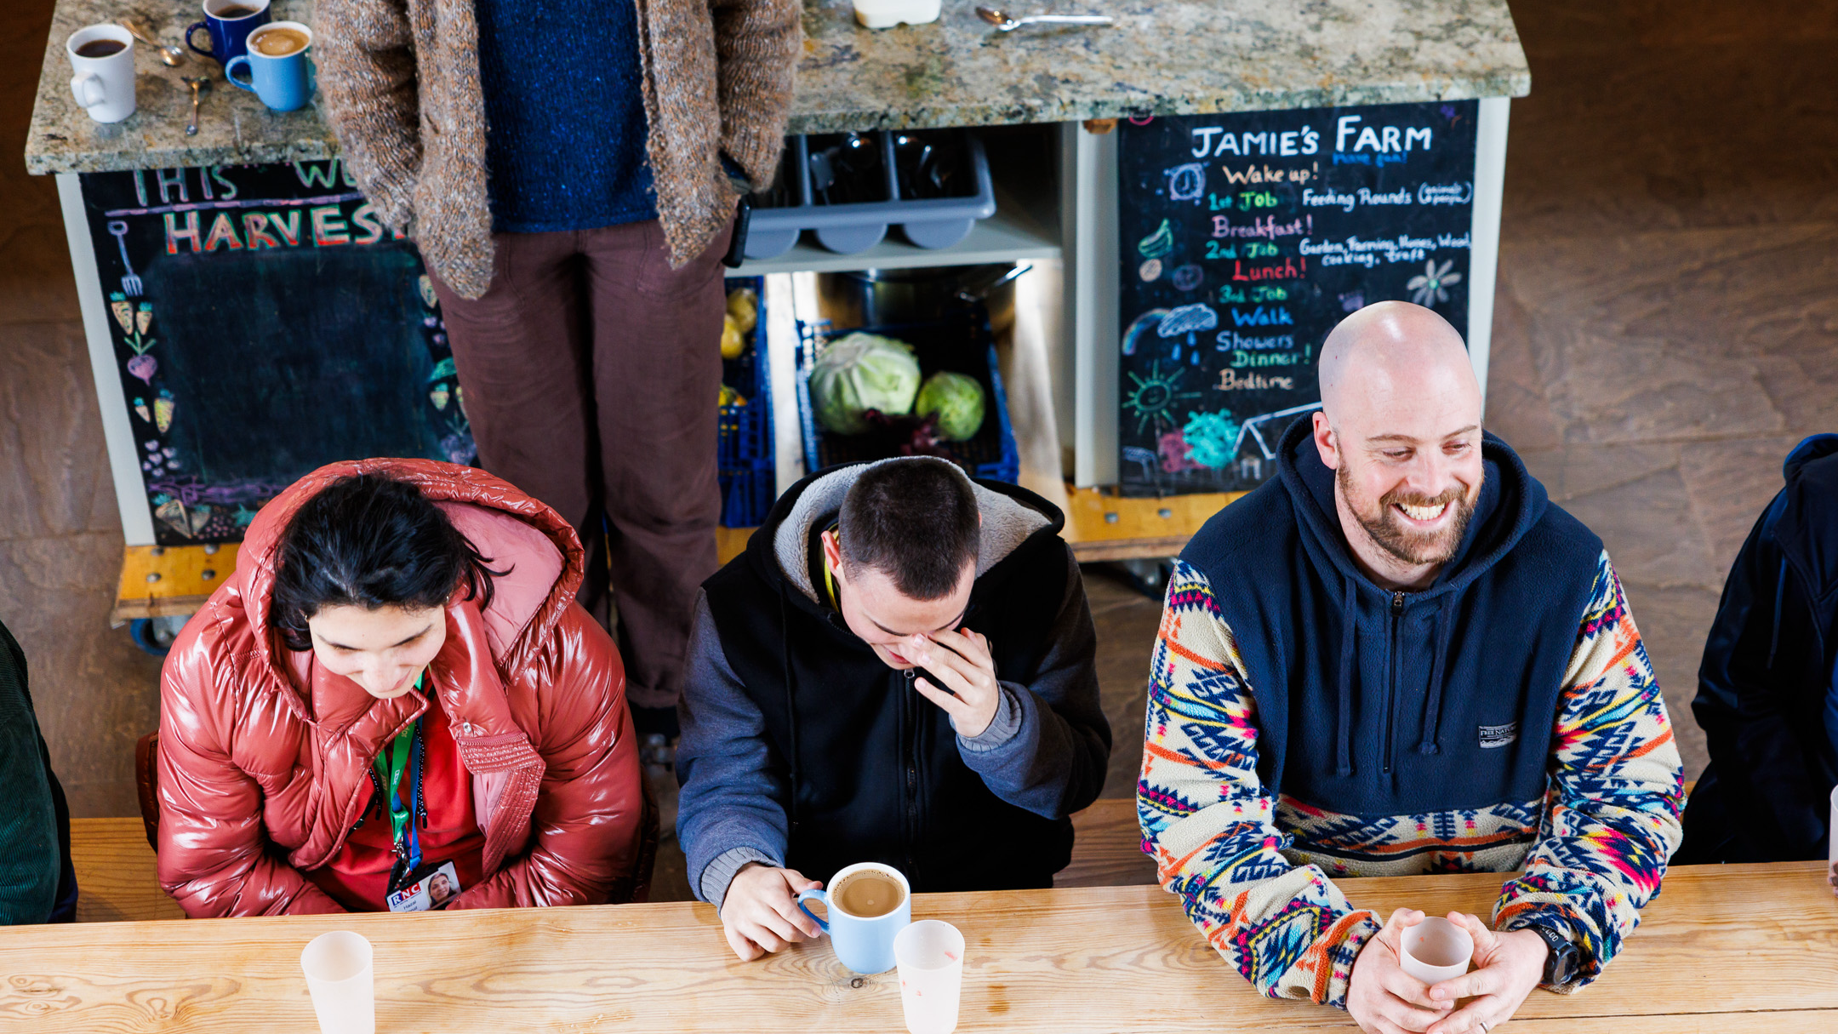
Social change
The partnerships we build and initiatives we support are changing lives for blind and vision impaired people.

Slide 8
Panel Discussion

Slide 9
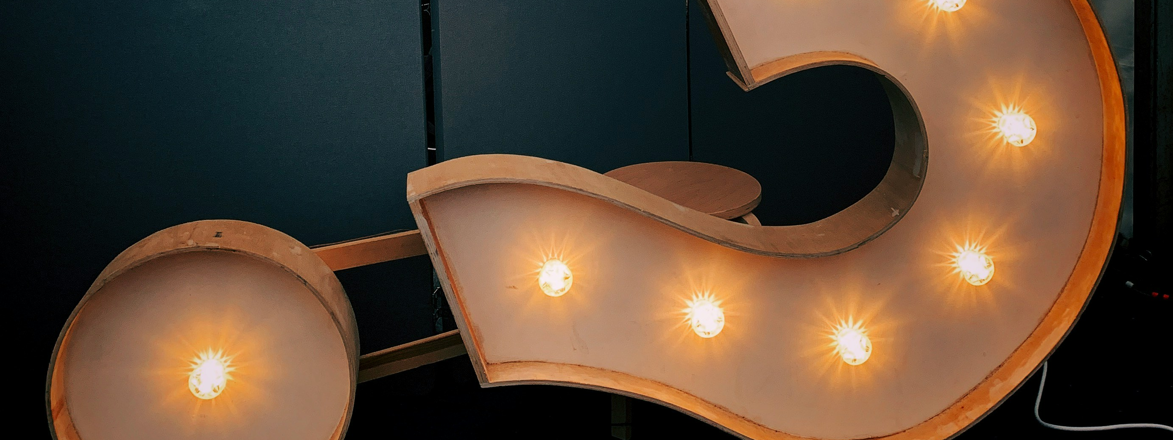
Q & A

Slide 10
Useful resources
Find out more about Prof. Ted
Read more about the glaucoma research we’ve supported
Read more about our small grants
Discover more about eye conditions in our A to Z
Read more about the impact of the scientific research and social change we’re funding
Please donate and help us fund more scientific research
Find out how to apply for funding from Fight for Sight

Slide 11
Fight for Sight Presents: Our next webinar
The Power of Sport with Metro Blind Sport and Bloomsbury Football Foundation
Wednesday, 24th June 2026 at 12:00-13:00.
Register here
What impact can sports have on the lives of people with vision loss?
Join us as we speak with Metro Blind Sport and Bloomsbury Football Foundation to explore how sport goes far beyond physical activity. Together, we’ll unpack the ripple effect that taking part in sport can have on confidence, independence and mental health, and why access to inclusive opportunities matters.
This webinar featured Rory, CEO of Metro Blind Sport; Georgia, from Bloomsbury and Owen from Bloomsbury.

Slide 12

Thank you
www.fightforsight.org.uk
#FightforSightPresents

