Slide 1

Fight for Sight Presents
Creating social communities with Sutton Vision and
Sutton Primary Care Networks
#FightforSightPresents

Slide 2
Welcome and housekeeping
Live captions are available during the webinar.
We may use illustrated slides to guide us, but we will read out everything on these.
Slides, a transcript and a recording, will be made available post-webinar.
Please use the Q&A window to ask questions.
The chat is disabled because it can be distracting for those using a screen reader, and because it is simpler for us to monitor one single channel.
When we end the webinar, it will end abruptly.

Slide 3
What to expect in this webinar
01 | Welcome from Kerry Firth, Grants Manager with an intro to our organisation
02 | ‘A network of friends’ with Denise and Pierre from Sutton Vision
03 | What is social prescribing and how is it tackling loneliness and isolation across the nation, with Rachel and Anna from Sutton Primary Care Networks
04 | Live discussion and Q&A

Slide 4
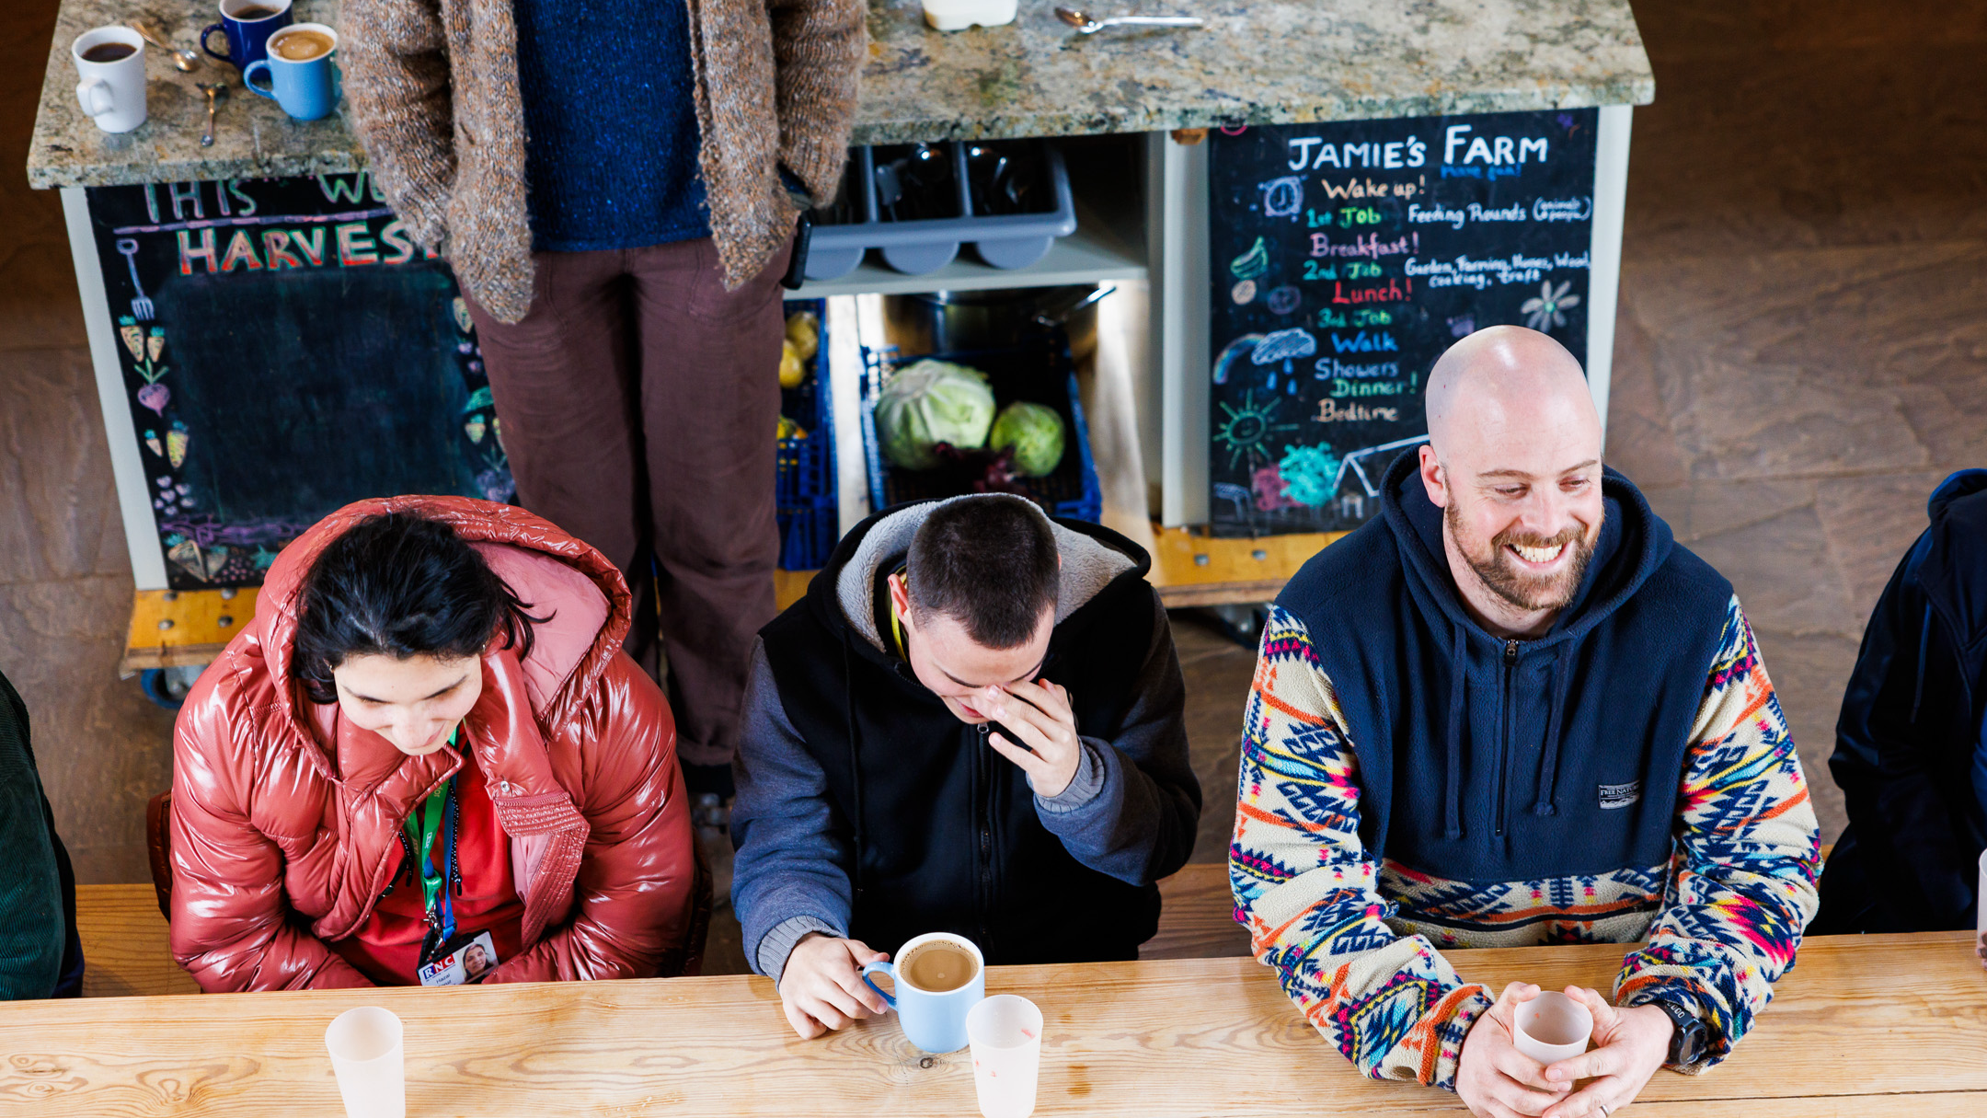
Outside: Blind and vision impaired people’s experiences of loneliness and isolation
1 in 3 people have experienced loneliness and isolation

Slide 5
Further Information
More on Sutton Vision’s activities, groups and volunteer-led programmes
More on Sutton Primary Care Networks
Discover more about our social change funding
Find out more about the projects we fund
Find out more about the research which guided the funding: Outside: blind and vision impaired people’s experiences of loneliness and isolation
Please donate and help us fund more lifechanging projects

Slide 6

Thank you
www.fightforsight.org.uk
#FightforSightPresents

