Slide 1
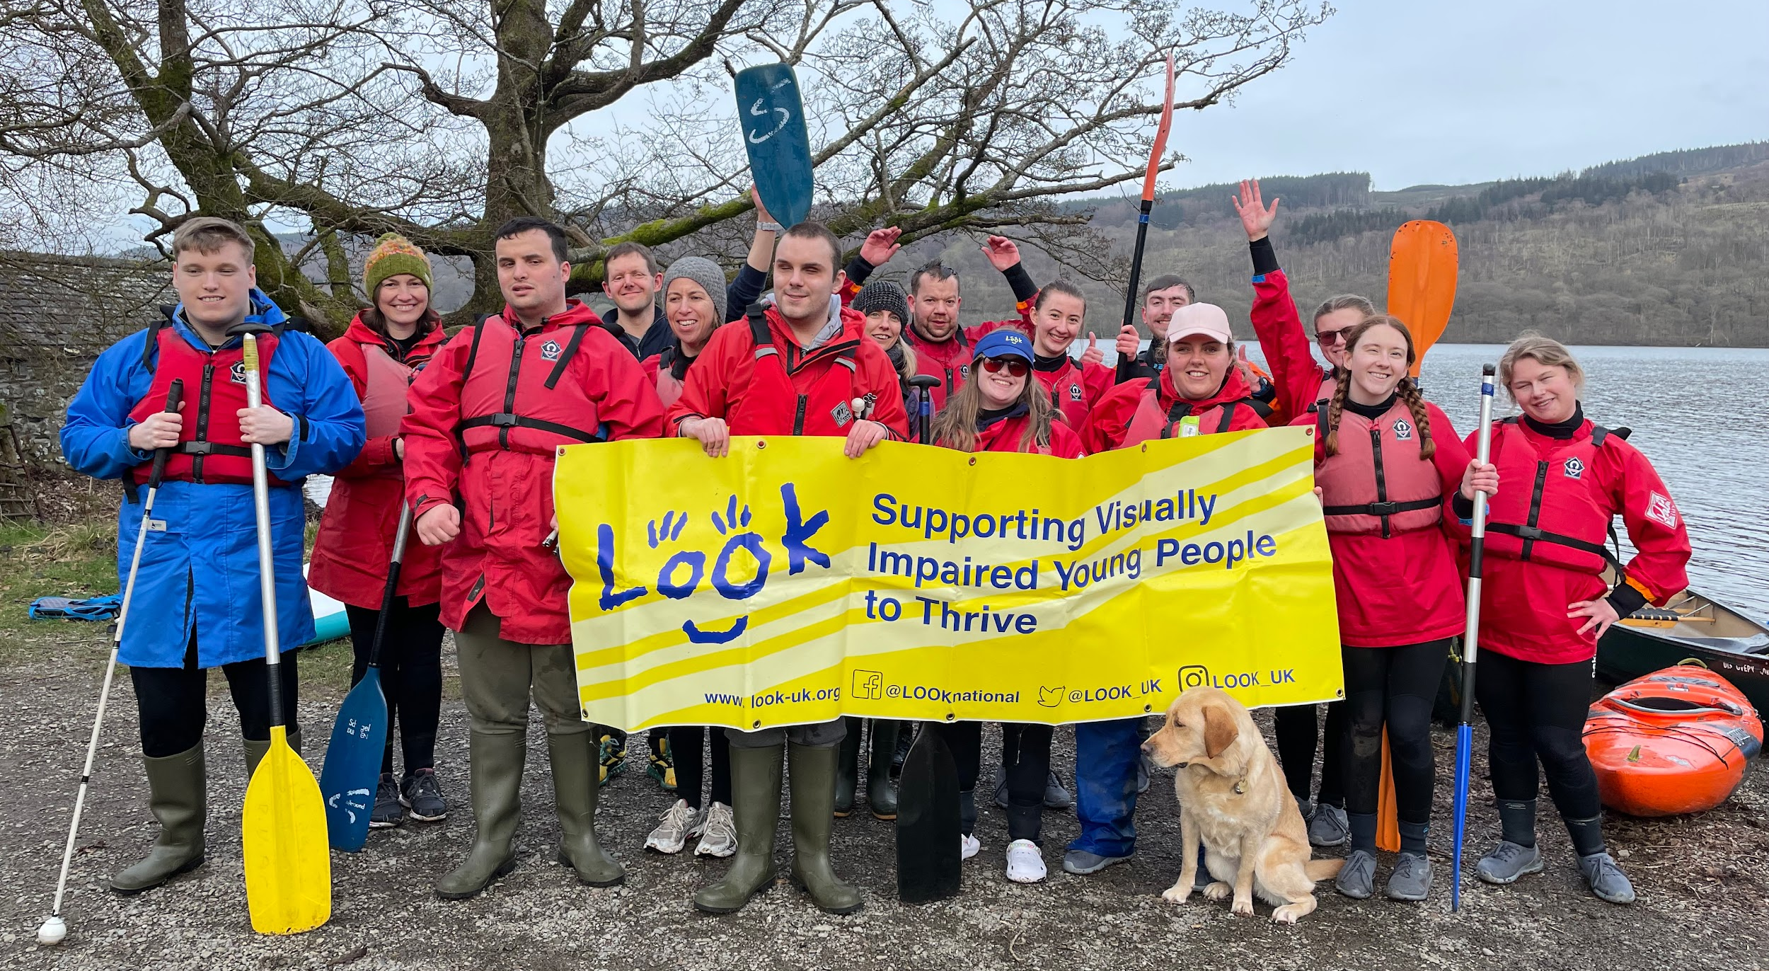

Supporting visually impaired young people to thrive
Shaping a Brighter Future
for Visually Impaired Young People and their families

Slide 2

Supporting visually impaired young people to thrive
Welcome to LOOK
We are a small, national charity established to empower visually impaired children and young people to thrive in a world where they are valued, included and equipped for success; and to connect their families with knowledge and support.
Our mission is to beat isolation and empower young people and their parent carers to speak up for their rights, to build their confidence and help them feel connected.
We provide:
Mentoring
School/Community Workshops
Transformational Events
Parent/Carer Support Groups

Slide 3
Our History
Supporting visually impaired young people to thrive
1991
2015
2016
NOW
Founded by Jennifer & Gareth Bowen
First UK parent support group network formed
New director Charlotte Carson
Developed mentoring programme
500+
mentoring partnerships
supported
Notes:
Megan

Slide 4
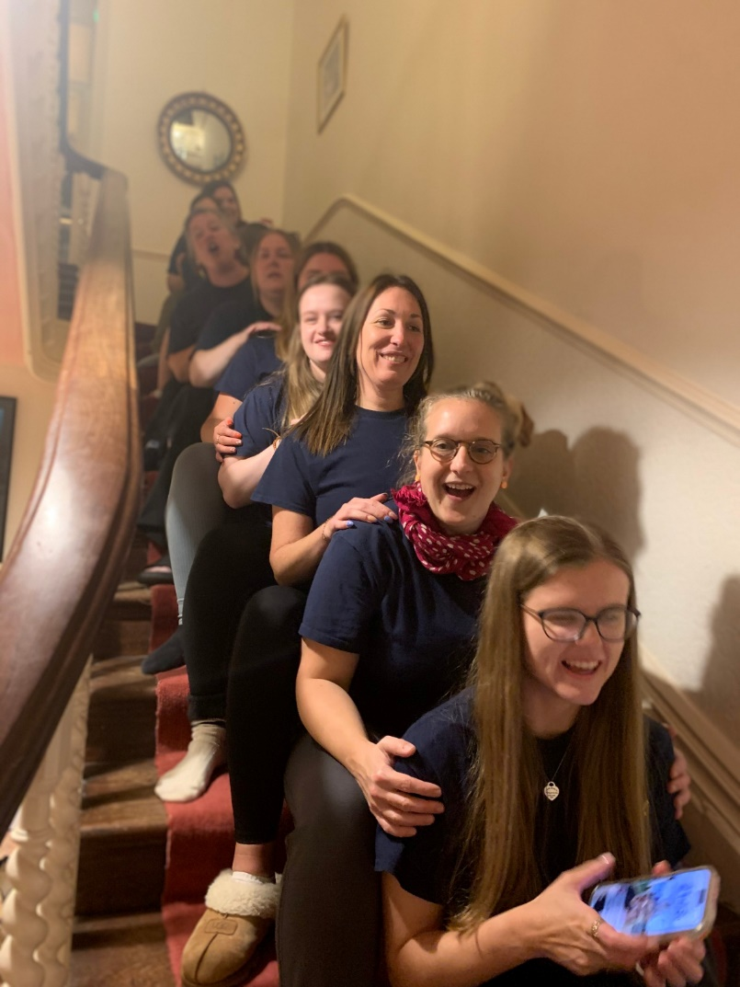
Who Is LOOK Today?
Supporting visually impaired young people to thrive
At LOOK, we’re not just a charity. We’re
a community, and people say
we’re a lifeline.
We work to ensure young people and their parent/carers are getting the support they need, whether that be at home, with friends, in education, or at work.
We have 16 members of staff - 80% of our staff are visually impaired (VI) or a parent of a child with a VI.
We are a charity built on lived experience.

Slide 5
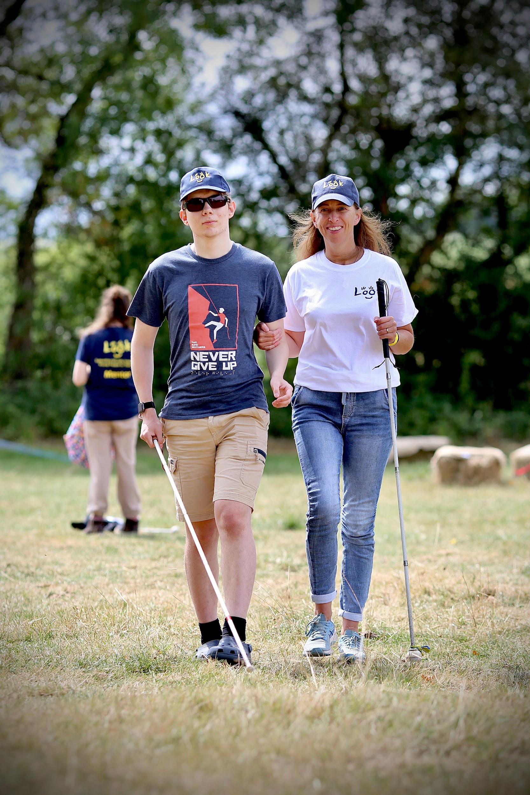
The Need
Supporting visually impaired young people to thrive
Visual impairment is a low incidence, high need disability
Children with a visual impairment are often the only visually impaired person in their family, school and/or community
Emotions around receiving a sight loss diagnosis
Low confidence and self-esteem
Practical guidance for independence and access
“I saw that the problems of isolation and lack of confidence had not really changed since I was a child. People still felt isolated, hopeless and lost. I saw a real lack of VI role models, and I sought to change that.” - Charlotte Carson, LOOK CEO

Slide 6
Who Is LOOK Mentoring For?
Supporting visually impaired young people to thrive
A Mentee is:
Someone with a visual impairment
Aged 11 - 29 years
Seeking support, advice and guidance through goal-focussed mentoring
A Mentor is:
Someone with a visual impairment
Aged 18 - 35 years
Committed to providing support to a younger peer based from their own lived experience

Slide 7
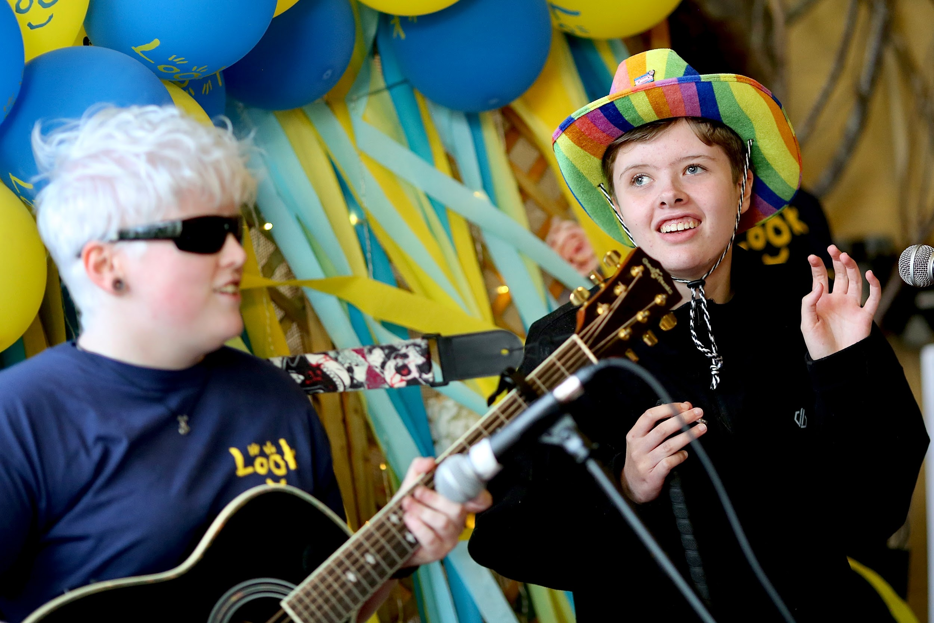
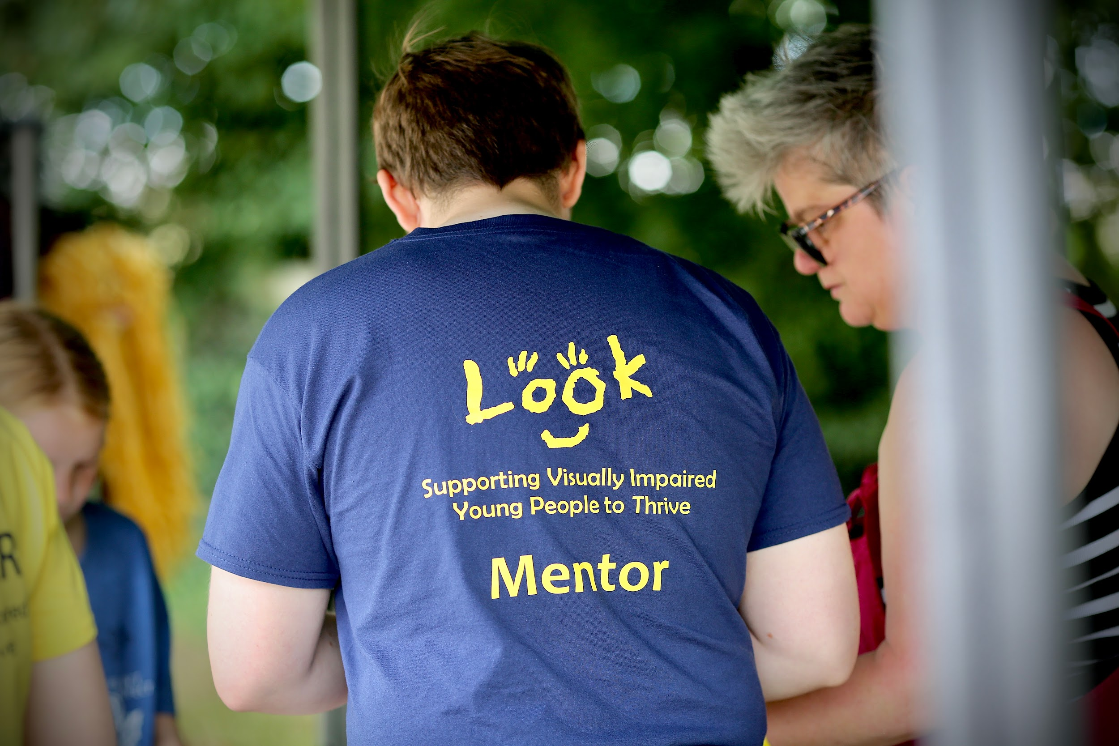
How LOOK Mentoring Works
Supporting visually impaired young people to thrive
Peer support from someone with lived experience of VI
Secure online messaging platform
One-to-one and group Zooms
Up to 12 month partnership
Supported by the LOOK team
Matching process
FREE
Mentees often talk about:
Independent living
Friendships
Access to school
Mobility
VI sports
Access to hobbies
Notes:
Charlotte

Slide 8
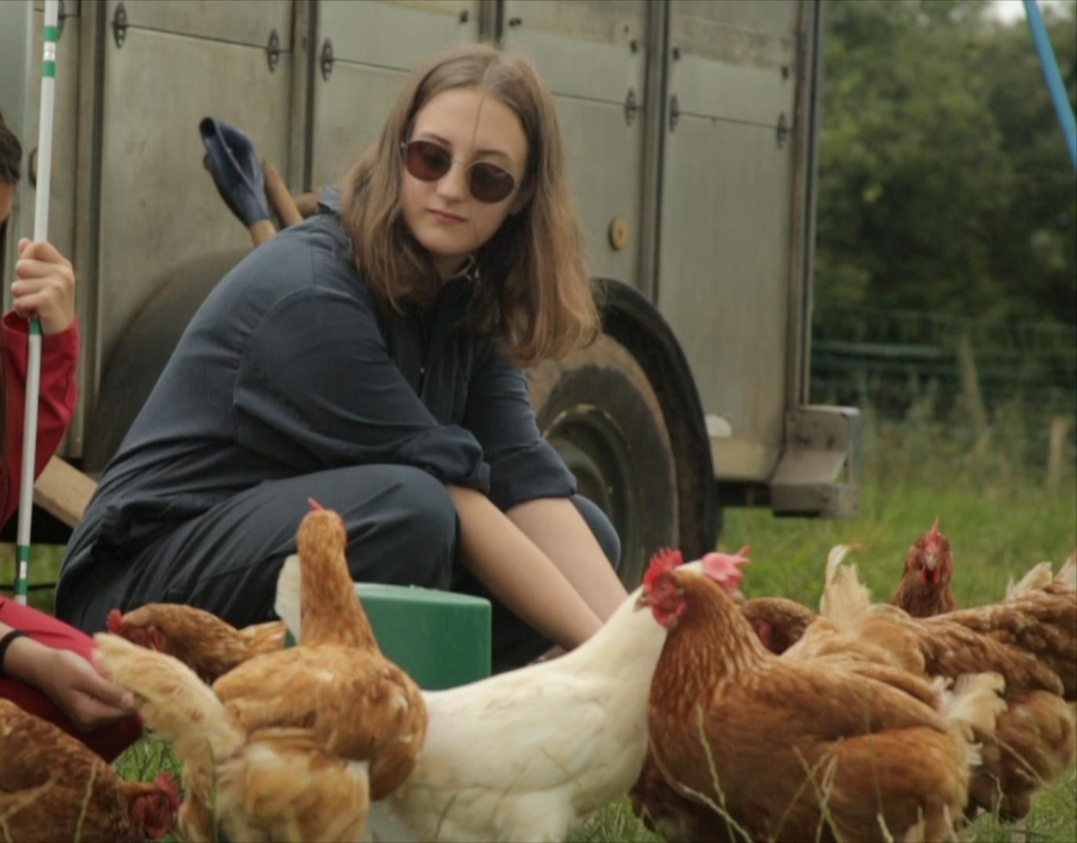
Supporting visually impaired young people to thrive
Real Stories
Faye, aged 19, was diagnosed with Stargardt disease, a progressive sight loss condition, when she was 16 years old. The LOOK peer mentoring programme helped Faye cope with this incredibly difficult time, providing her with the emotional and practical support she needed, from a mentor who had been through a similar experience and had shared interests.
LOOK didn’t just help me with practical support—they gave me the encouragement and reassurance I needed. I now feel excited about the next chapter of my life, and I’ve even trained to become a mentor myself, so I can give back to someone younger than me.

Slide 9
The Impact
95% say mentoring for LOOK has
increased their skills and
employability
Supporting visually impaired young people to thrive
95%
We have a 200 strong team of
visually impaired mentors
UK wide and support over 5,000
beneficiaries each year
100% of Mentors when asked, say
they would recommend becoming a
LOOK Mentor to other visually
impaired people
93% of Mentors surveyed say
mentoring has increased their
confidence
100%
93%
93%
93% of LOOK Mentors say they feel
connected to the mentoring
community
We reached 451 parents through parent support groups
We ran 109 activities, workshops and Q&A
events for VI young people and their
families, reaching 1,500 people.
100% of attendees report that our
Healthy Parent Carer course has
significantly improved their emotional
well-being.
100%
.

Slide 10
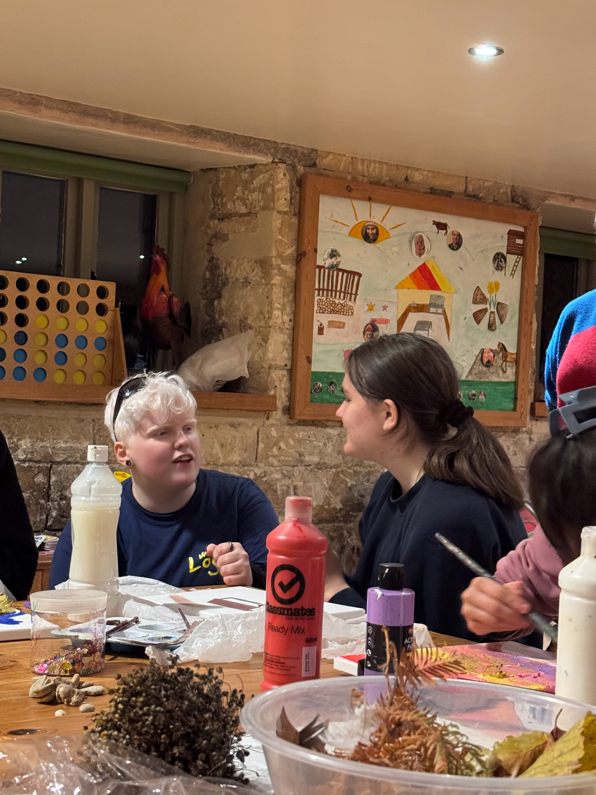
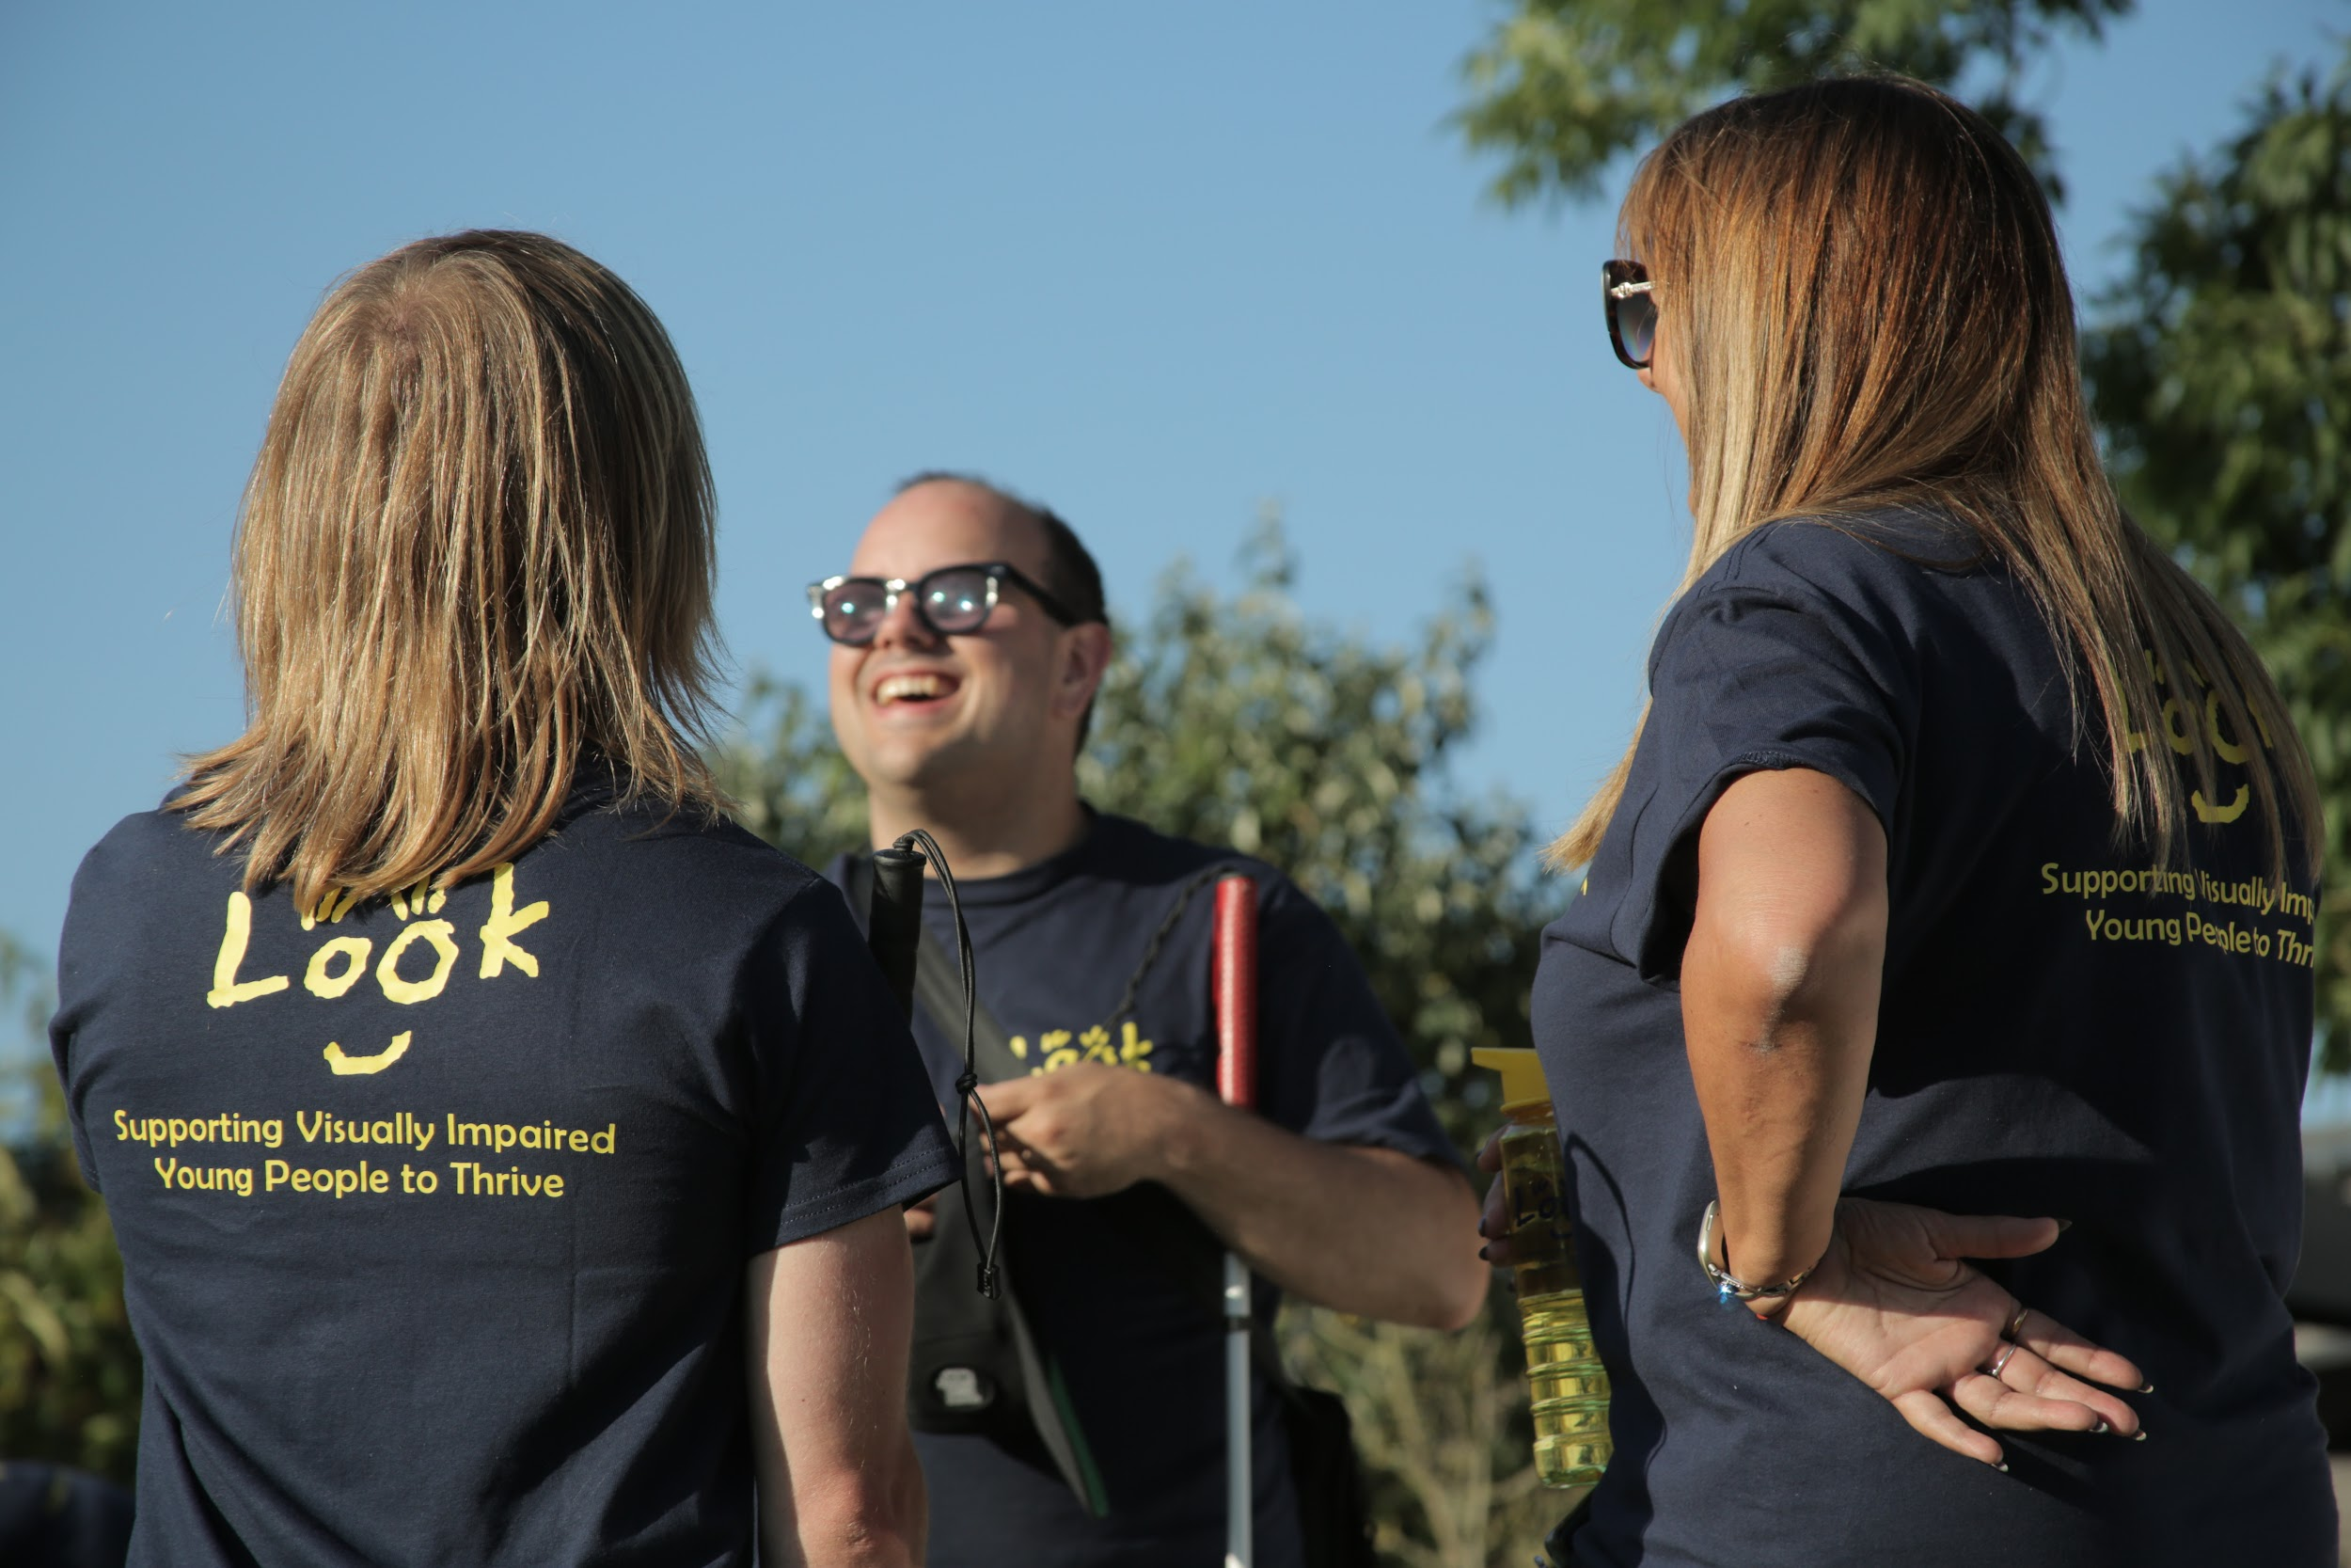
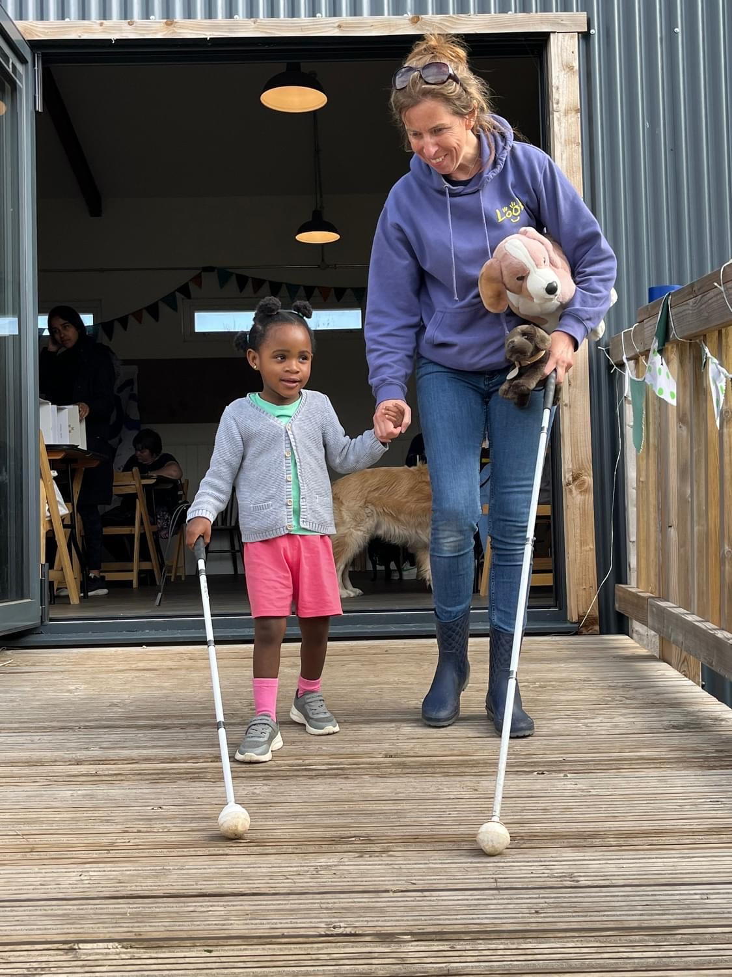
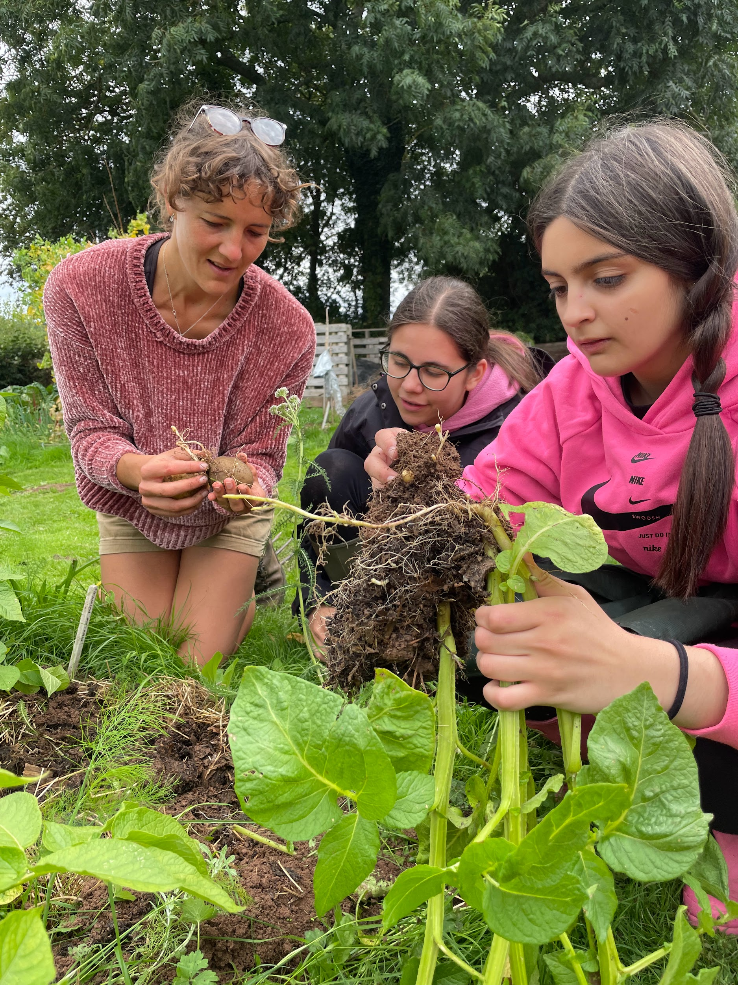
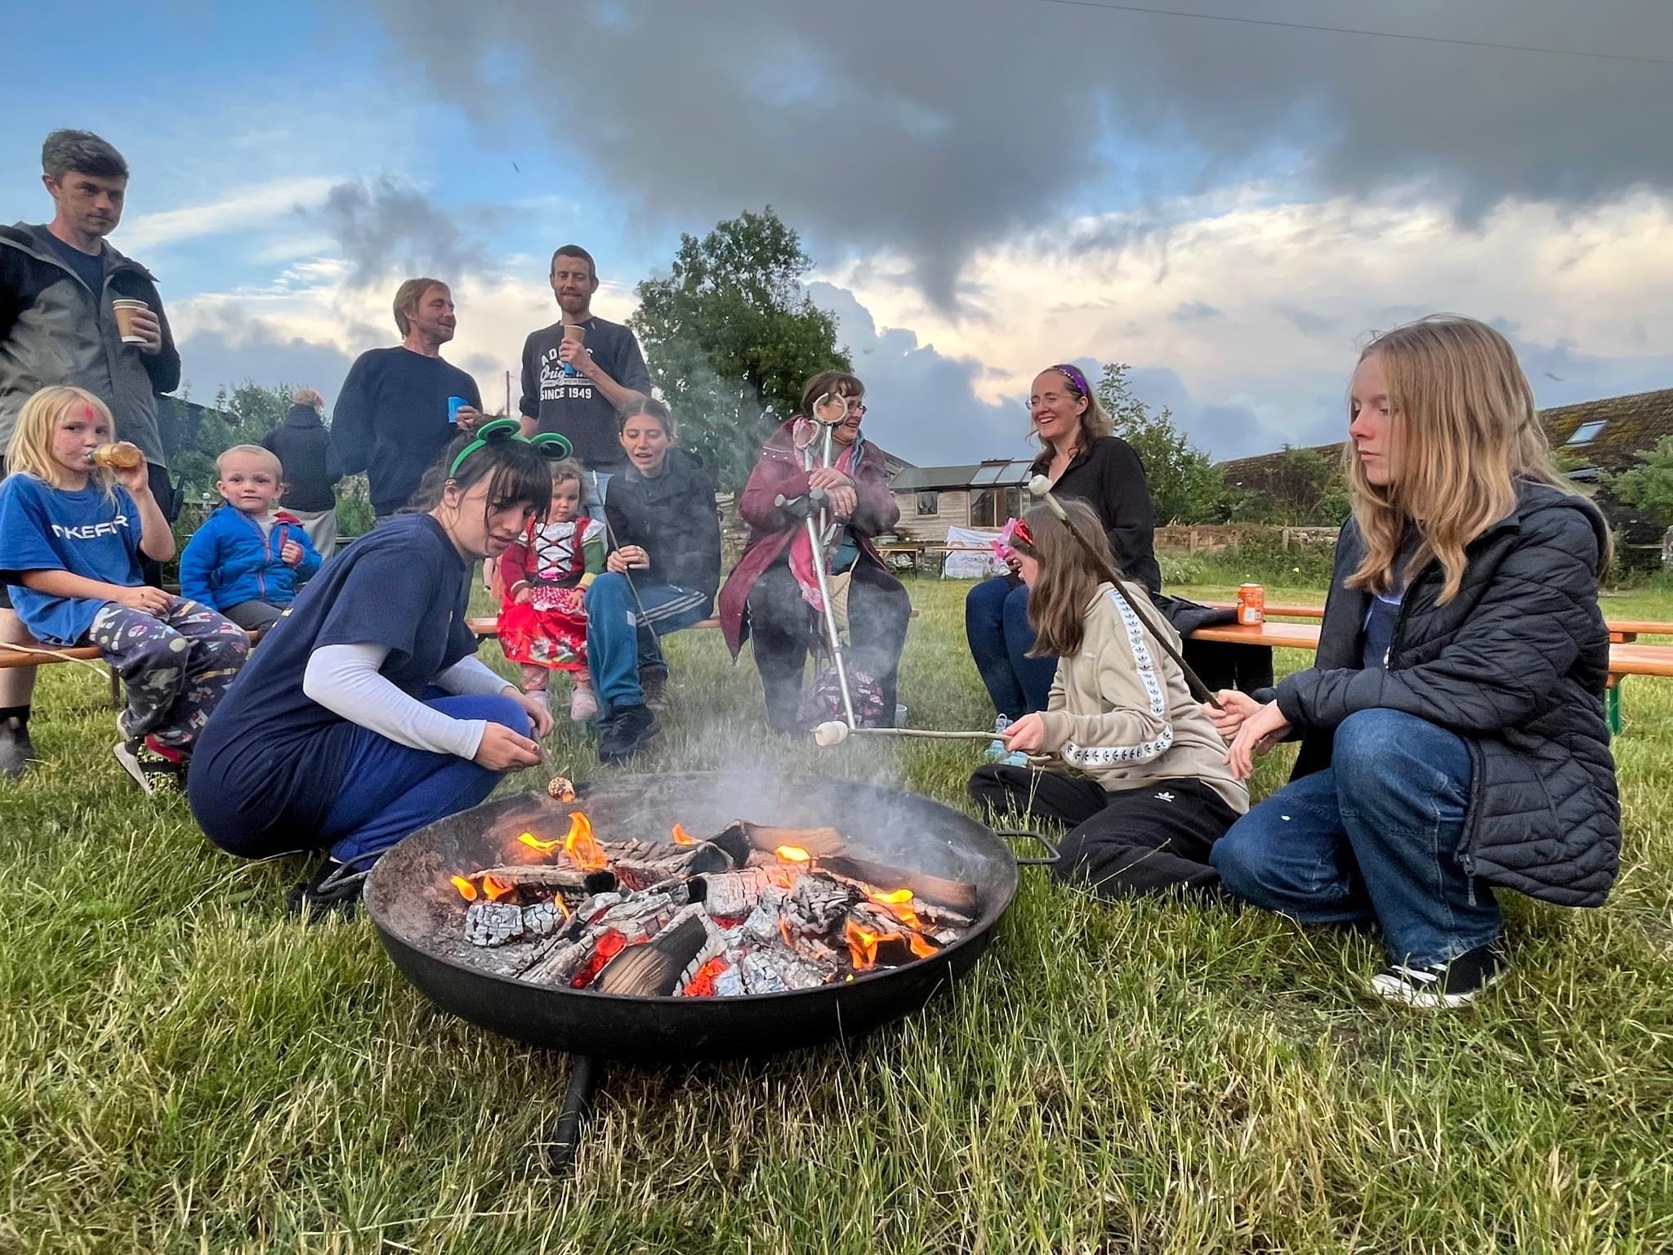
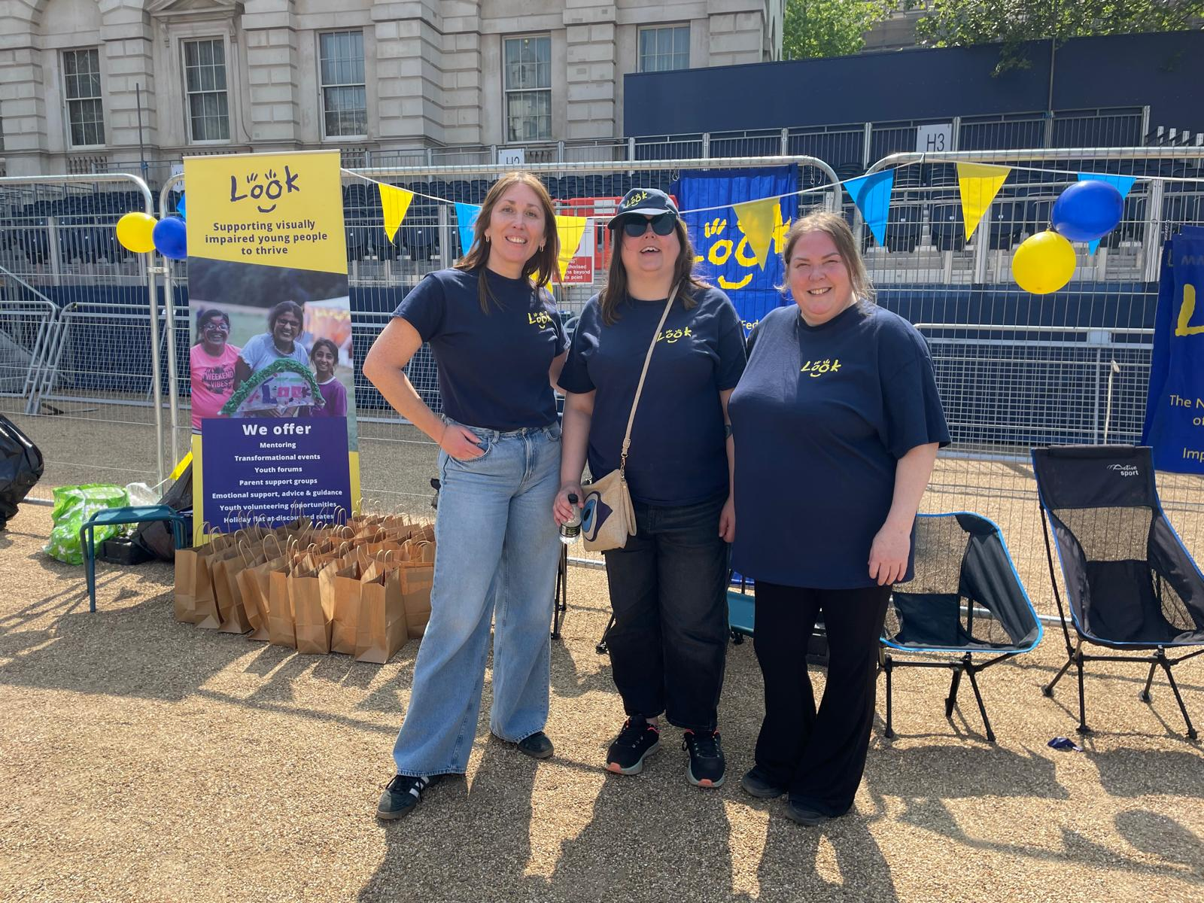
What else does LOOK offer?
Supporting visually impaired young people to thrive
Socials for Mentors
Parent Support Group
Healthy Parent Carer Course
Transformational Events - LOOKFest, Jamie’s Farm
School Workshops/Training

Slide 11
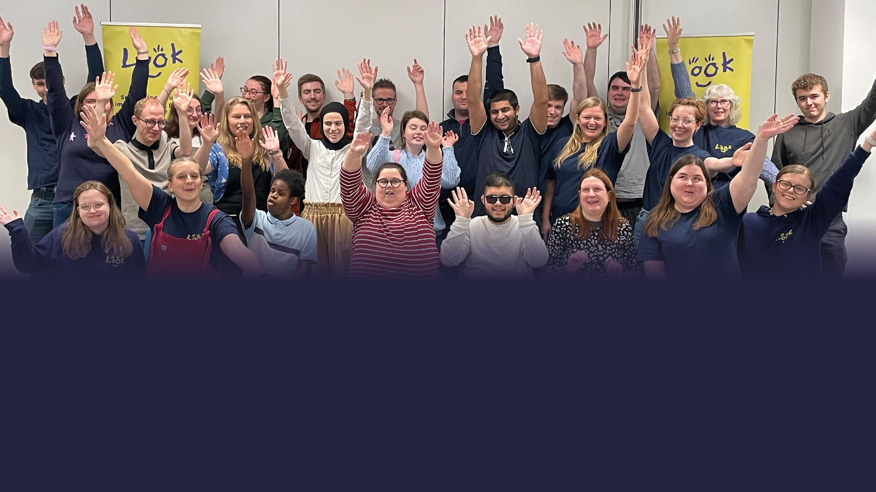

The Fred Bulmer Centre, Wall Street, Hereford, HR4 9HP
07464 351958
info@look-uk.org
Follow us:
Sign up to our newsletter at:
www.look-uk.org
Registered Charity in England and Wales 1140471 Registered Company in England and Wales 7406571

