Slide 1


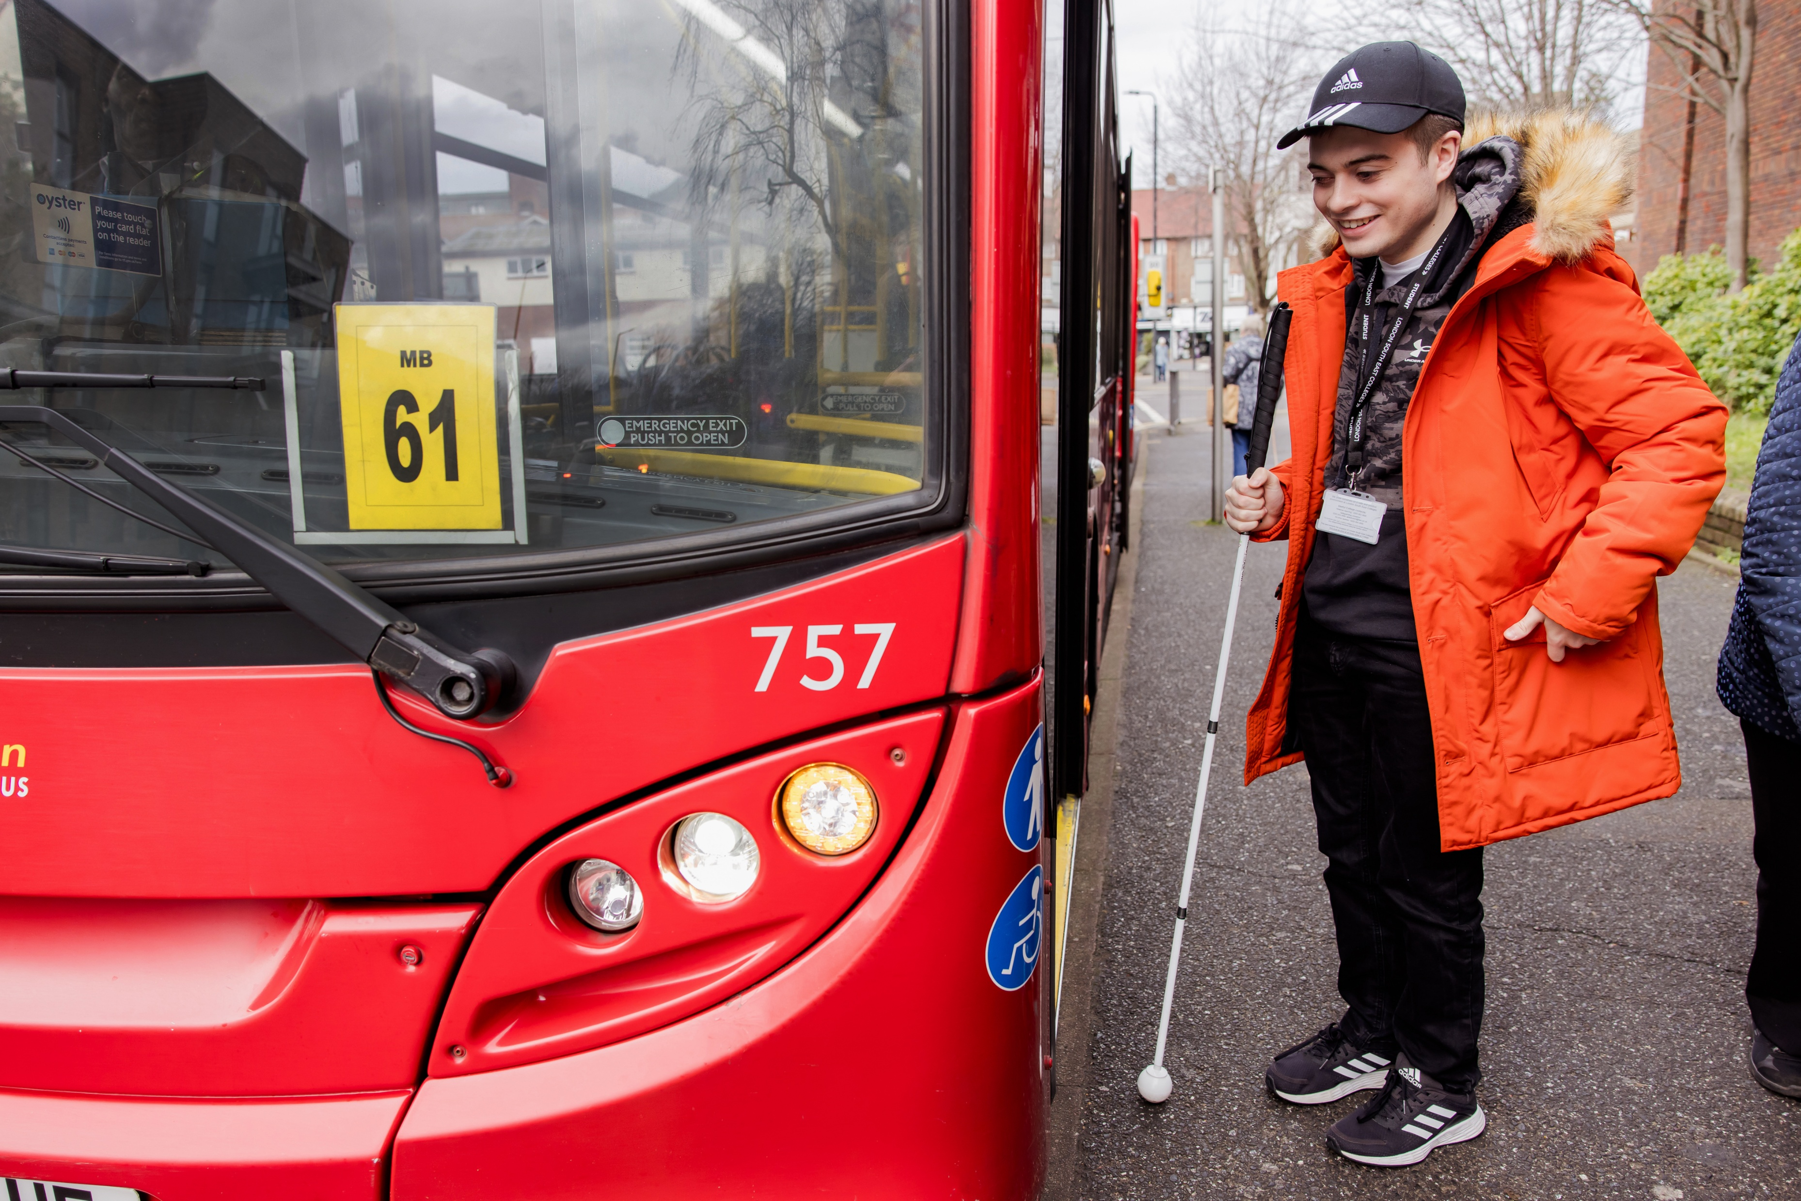
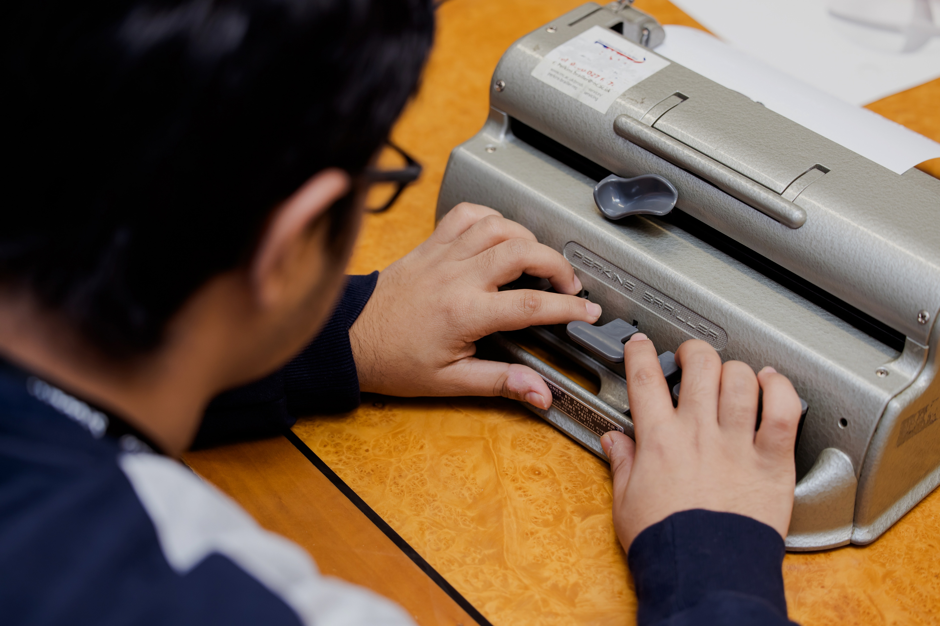
Inclusive education
Equity of opportunity

Slide 2


Expansion
Dorton College of Further Education
Providing the best in further education
for vision impaired young people through our hybrid model
NEW: VI Centres of Excellence
RSBC Dorton
College of Further Education
Established college
Based in Bromley southeast London
Seamless hybrid combination of VI specialist education with mainstream access
The perfect balance of education inclusion
NEW: EXPANSION
Phase 1
Surrey VI Centre of Excellence
Hosted by Nescot, based in Epsom
Specialist support
on site
in education settings
Wider production of specialist VI learning resources and materials
Training education professionals – wider awareness

Slide 3

Dorton College of Further Education
More than tripled student numbers in recent years
Hybrid Model
3 days at mainstream as a Dorton student with Dorton LSA.
2 days at VI hub doing VI specialist learning
All work resourced so student has access to learning
Robust Service Level Agreement in place
Our research shows students prefer this inclusive education approach to any other type of provision
20 years working as a hybrid college
Partnerships with GFE’s, Sixth Forms and Vocational providers
Partnerships
Bracknell and Wokingham College
Farnham Sixth Form College
Hertford Regional College
Croydon College
Nescot College
LSEC Orpington
LSEC Bromley
Extensive range of mainstream courses
40,000 hours of VI inclusive education 2025-26
Inclusive Education for VI students

Slide 4

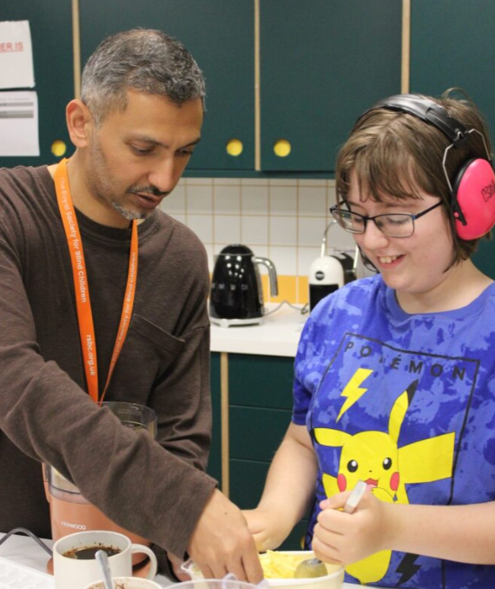
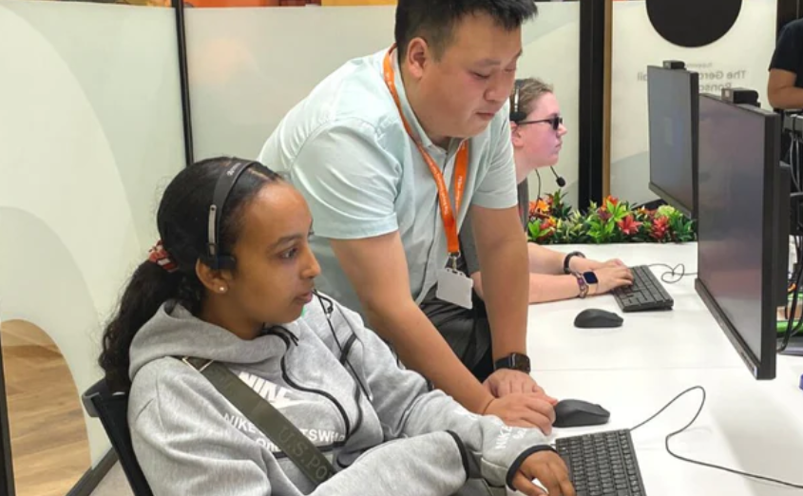
Services - Support, information, skills, social, fun and advocacy
Futures:
1 in 4 VI people are unemployed
VI young people leaving school without the right skills
We start where the young person is at
Work, internships, apprenticeships, FE, HE, volunteering, community
Practical support
Independent Living Skills
Activity Programme:
Social and peer
Skills based
Sports and fitness
Fun
Creative and musical
Early years
Residentials
Outdoor activities
Challenges
Family Fun Days
Cultural
Family Support:
A unique offer of support
No alternative statutory specialist provision
Holistic family support
Regionally based
Emotional Well Being
Practical & Financial
Habilitation Support
Online groups
Early Years
Impact is life changing
Youth Voice:
A manifesto for change
Mental Health, Education & Employment, Technology, Transport
Podcasts
Advocacy
Social Media channel
Training programme
Explore Phase II settings in parallel
Investigate Governance structure options
Making Activities Inclusive:
Free training
Mainstream youth organisations
Promoting accessibility and inclusivity
Video and live training
Bespoke options
RSBC kitemark
Assistive Technology – vital for VI children and young people

Slide 5
Weekly 1-1 Habilitation
Weekly 1-1 QTVI
Mainstream Course access Entry 1 – Level 3
Explore Phase II settings in parallel
Weekly 1-1 Braille Sessions
Assistive Technology
Weekly 1-1 Speech and Language Therapy
Unlimited post-16 course choice access
Weekly Occupational Therapy
Resourcing
Facilitates mainstream inclusion
Specialist skillset
Essential to equity of access
Investigate Governance structure options
Accredited Independent Living Skills
Futures – VI specialist Employability
VI Counselling
VI Specialist PSHE

Slide 6
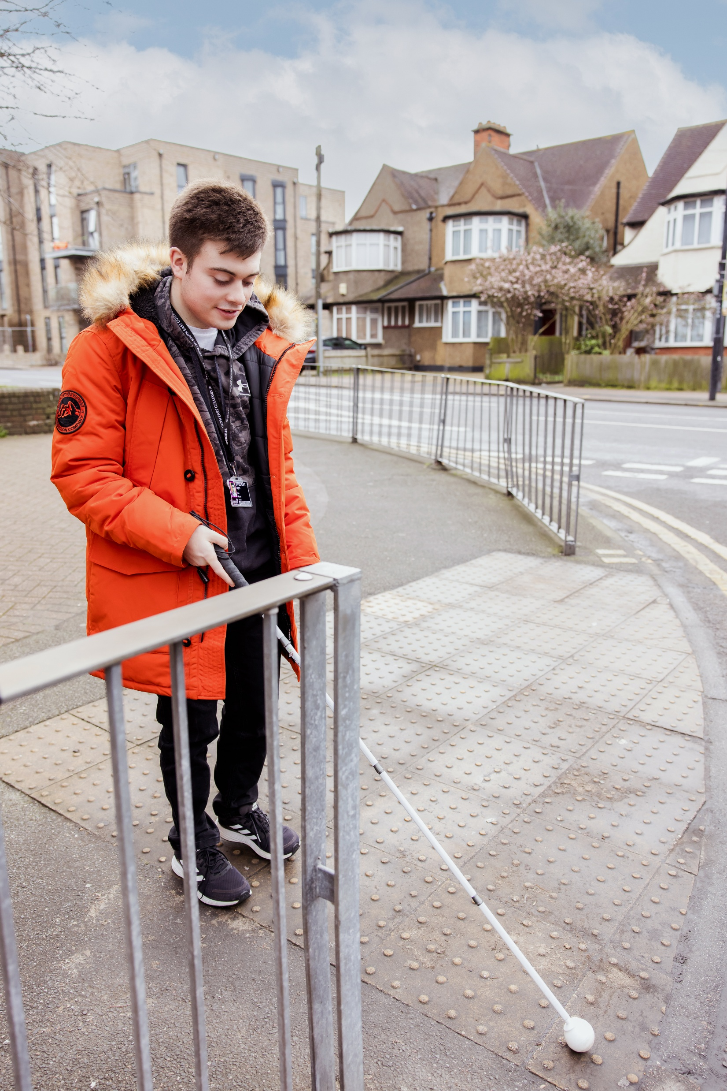
The VI Education Alliance
How it’s going!
How it started…
Visits to a range of VI education providers nationally
Meetings very well attended from a range of education providers and VI stakeholders
Development of a nationally recognised LSA/TA VI specialist accredited qualification
Similar issues nationally
Ensure VI pupils and students get the right support, in the right place and the right time
Sharing of ideas, resources and good practice in a stretched sector

Slide 7
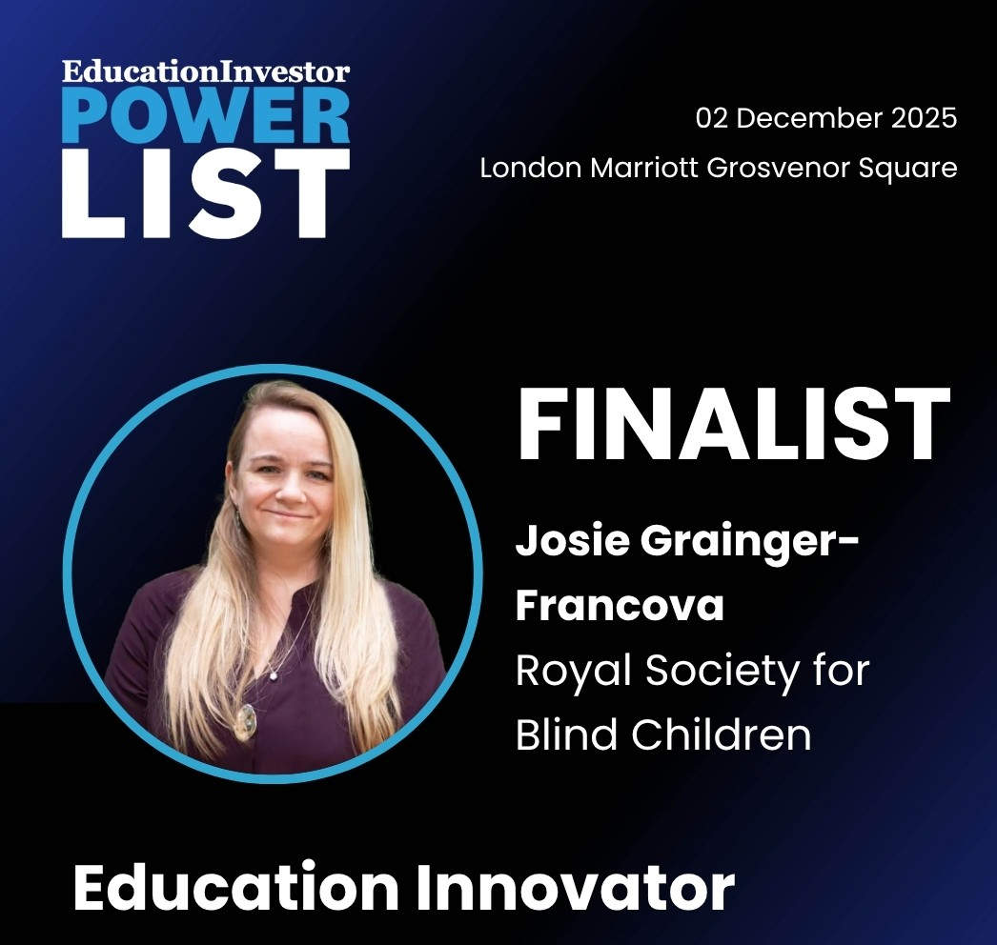
Initial set up funding need
National presence where it is needed most
NATIONAL AMBITION
For VI Centres of Excellence
where needed
Agile model of delivery
Equity of access and inclusion for ALL VI CYP
Meets regional needs
Cost effective models
High Educational Return on Investment
Seed staff set up - QTVI and Habilitation
Complementary partnerships with other regional VI specialists and services

