Slide 1

Fight for Sight Presents
Breaking down barriers to loneliness and isolation with green walks
#FightforSightPresents

Slide 2
Welcome and housekeeping
Live captions are available during the webinar.
We may use illustrated slides to guide us, but we will read out everything on these.
Slides, a transcript and a recording, will be made available post-webinar.
Please use the Q&A window to ask questions.
The chat is disabled because it can be distracting for those using a screen reader, and because it is simpler for us to monitor one single channel.
When we end the webinar, it will end abruptly.

Slide 3
What to expect in this webinar
01 | Welcome from Kerry Firth, Grants Manager with an intro to our organisation
02 | Introduction to MyVision Oxfordshire’s Green Walks programme
03 | Live discussion with Mark Upton and Tanya Braun, Living Streets
04 | Thank you for joining us

Slide 4
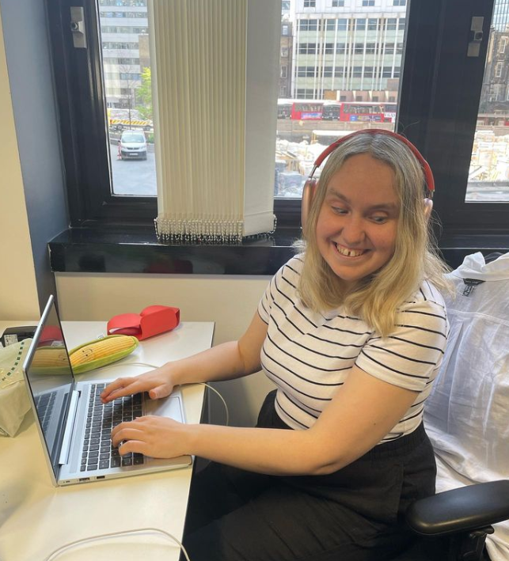
Meet your host, Kerry Firth
Kerry is passionate about bringing her own personal and professional experiences of living with sight loss to the role of grants manager. Having completed a PhD in music and managed a freelance operatic career, she feels at home when evaluating projects, building exciting relationships, and being involved in initiatives that directly address barriers faced by vision impaired communities.

Slide 5

About Fight for Sight
We fund the brilliant minds and bright ideas that put change in sight.
Notes:
Explain that we are a funder

Slide 6
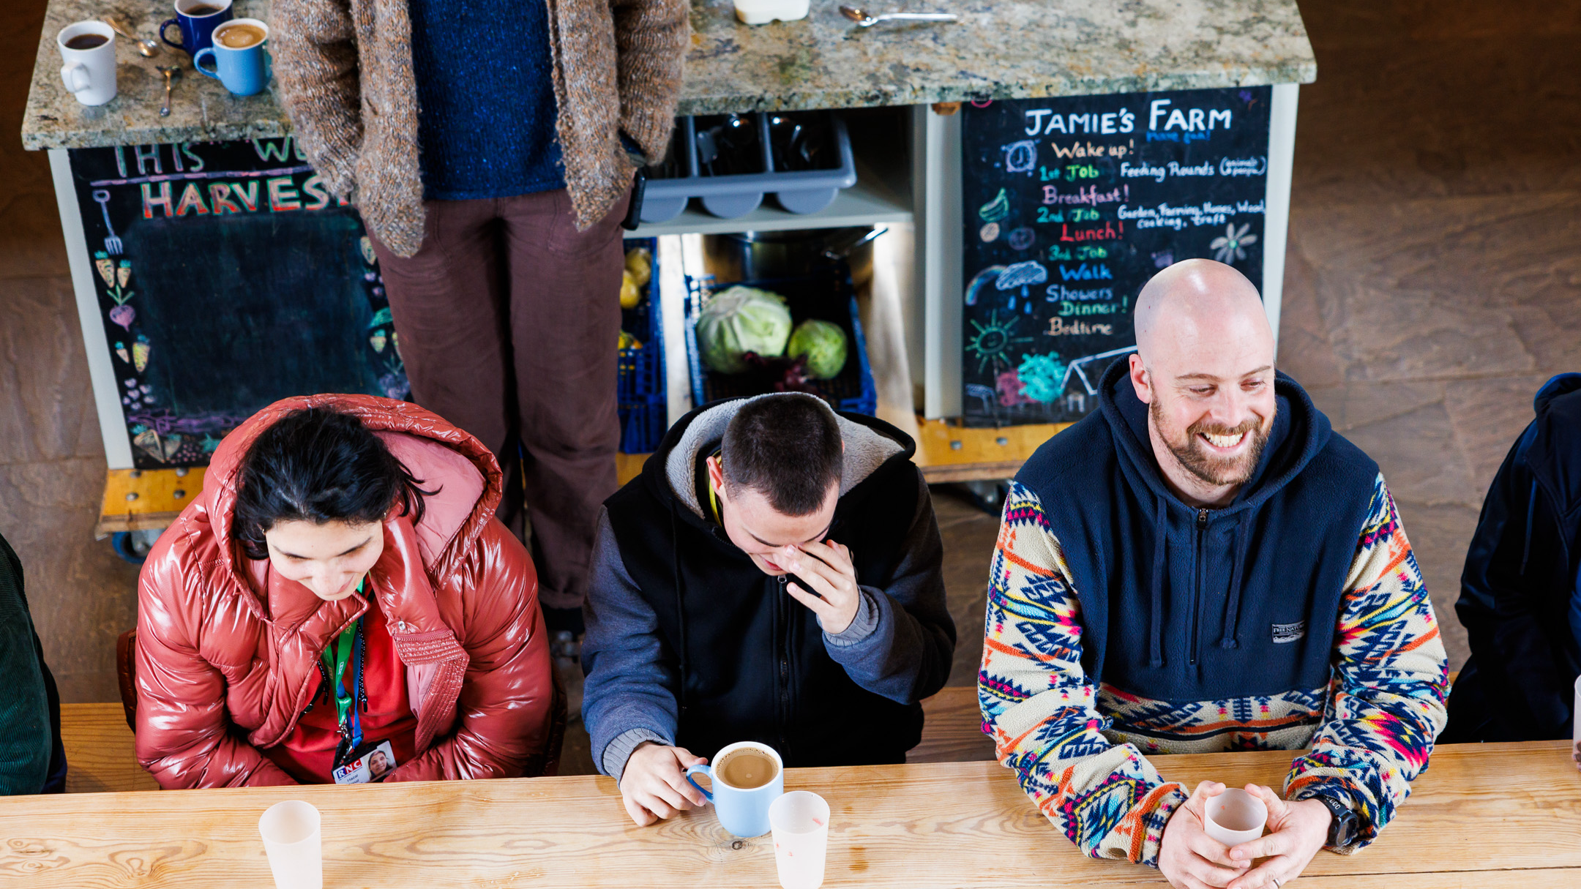
Outside: Blind and vision impaired people’s experiences of loneliness and isolation
1 in 3 people have experienced loneliness and isolation

Slide 7
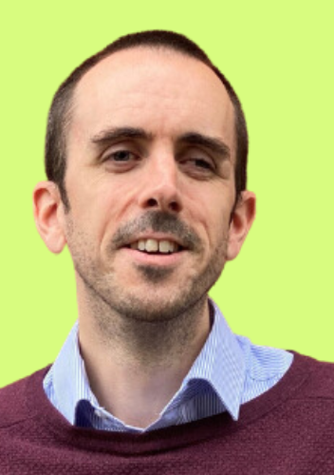
Mark Upton has been MyVision Oxfordshire's Chief Executive since 2021. Mark has been visually impaired since birth and is passionate about inclusion, accessibility and promoting lived experience within the sight loss sector.
Mark is also Chair of Visionary UK.
Mark Upton

Slide 8
“With time the walks organised by the group members have increased in length, up to a five mile walk in some cases. And this shows how, alongside physical fitness, people’s confidence has grown.“
Mark Upton

Slide 9
Live discussion with Mark and Tanya from Living Streets
What are the benefits of walking, why is it so important for organisations such as Living Streets to protect walking in cities, as well as other organisations which do the same for rural areas?
This programme was born out of the Natural England report which identified the value of access to green and blue spaces, but that certain groups still face significant barriers when it comes to experiencing and enjoying natural spaces. What are the barriers to walking in cities?
Mark, what has surprised you most about these walks, and what is your favourite learning from the programme so far?

Slide 10
Further Information
More on MyVision Oxfordshire’s Green Walks programme
Discover more about our social change funding
Find out more about the projects we fund
Find out more about the research which guided the funding: Outside: blind and vision impaired people’s experiences of loneliness and isolation
Check out what’s next on the Fight for Sight Presents programme
Find out more about Living Streets
Sign up for Fight for Sight’s regular e-newsletter
Please donate and help us fund more lifechanging projects

Slide 11
Fight for Sight Presents
Predicting and diagnosing sight loss in children with Dr Ameenat Lola Solebo
Wednesday 22 January 2025, 12-1pm
Register here
Dr Ameenat Lola Solebo is a Consultant in Paediatric Ophthalmology and works at the world-famous Great Ormond Street Hospital for Children. She is a former TEDx speaker, a talk that showcases her passion for tackling rare diseases in children that can lead to blindness.
We're excited to introduce her as part of Fight for Sight presents. Dr Solebo will speak about her work in preventing childhood glaucoma -she has received a Small Grant from us to help fund this, as well as her new Project Grant on childhood uveitis. Dr Solebo will be joined by Lizzie Maxwell, who’s vision loss is the result of complications arising from a childhood condition, which led to cataracts that robbed her of her sight. She spent long spells in Great Ormond Street Hospital (GOSH) as a child.
Sign up to this webinar here.

Slide 12
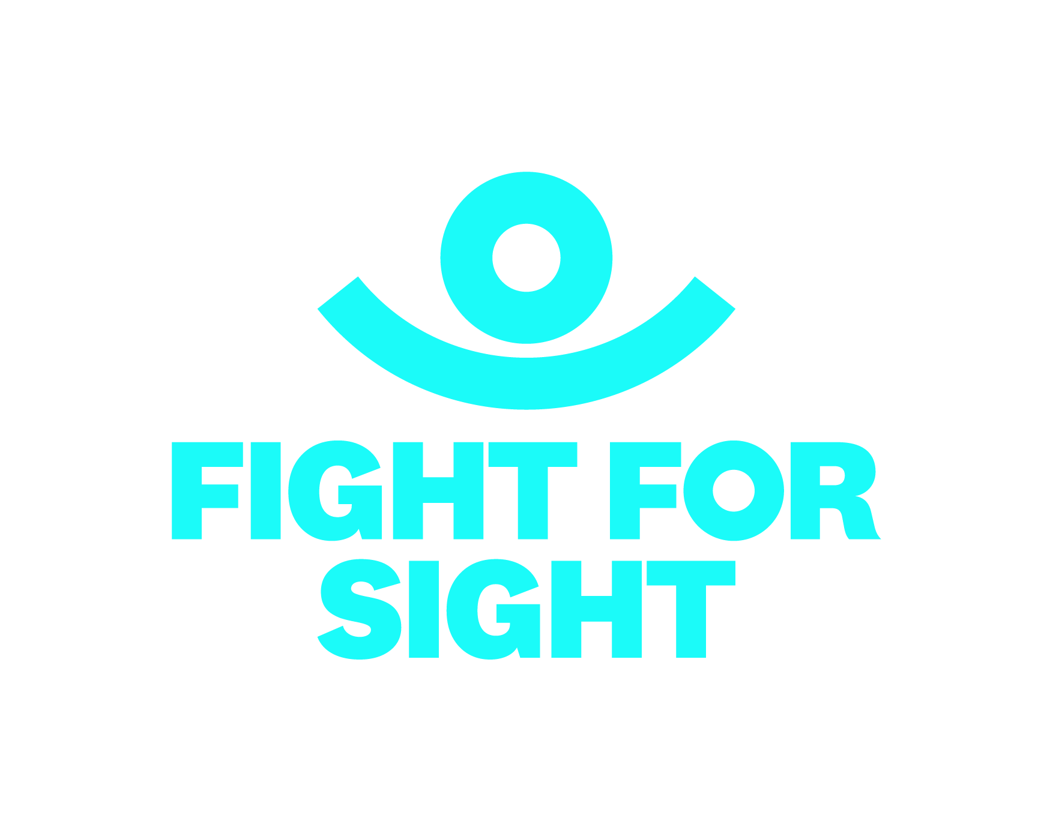
Thank you
www.fightforsight.org.uk
#FightforSightPresents

