Slide 1

Fight For Sight Presents
Tackling the SEND crisis

Slide 2
Welcome and housekeeping
Live captions are available during the webinar.
We may use illustrated slides to guide us, but we will read out everything on these.
Slides, a transcript and a recording, will be made available post-webinar.
Please use the Q&A window to ask questions.
The chat is disabled because it can be distracting for those using a screen reader, and because it is simpler for us to monitor one single channel.

Slide 3
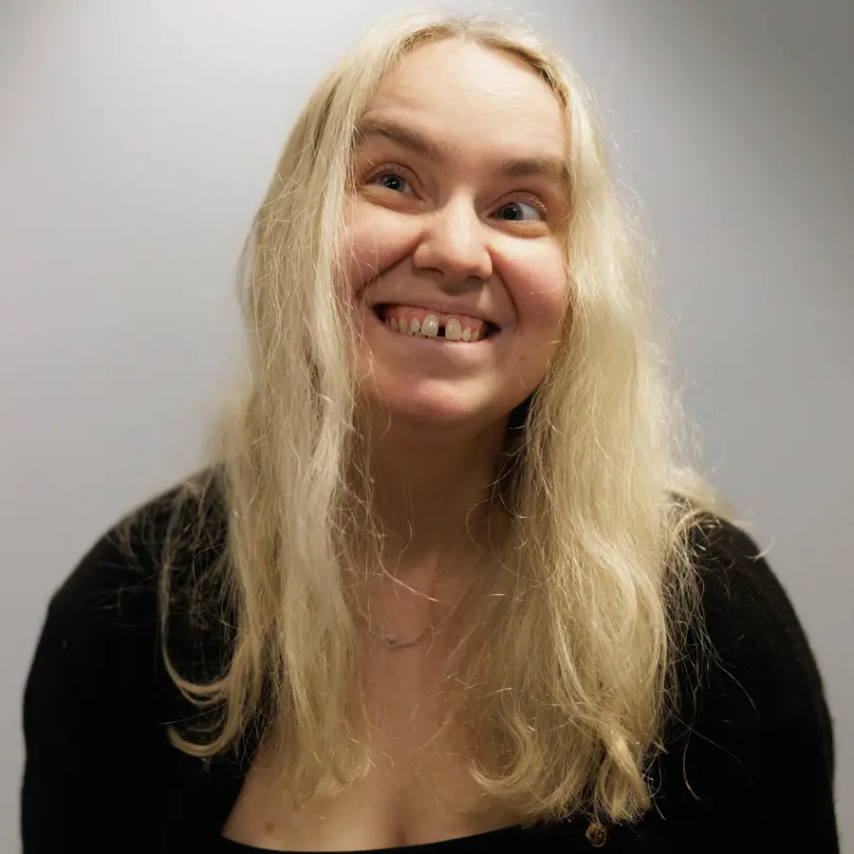
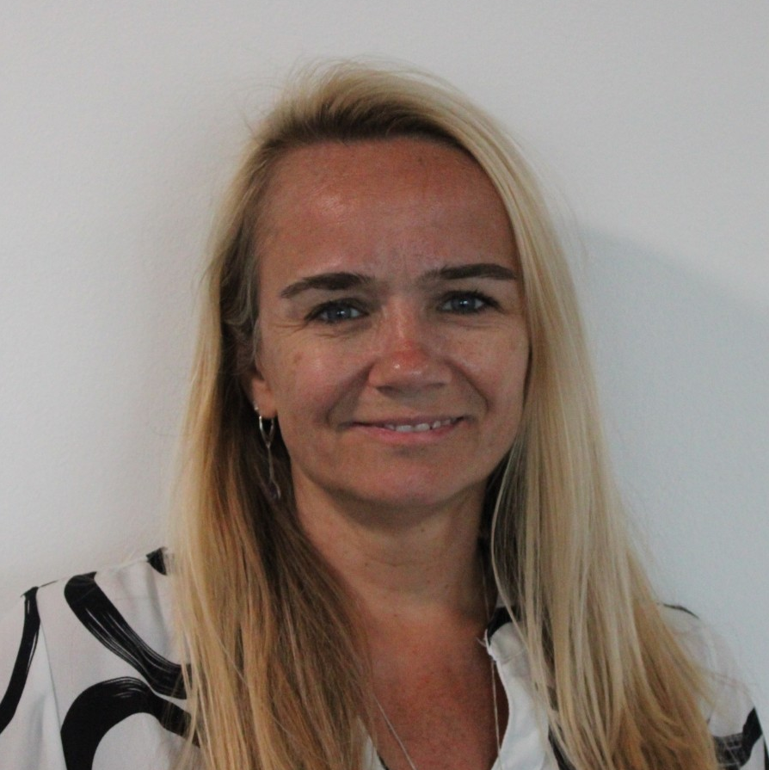
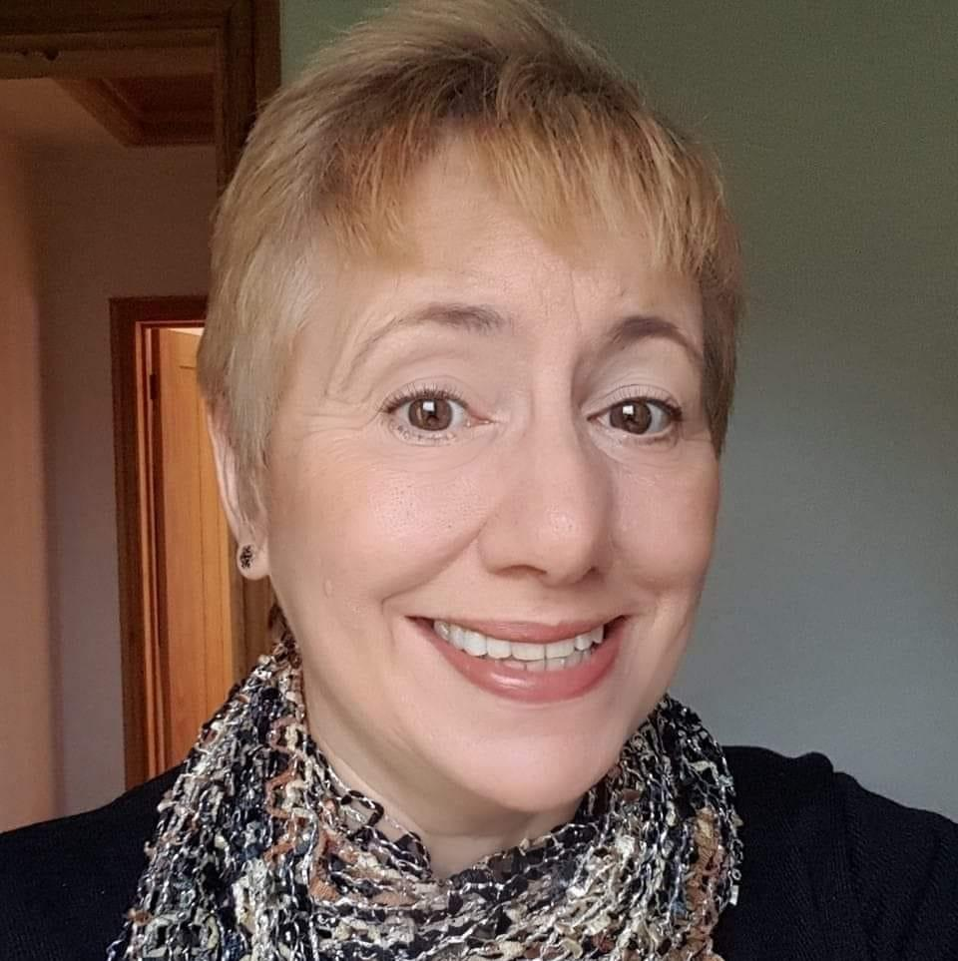
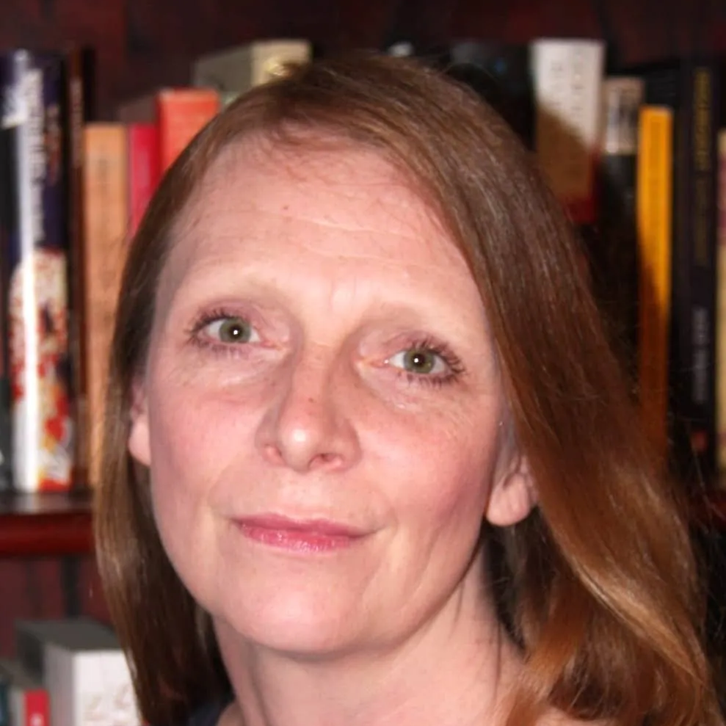
Our panel
Host: Kerry Firth, Grants Manager, Social Change, Fight for Sight
Speaker: Josie Grainger-Francova, Education Director for the Royal Society for Blind Children (RSBC)
Speaker: Laura Hughes, Founder and CEO of MoorVision
Speaker: Gillian Doherty, Co-director of Special Needs Jungle (SNJ)

Slide 4
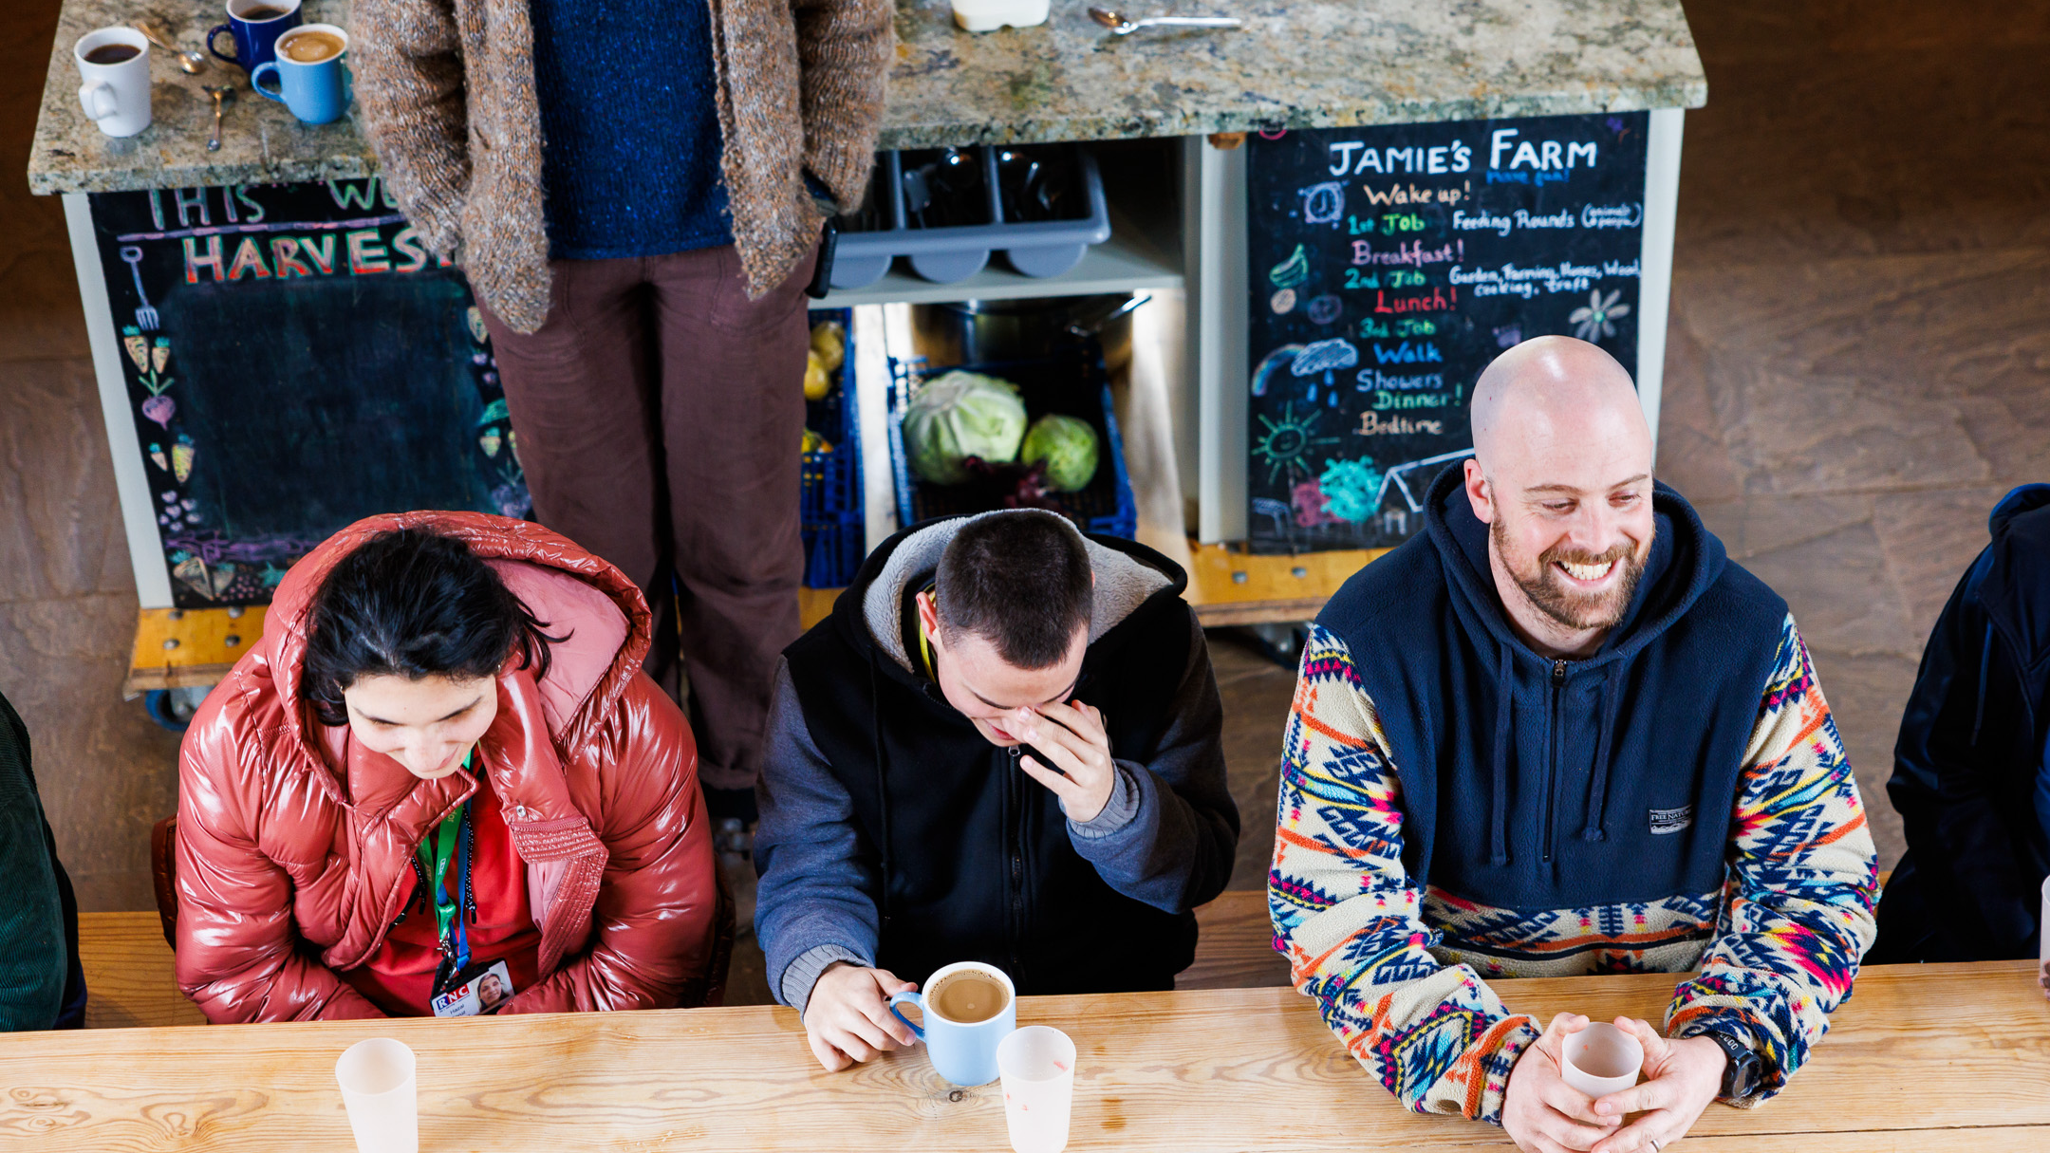

Social change
We fund the brilliant minds and bright ideas that put change in sight.

Slide 5
Panel Discussion

Slide 6

Q & A

Slide 7
Useful resources
Read about MoorVision’s work
Find out more about MoorVision
Find out more about RSBC
Find out more about Special Needs Jungle
Fundraise for us through your steps – Summit for Sight
Discover more about our social change funding
Find out more about the projects we fund
Please donate and help us fund more scientific research

Slide 8
Fight for Sight Presents: Our next webinar
Building mentorship opportunities in vision research
Wednesday 21st January 2026 at 12:00-13:00.
Register here
Good mentorship is essential for building the next generation of vision researchers. Eye research is an underfunded area; in 2018, just over 1.5 percent (£24 million) of the £1.4 billion that UK Research and Innovation, government and other public bodies invested in medical research was for eye research. This lack of funding means it is hard to get the brilliant minds we need into the field. That's why Fight for Sight offers two mentorship opportunities: our UK Vision Research Network Doctoral Training Programme, and our competitive PhD Studentships.
In this webinar we'll be hosting Professor Marcela Votruba from Cardiff University and Dr Monika Winter from Northumbria University, to discuss their perspectives on the importance of mentorship across different research career stages.

Slide 9
Fight for Sight Presents: Our next social change webinar
Mentoring for Social Change with Look UK
Wednesday 25th Feb, 2026 at 12:00-13:00.
Register here
Join us as we learn from Look UK’s successful mentorship programme, their successes and the difference this has made to the lives of young people. We will dive into the value of mentoring, how their programme works and what it takes to set up a mentorship programme.

Slide 10

Thank you
www.fightforsight.org.uk
#FightforSightPresents

