Slide 1
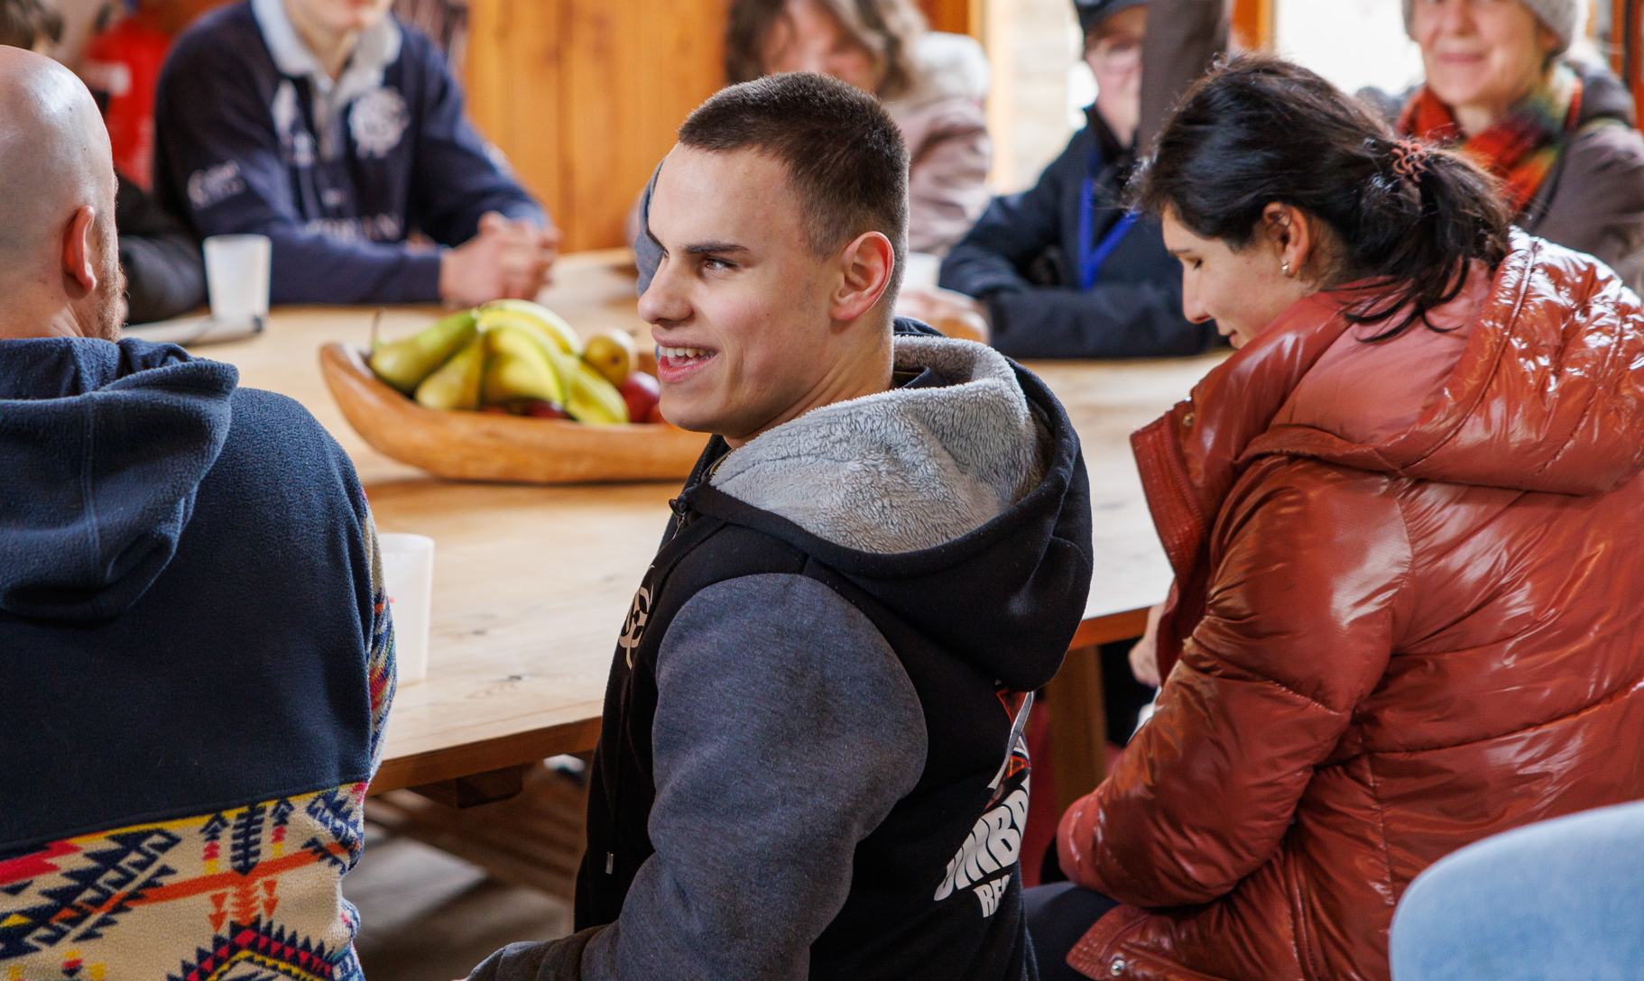
Fight For Sight
Webinar: the future of diagnosing retinoblastoma

Slide 2
A little bit of housekeeping
Live captions are available during the webinar
Slides, a transcript and a recording, will be made available post-webinar
Please use the Q&A window to ask questions
We’ll send you an email including a survey after the webinar

Slide 3
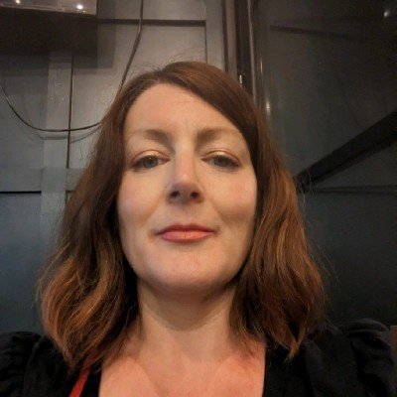
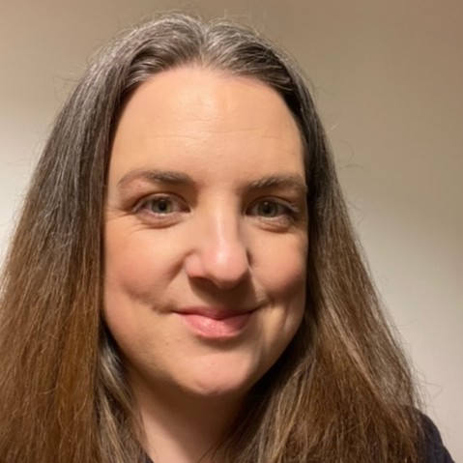
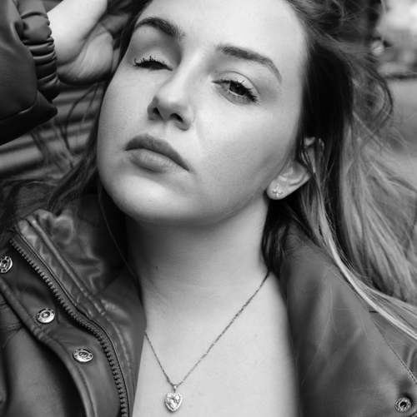
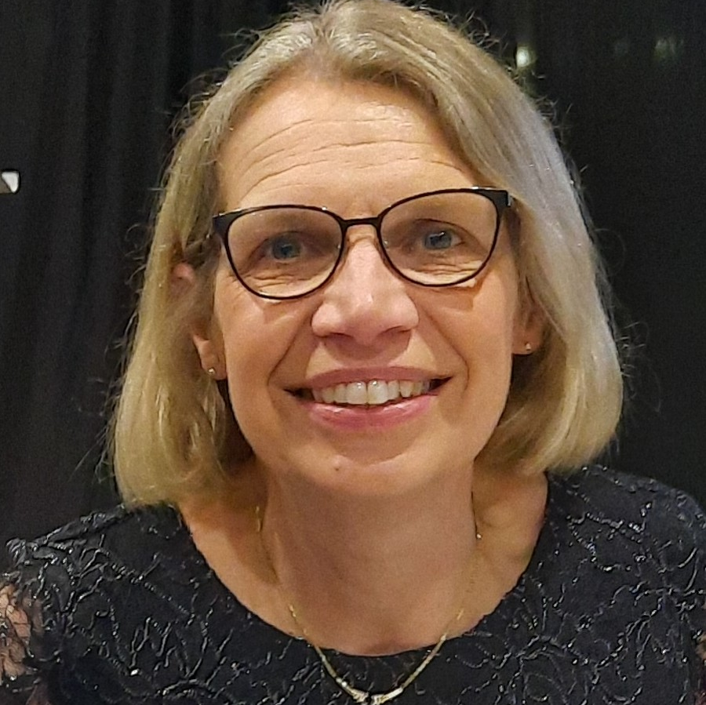
Welcome to our webinar
 | Host: Emma Blamont, Head of Research and Programmes at Fight for Sight
 | Speakers: Dr Amy Gerrish, Principal Research Scientist at Birmingham Women and Children’s NHS Foundation Trust
 | Katie Elliott, a Fight for Sight ambassador
 | Dr Helen Jenkinson, paediatric oncologist, Clinical Lead for Retinoblastoma Service at Birmingham Women and Children’s NHS Foundation Trust
Notes:
Get everyone to say a ‘quick’ hello – so everyone’s voices are ‘in the room’.

Slide 4

About Fight for Sight
We fund the brilliant minds and bright ideas that put change in sight.
Notes:
Explain that we are a funder

Slide 5
Our brand story, imagine…
Imagine being told that you, or someone you love, is losing their sight. At that moment, two profound questions present:
Can this be stopped? How do I live my life?

Slide 6
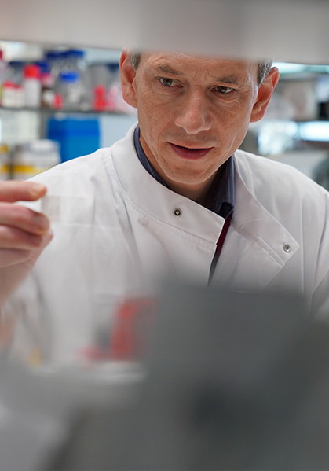
Investing to put change in sight
Over the next five years, we plan to distribute £30m in grants.

Slide 7
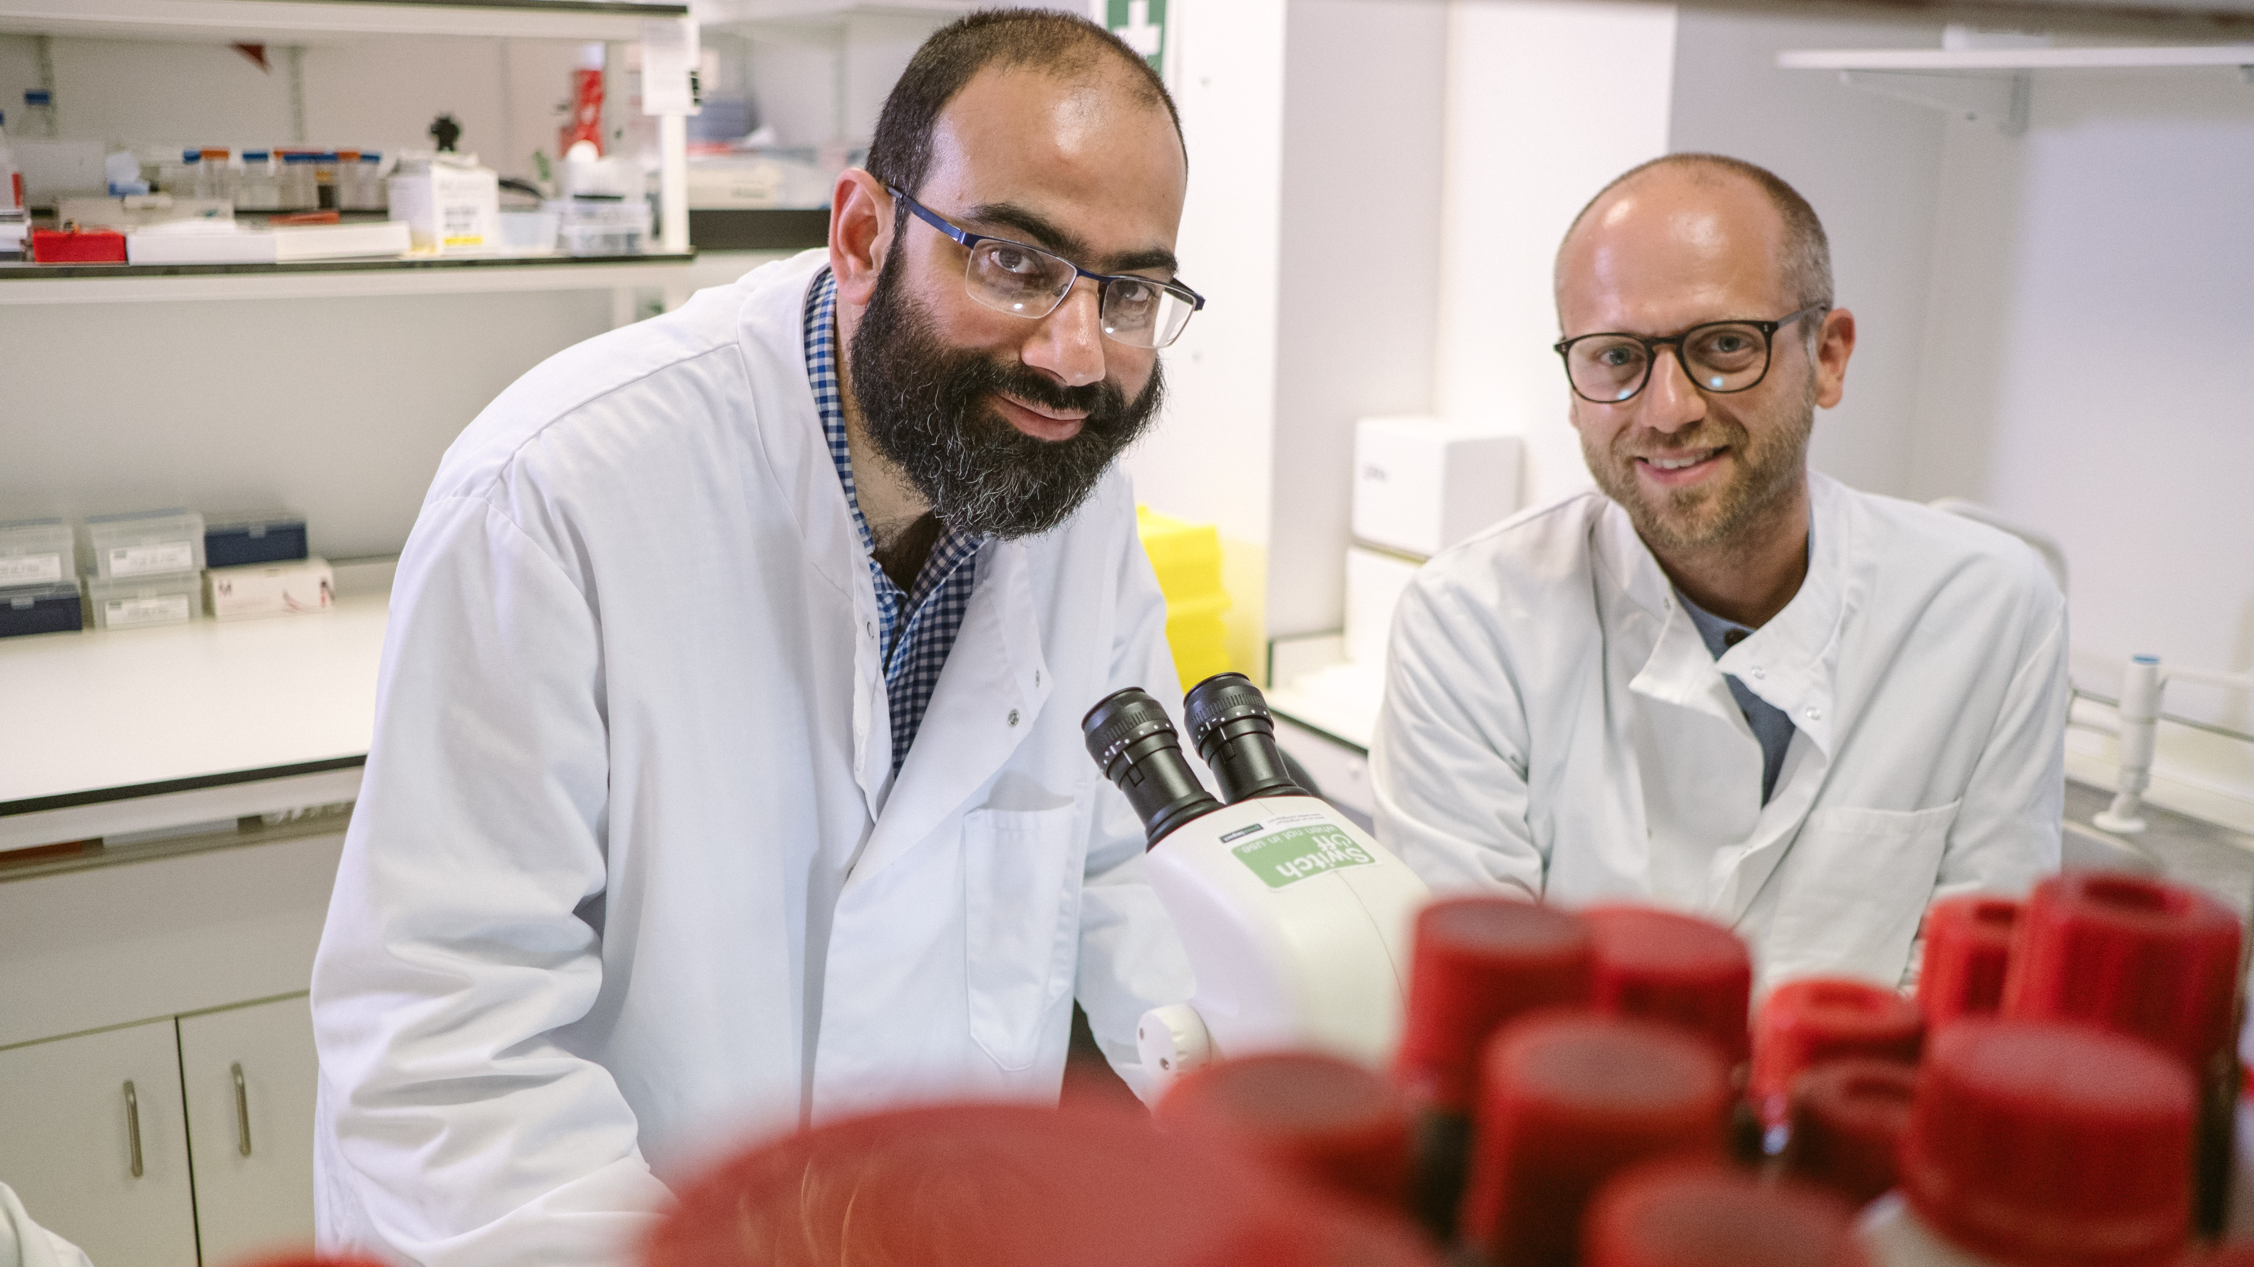
Research strategy
Our researchers are working to better understand, diagnose, prevent and treat vision loss.

Slide 8

Q & A

Slide 9
Useful resources
Discover more about retinoblastoma in our A to Z
Read Katie’s story on our website
Read more about Dr Gerrish’s work, funded by Fight for Sight
Read more about the impact of the scientific research and social change we’re funding
Please donate and help us fund more scientific research
Find out how to apply for funding from Fight for Sight

Slide 10
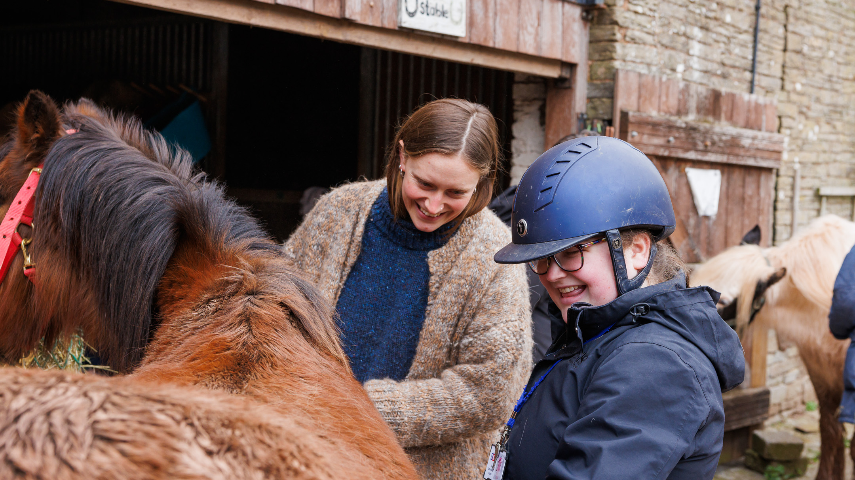
Social change
The partnerships we build and initiatives we support are changing lives for blind and vision impaired people.

Slide 11
Fight for Sight Presents: our next webinar
Building confidence through a pathway of independence model
Thursday 10 April 2025 at 12:00-13:00.
Register here
In this webinar we're joined by Henshaw's, a Greater Manchester based organisation. Recent research funded by us and conducted by researchers from Abertay University identified that blind and vision impaired people (who are three times more likely to experience loneliness and isolation) lack confidence to get out and about and enjoy activities that enrich life experiences, such as sporting activities.
Henshaw's runs a portfolio of accessible social and hobby groups for vision impaired children and young people with the aim to build independence and take on the goals they've set for themselves.

Slide 12
Fight for Sight Presents: our next scientific research webinar
Creating artificial corneas for transplantation
Thursday 22 May 2025 at 13:00-14:00
Register here
Millions of people worldwide are waiting for a cornea transplant, while their sight worsens. But with funding from Fight for Sight, Dr Hannah Levis and her team are developing an option which could help people get their eyesight back sooner.
Every year in the UK, 3,000 cornea transplants take place, using corneas donated by people after their death. But for many reasons, there is a shortage of willing donors. Globally, for every one corneal transplant that happens, there are 70 other people in need.

Slide 13

Thank you
www.fightforsight.org.uk
#FightforSightPresents

