Slide 1
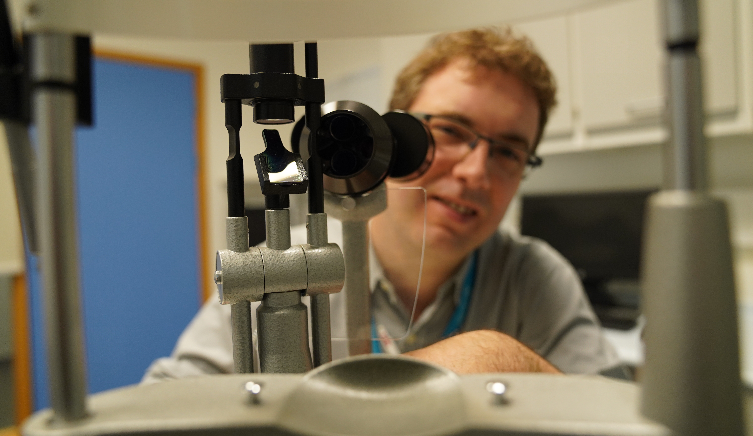
Fight For Sight
Webinar: The Importance of Collaboration in Research

Slide 2
A little bit of housekeeping
Live captions are available during the webinar
Slides, a transcript and a recording, will be made available post-webinar
Please use the Q&A window to ask questions
We’ll send you an email including a survey after the webinar

Slide 3
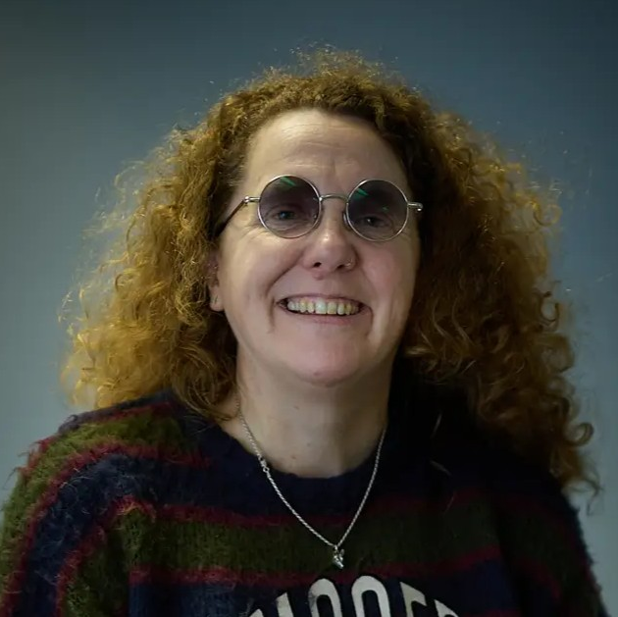
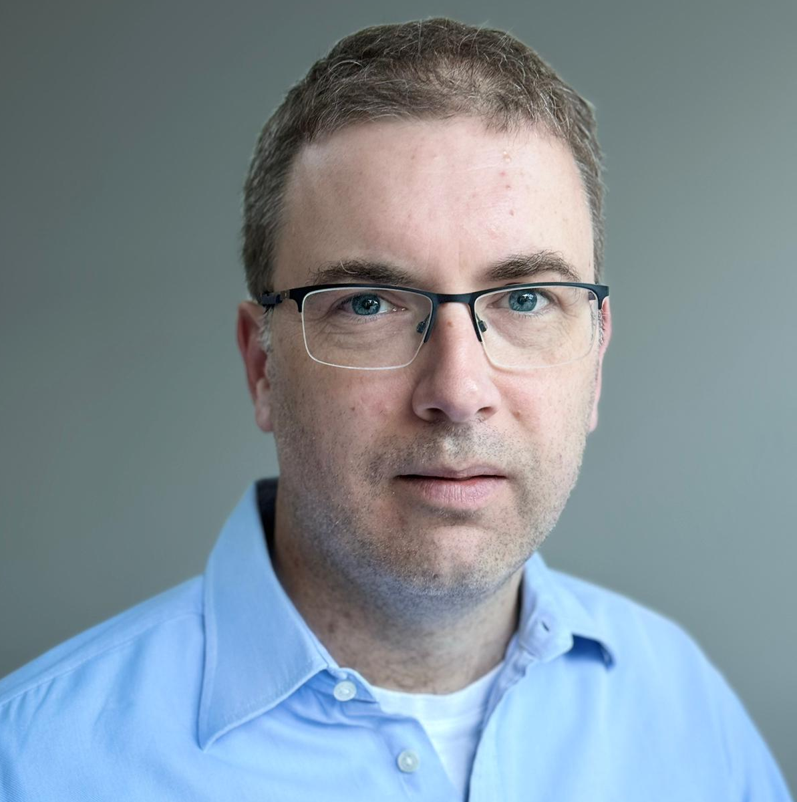
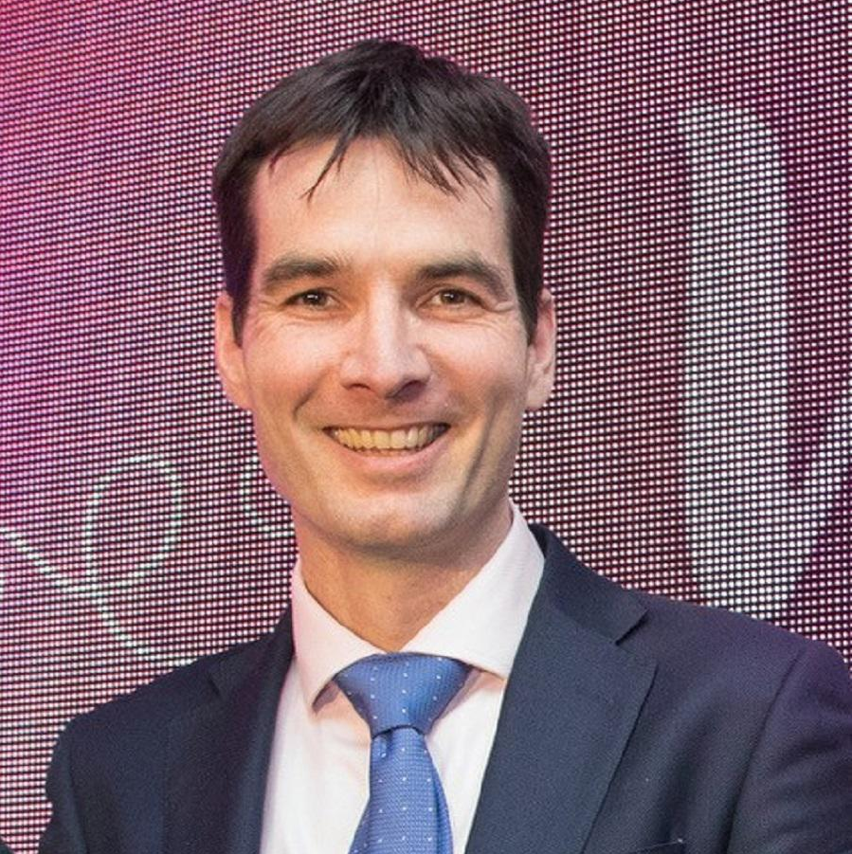
Welcome to our webinar
 | Host: Sarah Kidner, Head of Communications and External Affairs
 | Speaker: Professor Pearse Keane, Professor of Artificial Medical Intelligence at the UCL Institute of Ophthalmology
 | Speaker: Professor Alastair Denniston, Professor of Regulatory Science and Innovation at the University of Birmingham

Slide 4

About Fight for Sight
We fund the brilliant minds and bright ideas that put change in sight.
Notes:
Explain that we are a funder

Slide 5
Our brand story, imagine…
Imagine being told that you, or someone you love, is losing their sight. At that moment, two profound questions present:
Can this be stopped? How do I live my life?

Slide 6
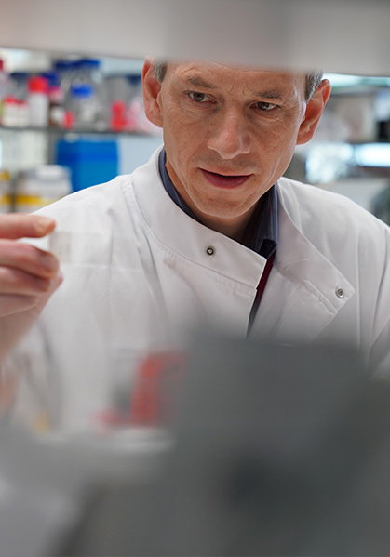
Investing to put change in sight
Over the next five years, we plan to distribute £30m in grants.

Slide 7
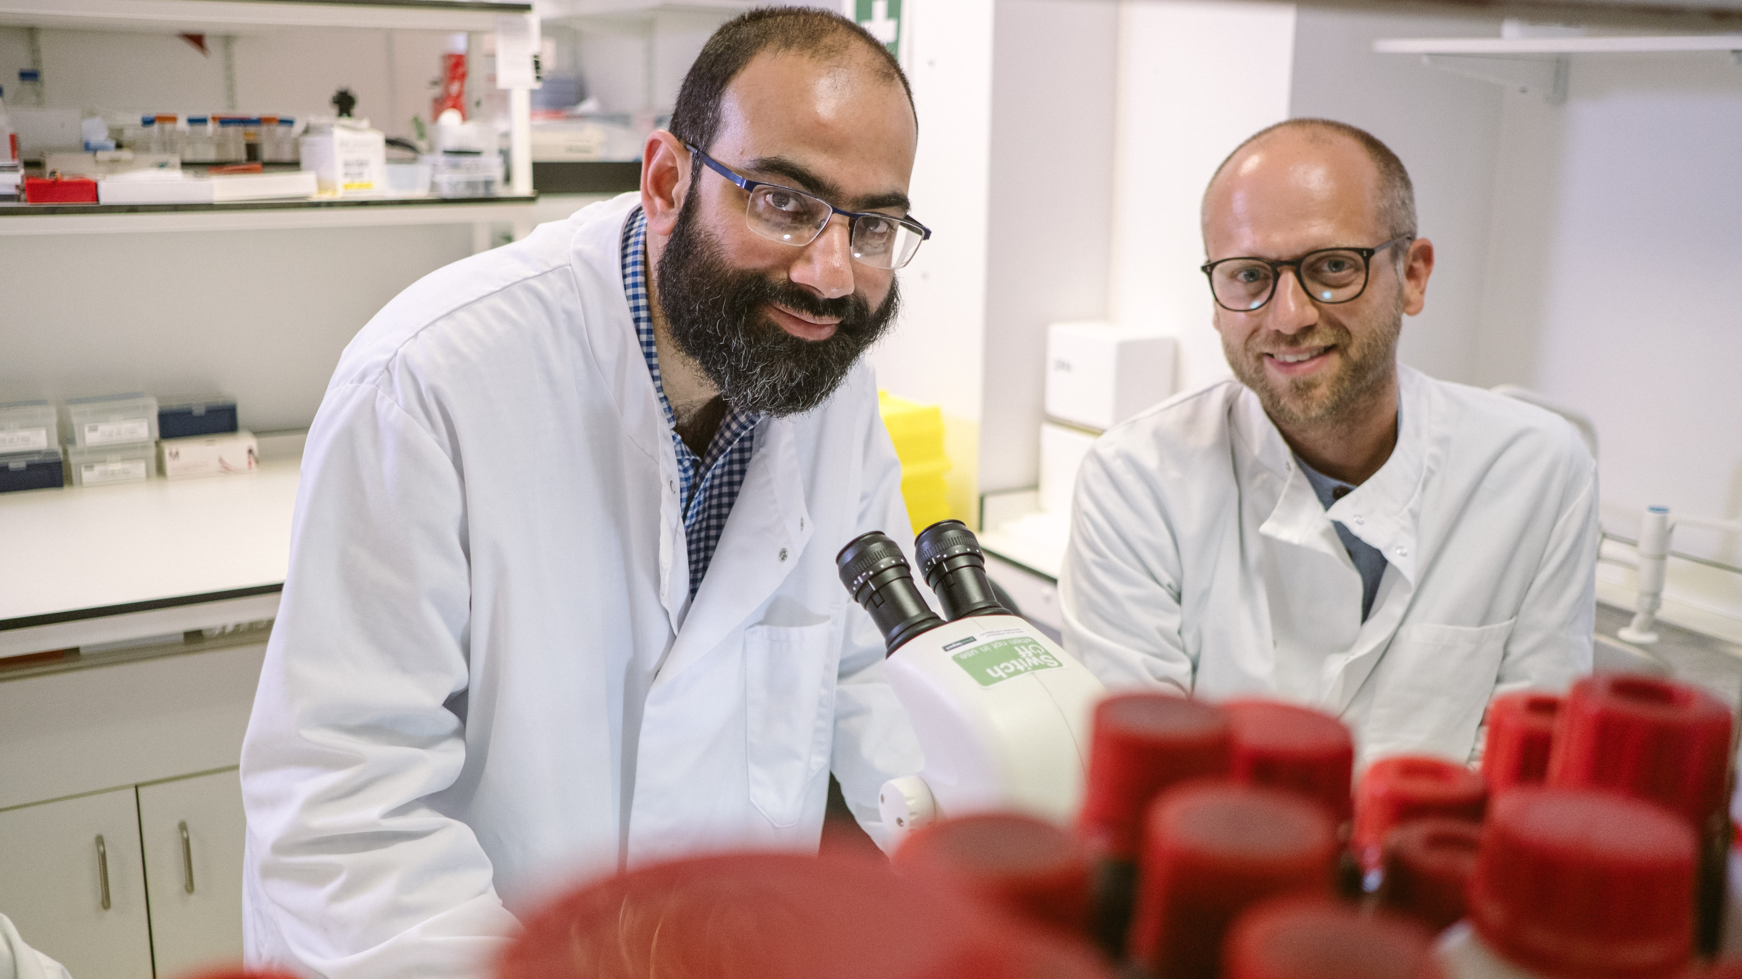
Research strategy
Our researchers are working to better understand, diagnose, prevent and treat vision loss.

Slide 8
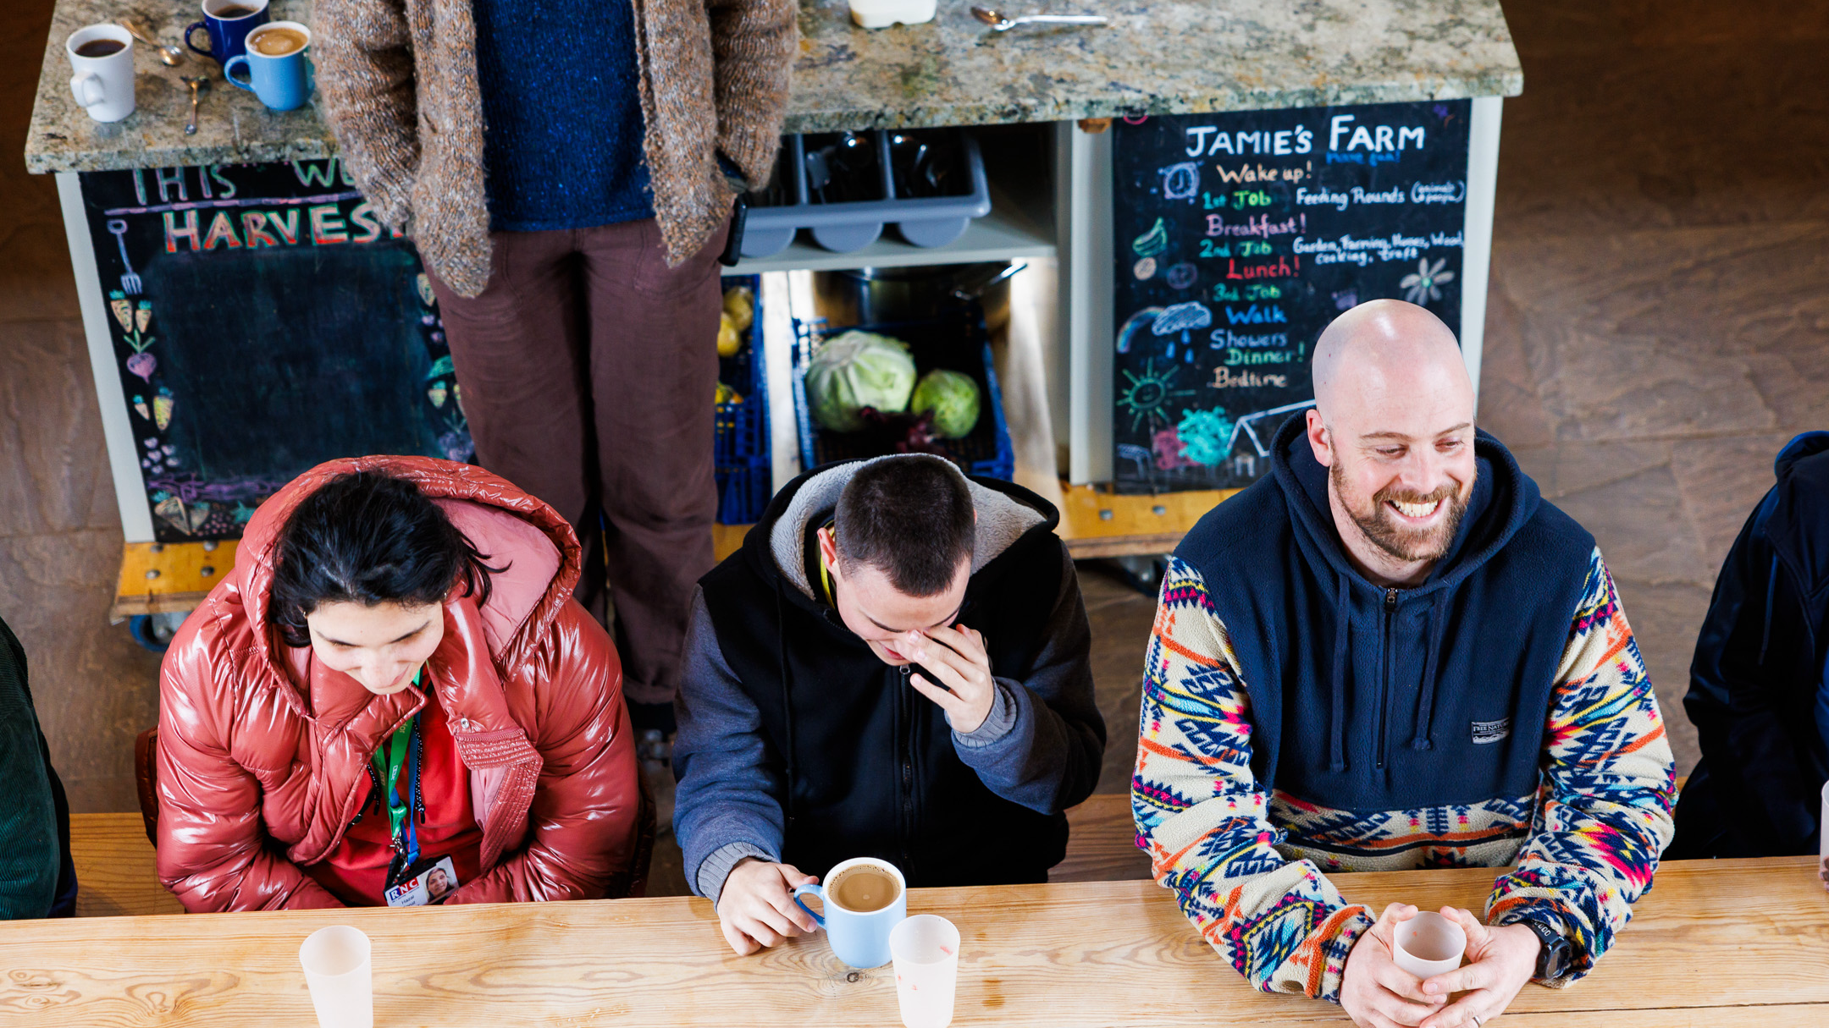
Social change
The partnerships we build and initiatives we support are changing lives for blind and vision impaired people.

Slide 9
Panel Discussion

Slide 10

Q & A

Slide 11
Useful resources
Read more about the Profs’ work
Find out more about Prof. Keane
Find out more about Prof. Denniston
Read more about our small grants
Discover more about eye conditions in our A to Z
Fundraise for us through your steps – Summit for Sight
Read more about the impact of the scientific research and social change we’re funding
Please donate and help us fund more scientific research
Find out how to apply for funding from Fight for Sight

Slide 12
Fight for Sight Presents: Our next webinar
Tackling the SEND crisis
Thursday 6th November 2025 at 12:00-13:00.
Register here
Join us for an important conversation on the ongoing crisis in Special Educational Needs and Disabilities (SEND) support. What support is available, what is working and what needs to change?
Our panel of leaders from MoorVision, Special Needs Jungle and RSBC explore the reality of the crisis and share their lived experiences working in this space. They will dive into the importance of proper SEND support, the challenges the sector is facing, and what the future has in store.

Slide 13
Fight for Sight Presents: Our next scientific research webinar
Building mentorship opportunities in vision research
Wednesday 21st January 2026 at 12:00-13:00.
Register here
Good mentorship is essential for building the next generation of vision researchers. Eye research is an underfunded area; in 2018, just over 1.5 percent (£24 million) of the £1.4 billion that UK Research and Innovation, government and other public bodies invested in medical research was for eye research. This lack of funding means it is hard to get the brilliant minds we need into the field.
That's why Fight for Sight offers two mentorship opportunities: our UK Vision Research Network Doctoral Training Programme, and our competitive PhD Studentships.
In this webinar we'll be hosting Professor Marcela Votruba from Cardiff University and Dr Monika Winter from Northumbria University, to discuss their perspectives on the importance of mentorship across different research career stages.

Slide 14

Thank you
www.fightforsight.org.uk
#FightforSightPresents

