Slide 1
Social Prescribing:
A non-medical approach to health and wellbeing
Rachel Jenkins & Anna Peiris

Slide 2


What is Social Prescribing
A non-medical approach to health and wellbeing
Holistic, person-centred approach
Helps people access support in their community.
Complements traditional medical treatments.
Focuses on social, emotional and practical issues.

Slide 3









Some of the topics we talk to people about are…
Loneliness and Isolation
Social Connections, Hobbies/Interests
Physical Health and Emotional Wellbeing
Money, Benefits and Debt
Work and Volunteering
Practical Support
Family and Home Life
Carers Support
Physical Activity

Slide 4
What are the benefits of Social Prescribing
Improves Mental Health and Wellbeing
Supports People with Long-Term Conditions
Reduces Loneliness and Social Isolation
Promotes Self-Management and Independence
Addresses Social Determinants of Health
Reduces Pressure on NHS and GP Services

Slide 5
Connecting with others ……
Builds a sense of belonging and reduces loneliness
Provides emotional support and reduces stress
Boosts happiness and mental well-being
Strengthens physical health and immunity
Encourages personal growth and learning
Opens doors to opportunities and collaboration
Increases motivation and accountability

Slide 6
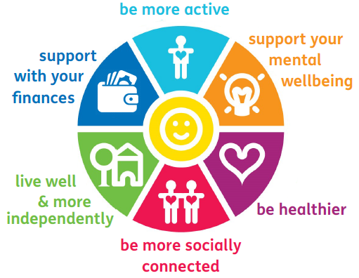
Building social connections in the community ….
Social groups
Lunch clubs and coffee mornings
Befriending services
Creative/ arts activities
Singing/ music groups
Specific support groups / services
Peer support
Faith groups
Exercise and physical activity
Nature based activities – gardening
Volunteering opportunities
Skills / courses

