Slide 1
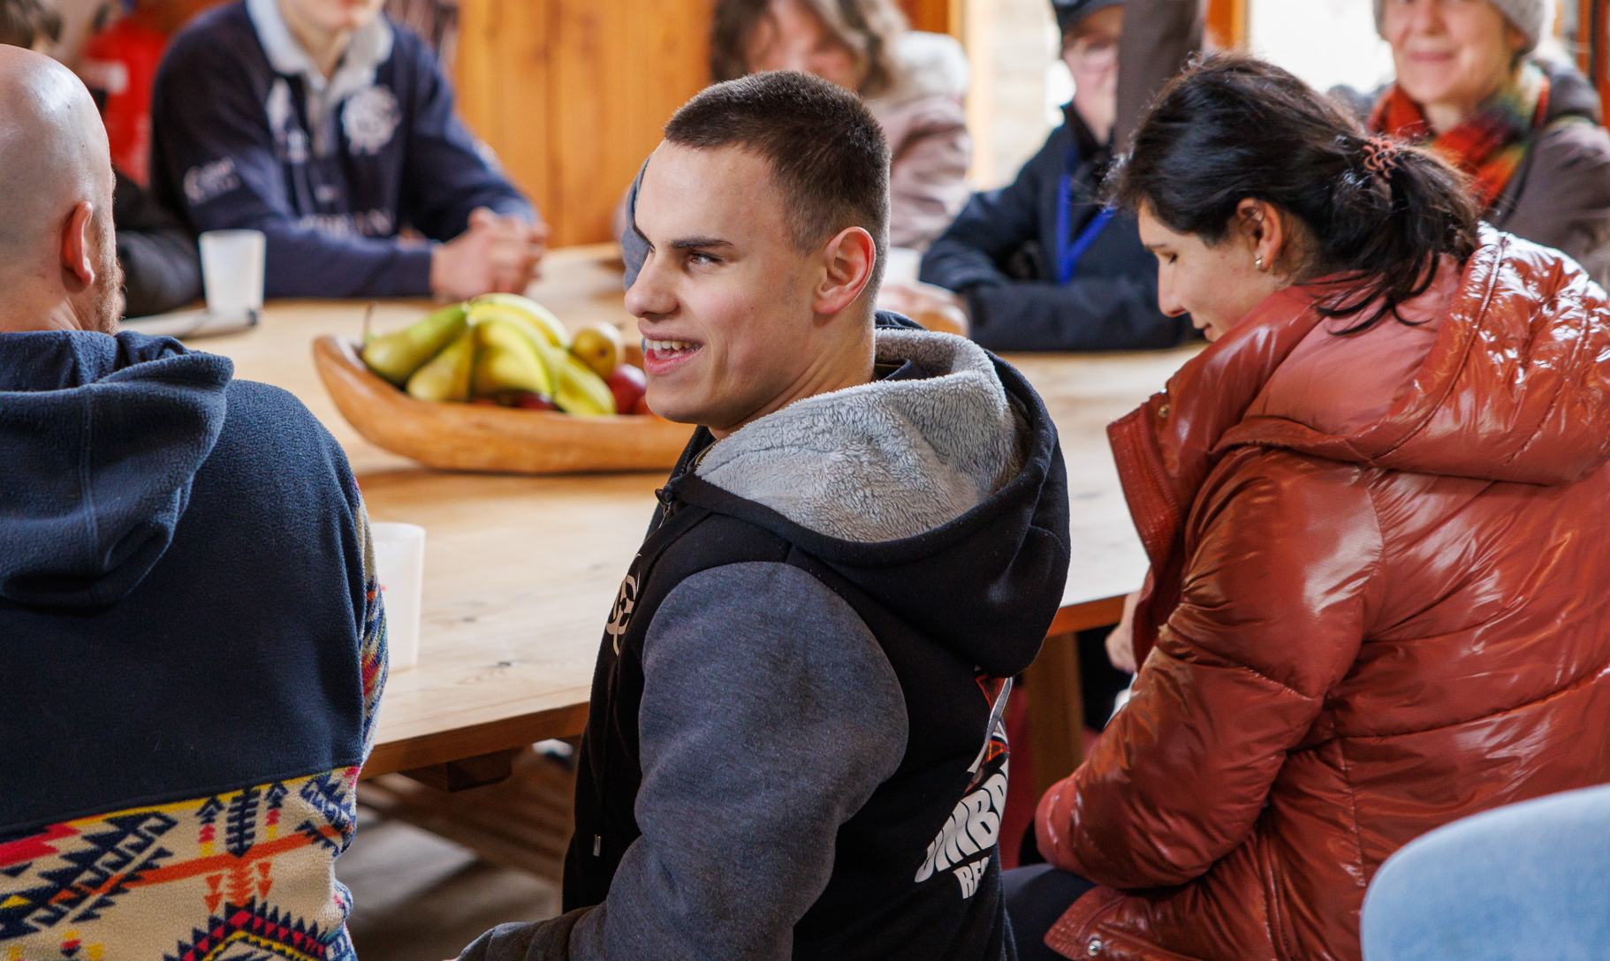
Fight For Sight
Webinar: creating artificial corneas for transplantation

Slide 2
A little bit of housekeeping
Live captions are available during the webinar
Slides, a transcript and a recording, will be made available post-webinar
Please use the Q&A window to ask questions
We’ll send you an email including a survey after the webinar

Slide 3
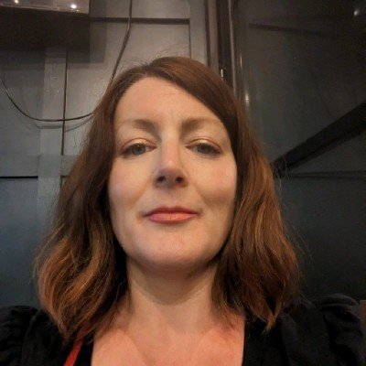
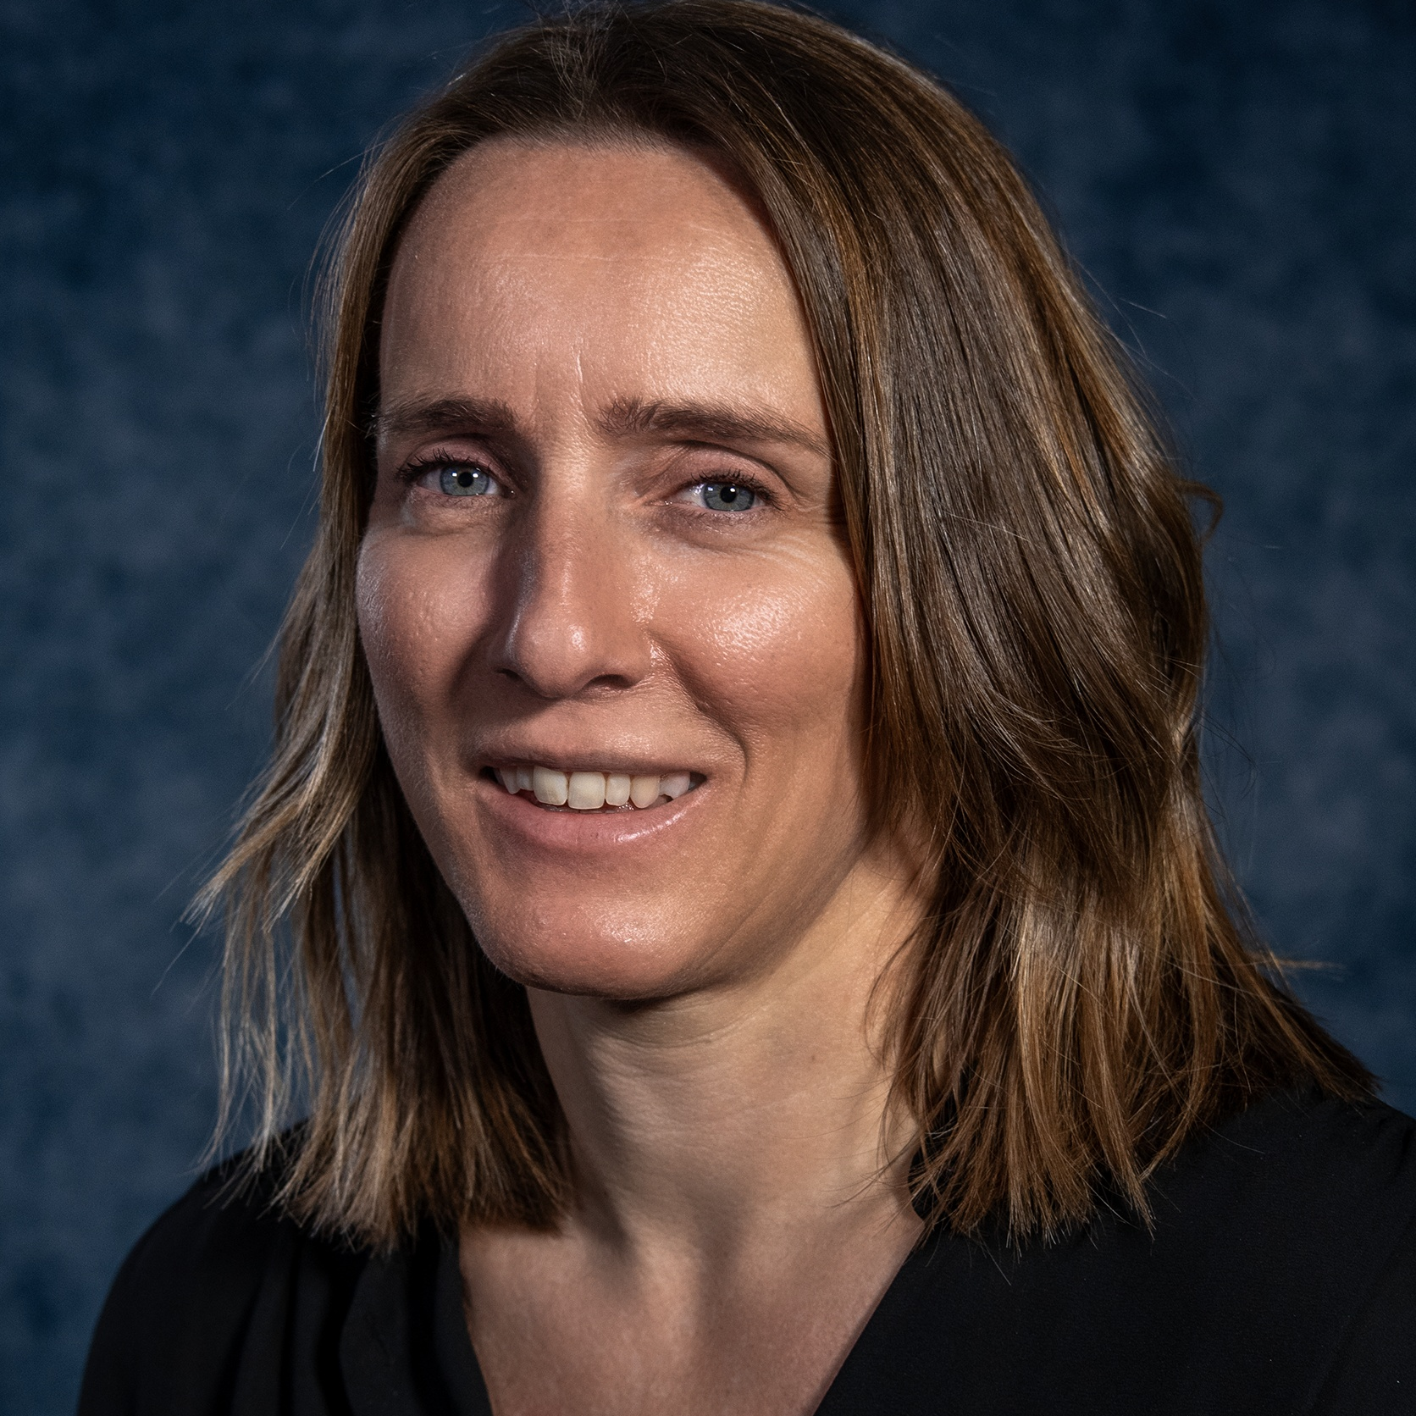
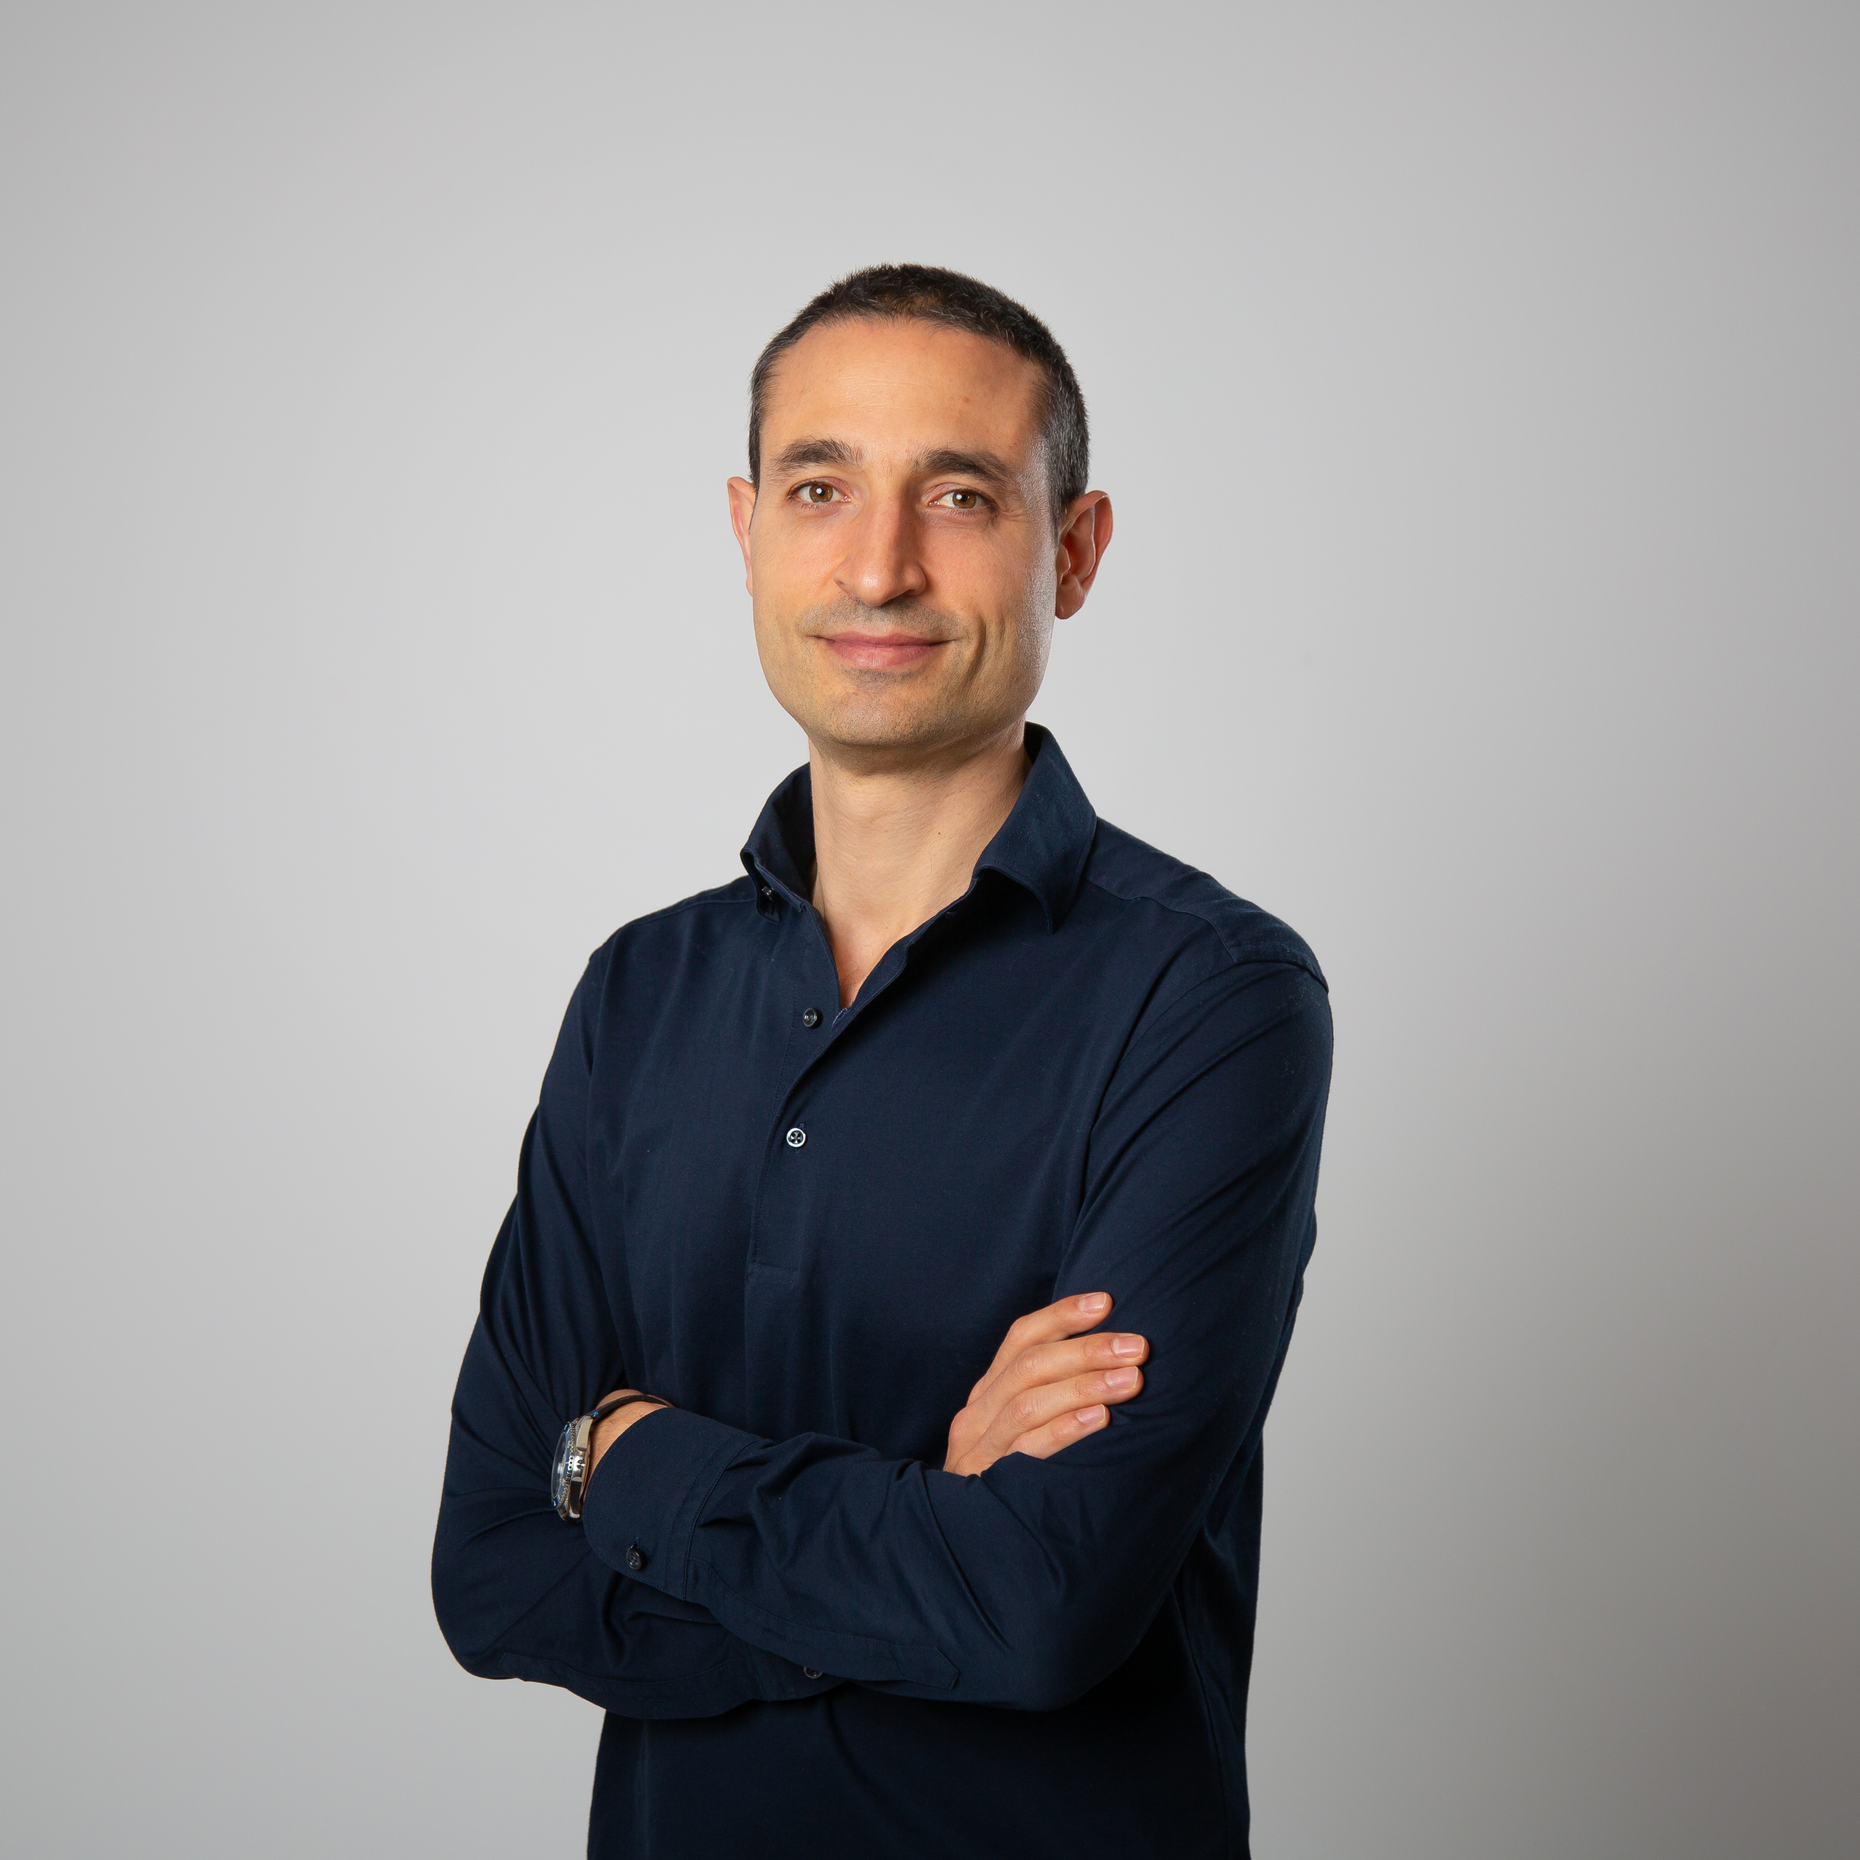
Welcome to our webinar
 | Host: Emma Blamont, Head of Research and Programmes at Fight for Sight
 | Speakers: Dr Hannah Levis, Reader in Ophthalmic Bioengineering, University of Liverpool
 | Dr Vito Romano, Professor of Ophthalmology at the University of Brescia
Notes:
Get everyone to say a ‘quick’ hello – so everyone’s voices are ‘in the room’.

Slide 4

About Fight for Sight
We fund the brilliant minds and bright ideas that put change in sight.
Notes:
Explain that we are a funder

Slide 5
Our brand story, imagine…
Imagine being told that you, or someone you love, is losing their sight. At that moment, two profound questions present:
Can this be stopped? How do I live my life?

Slide 6
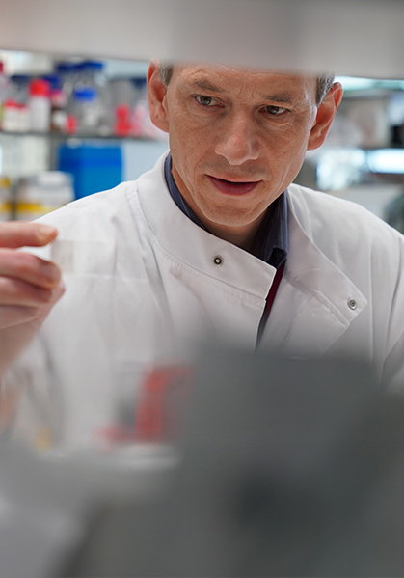
Investing to put change in sight
Over the next five years, we plan to distribute £30m in grants.

Slide 7
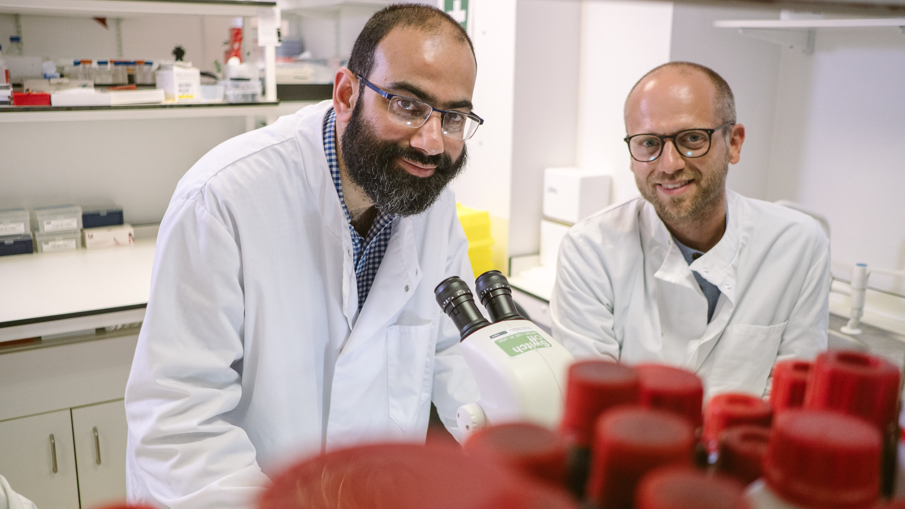
Research strategy
Our researchers are working to better understand, diagnose, prevent and treat vision loss.

Slide 8

Q & A

Slide 9
Useful resources
Discover more about Fuchs’ dystrophy, keratoconus, and corneal dystrophy in our A-Z
Read more about Dr Levis’ work, funded by Fight for Sight
Read more about the impact of the scientific research and social change we’re funding
Please donate and help us fund more scientific research
Find out how to apply for funding from Fight for Sight

Slide 10
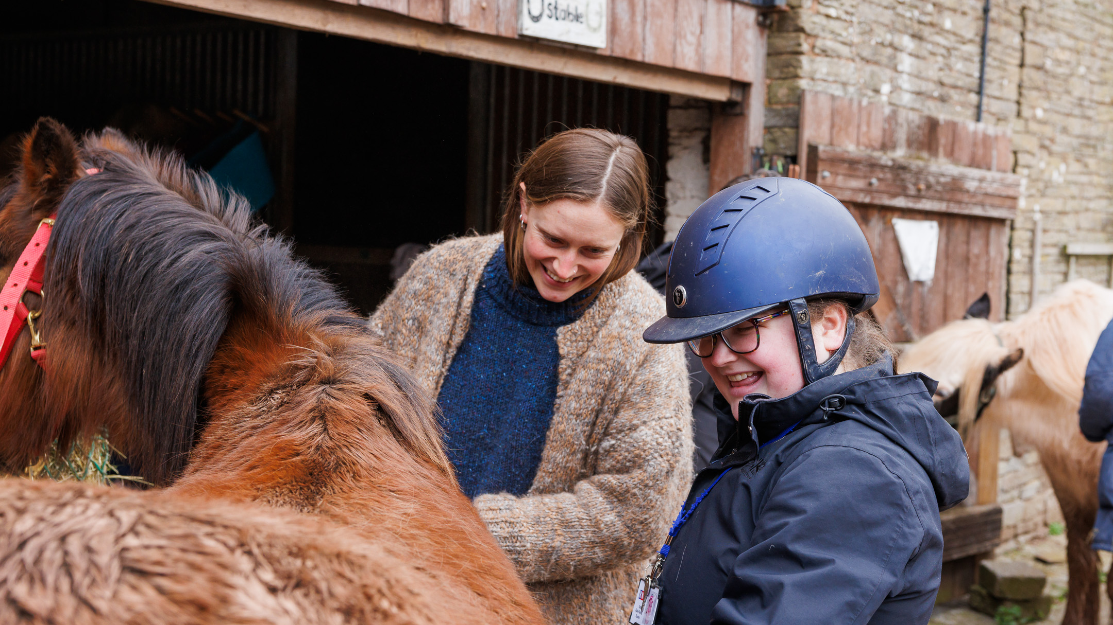
Social change
The partnerships we build and initiatives we support are changing lives for blind and vision impaired people.

Slide 11
Fight for Sight Presents: our next webinar
Creating social communities with Sutton Vision
Thursday 10 April 2025 at 13:00-14:00.
Register here
In this webinar Denise, CEO of Sutton Vision, talks through the outcome of those surveys and the 'network of friends' which has developed. She'll be joined by one of the members enjoying the connections and friendships she's built.
The work of Sutton Vision is heavily linked to the many benefits of social prescribing. We'll be joined by a social prescribing link worker who'll talk us through the evidence and benefits of social prescribing particularly in combating social isolation and improving health and wellbeing.

Slide 12

Thank you
www.fightforsight.org.uk
#FightforSightPresents

