Slide 1

Fight For Sight
Webinar: Mentoring for Social Change with LOOK UK

Slide 2
A little bit of housekeeping
Live captions are available during the webinar
Slides, a transcript and a recording, will be made available post-webinar
Please use the Q&A window to ask questions
We’ll send you an email including a survey after the webinar

Slide 3
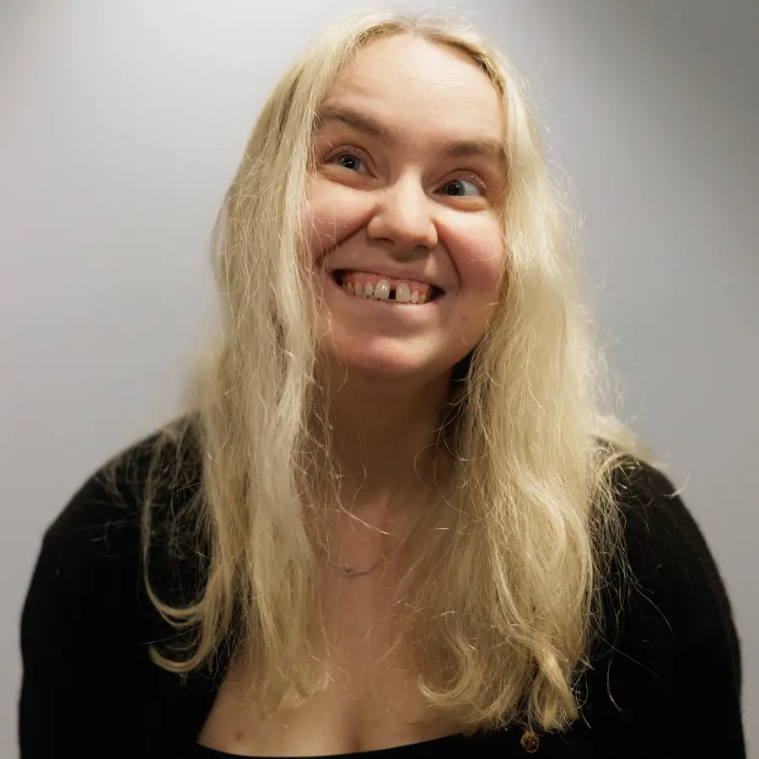
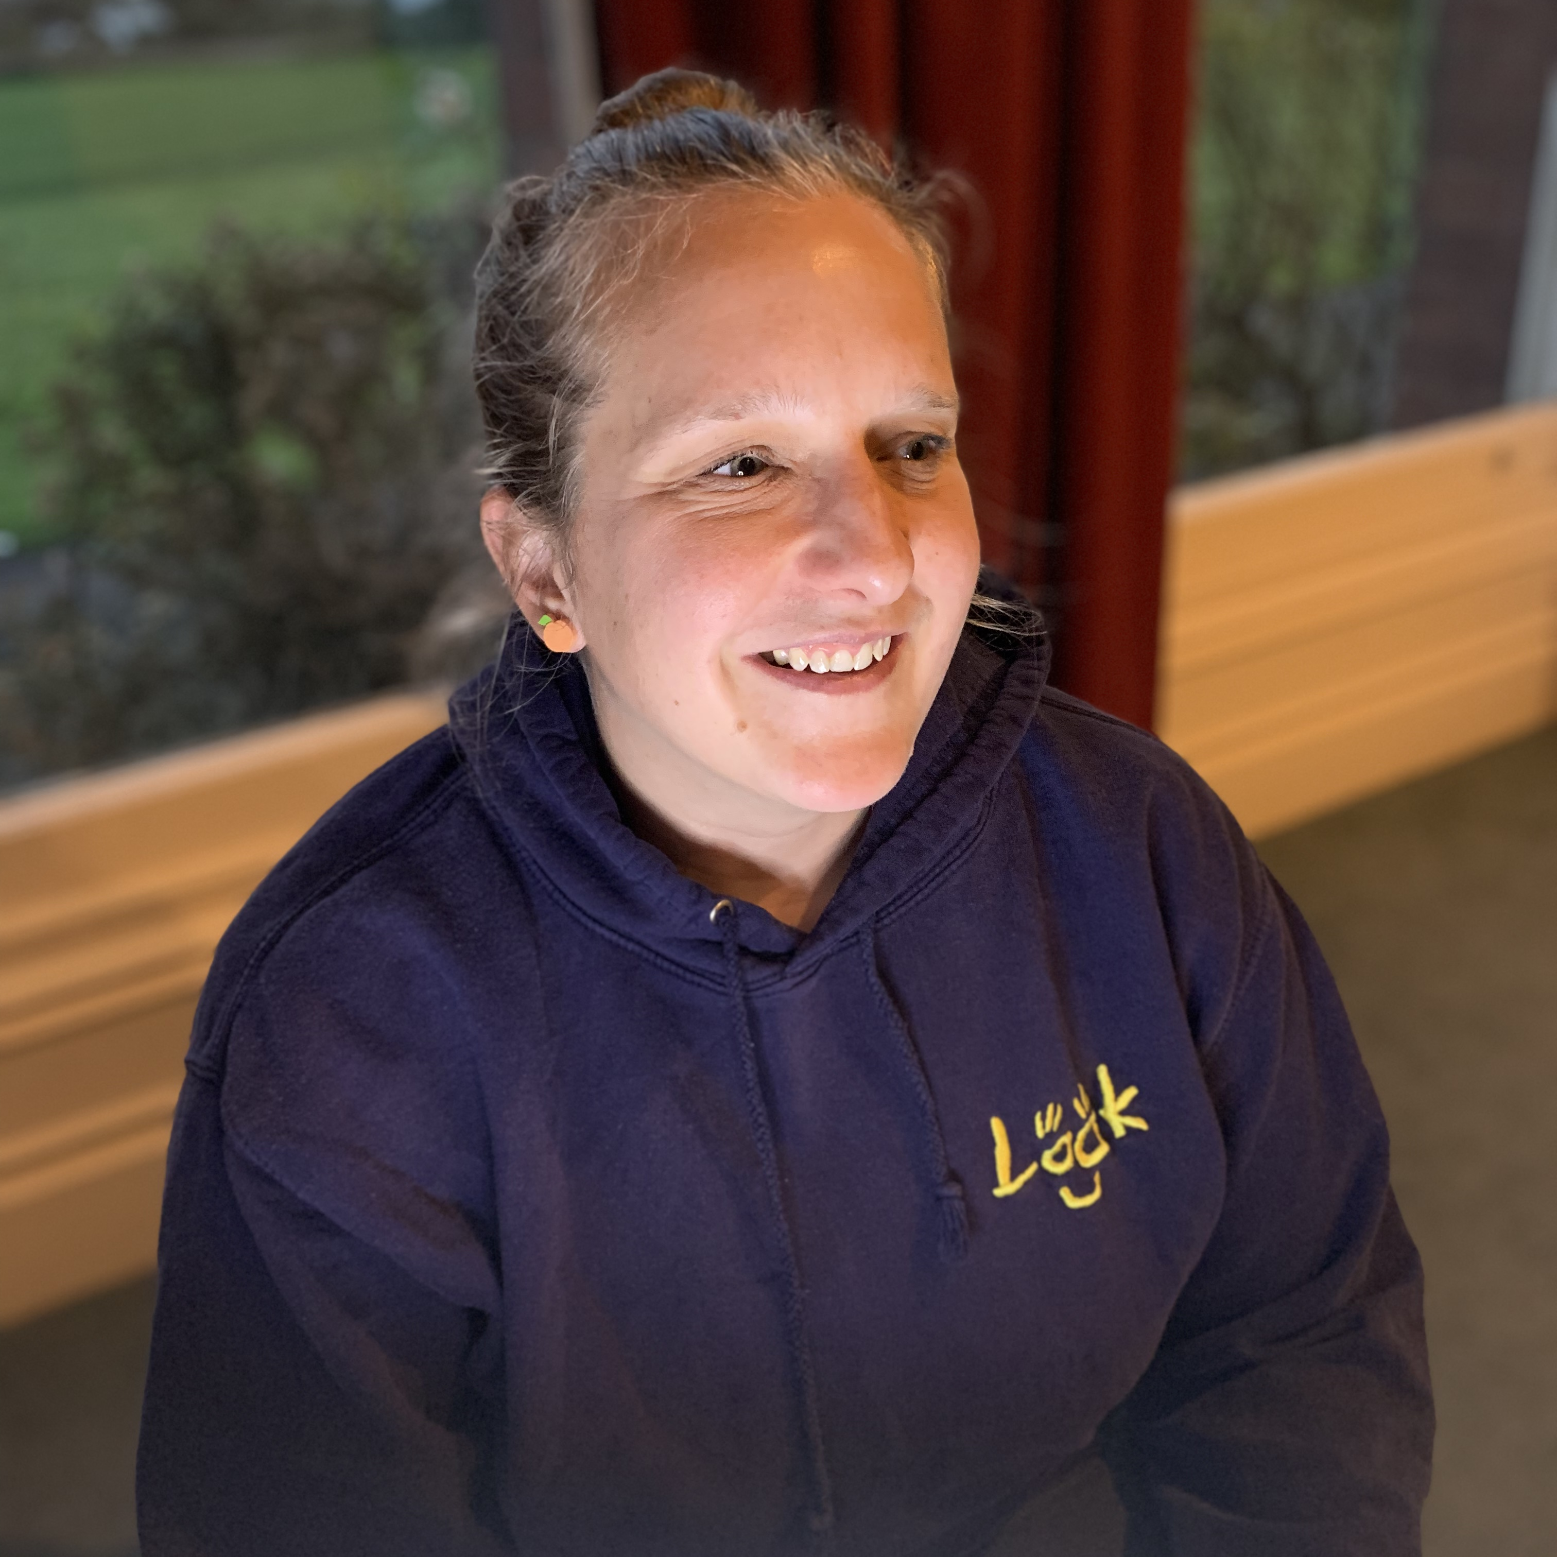
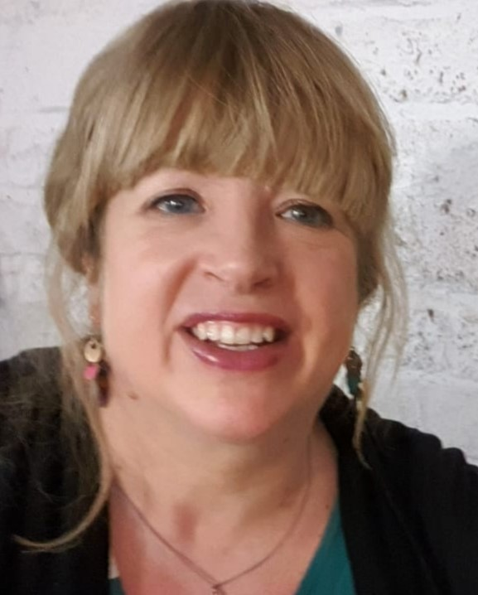
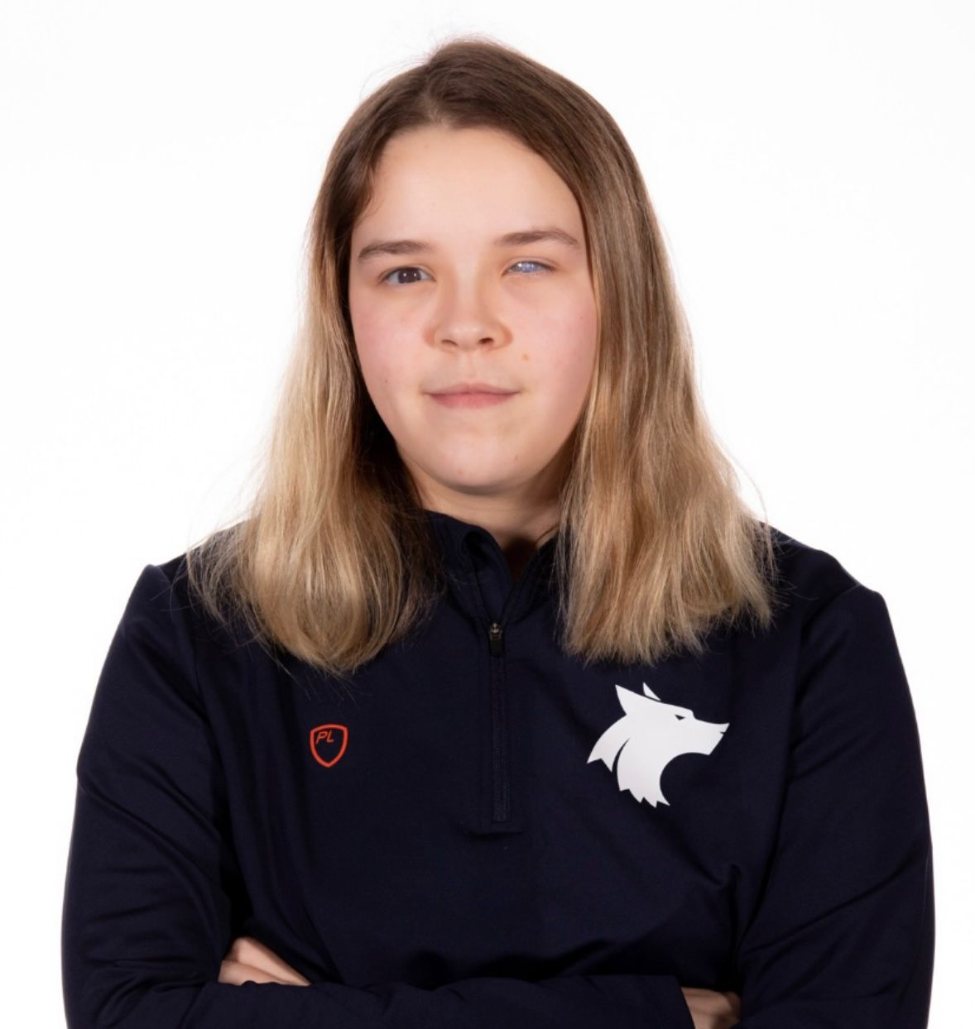
Our panel
Host: Kerry Firth, Grants Manager, Social Change, Fight for Sight
Speaker: Mo, current mentor at LOOK UK
Speaker: Ruth Storey, Mentor Project Manager at LOOK UK
Speaker: Jane Ring,
Parent Support Officer at LOOK UK
Speaker: Caitlin, former mentee, current mentor and intern at LOOK UK

Slide 4

About Fight for Sight
We fund the brilliant minds and bright ideas that put change in sight.
Notes:
Explain that we are a funder

Slide 5
Our brand story, imagine…
Imagine being told that you, or someone you love, is losing their sight. At that moment, two profound questions present:
Can this be stopped? How do I live my life?

Slide 6
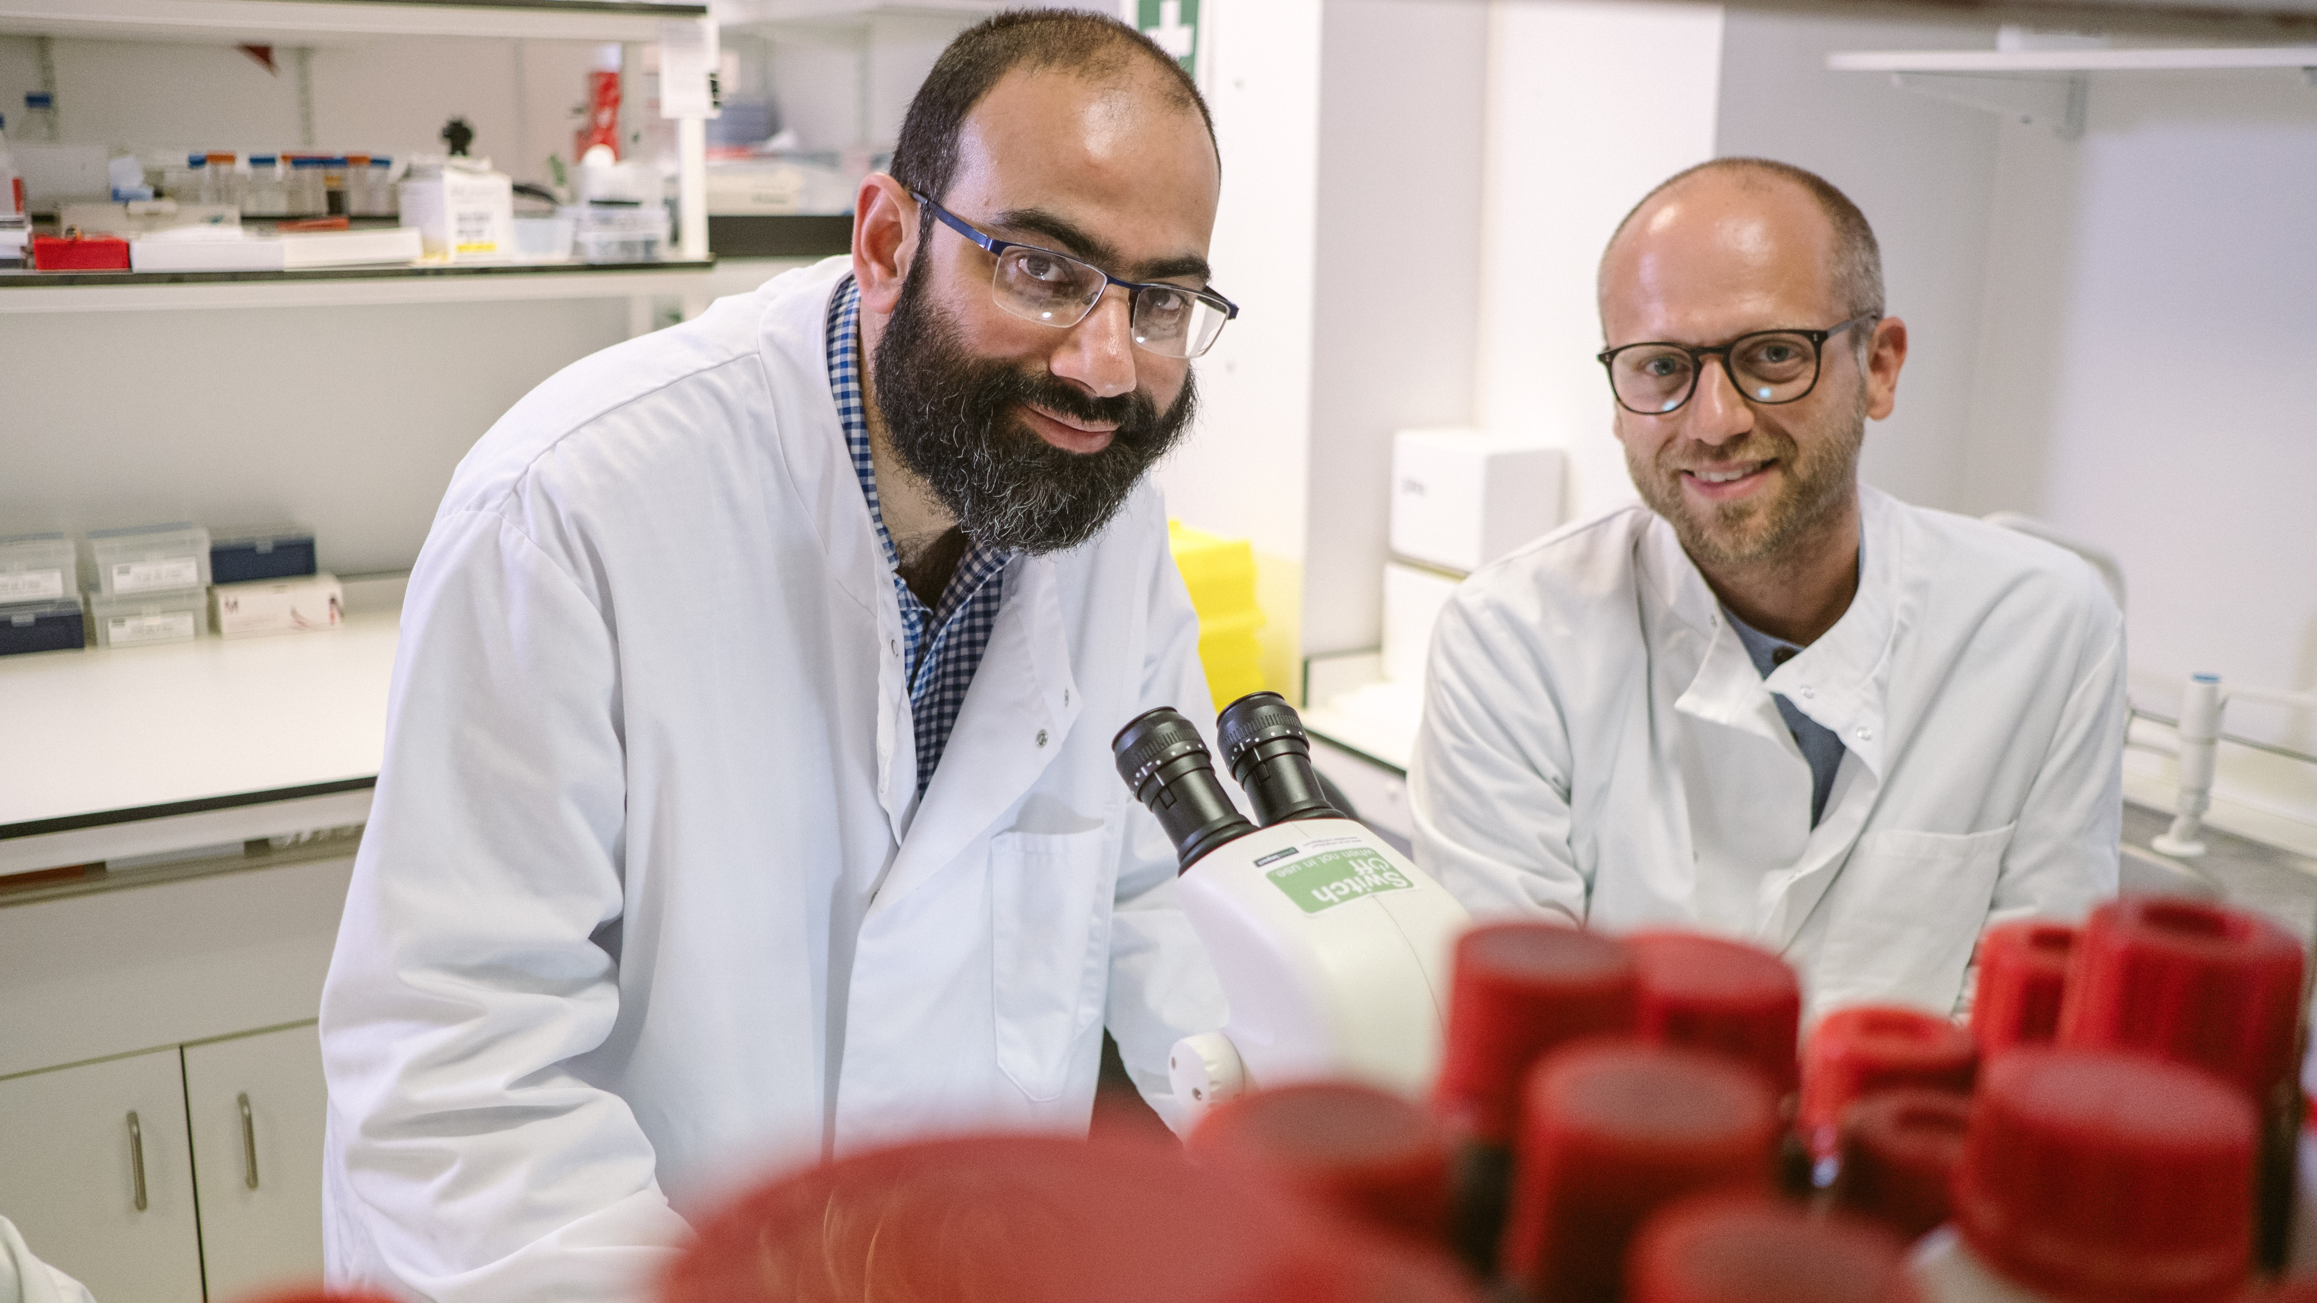
Research strategy
Our researchers are working to better understand, diagnose, prevent and treat vision loss.

Slide 7

Social change
The partnerships we build and initiatives we support are changing lives for blind and vision impaired people.

Slide 8
Panel Discussion

Slide 9

Q & A

Slide 10
Useful resources
Read about LOOK UK’s work
Find out more about LOOK UK
Discover more about our social change funding
Find out more about the projects we fund
Fundraise for us through your steps – Summit for Sight
Please donate and help us fund more scientific research

Slide 11
Fight for Sight Presents: Our next webinar
Why is a form of vitamin B3 being tested in glaucoma clinical trials?
Tuesday 21 April 2026, at 13:00 – 14:00.
Register here
Glaucoma is one of the leading causes of blindness and visual impairment, affecting around 80 million patients worldwide. It’s also one of the most common neurodegenerative diseases.
Currently, the only approved way to manage glaucoma is through lowering pressure in the eye, but these treatments don’t work for everyone, and they don’t address the neurodegeneration that is a hallmark of the disease. That’s why recent research has investigated the potential therapeutic effects of something called ‘nicotinamide’ (otherwise known as NAM; a form of vitamin B3 that’s found in the diet or supplements). To put it simply, NAM can help to increase the amount of energy our cells have.
For this webinar we will be joined by Professor Ted Garway-Heath from UCL, and Associate Professor Gerassimos Lascaratos, who have been funded by Fight for Sight for their work on glaucoma.

Slide 12

Thank you
www.fightforsight.org.uk
#FightforSightPresents

