Slide 1

Fight for Sight Presents
Building confidence through a pathway of independence model
#FightforSightPresents

Slide 2
Welcome and housekeeping
Live captions are available during the webinar.
We may use illustrated slides to guide us, but we will read out everything on these.
Slides, a transcript and a recording, will be made available post-webinar.
Please use the Q&A window to ask questions.
The chat is disabled because it can be distracting for those using a screen reader, and because it is simpler for us to monitor one single channel.
When we end the webinar, it will end abruptly.

Slide 3
What to expect in this webinar
01 | Welcome from Kerry Firth, Grants Manager with an intro to our organisation
02 | Outside: blind and vision impaired people’s experiences of loneliness and isolation
03 | Who is Henshaws and what is the independence model with Hayley from Henshaws
04 | Q&A and open discussion

Slide 4

About Fight for Sight
We fund the brilliant minds and bright ideas that put change in sight.
Notes:
Explain that we are a funder

Slide 5
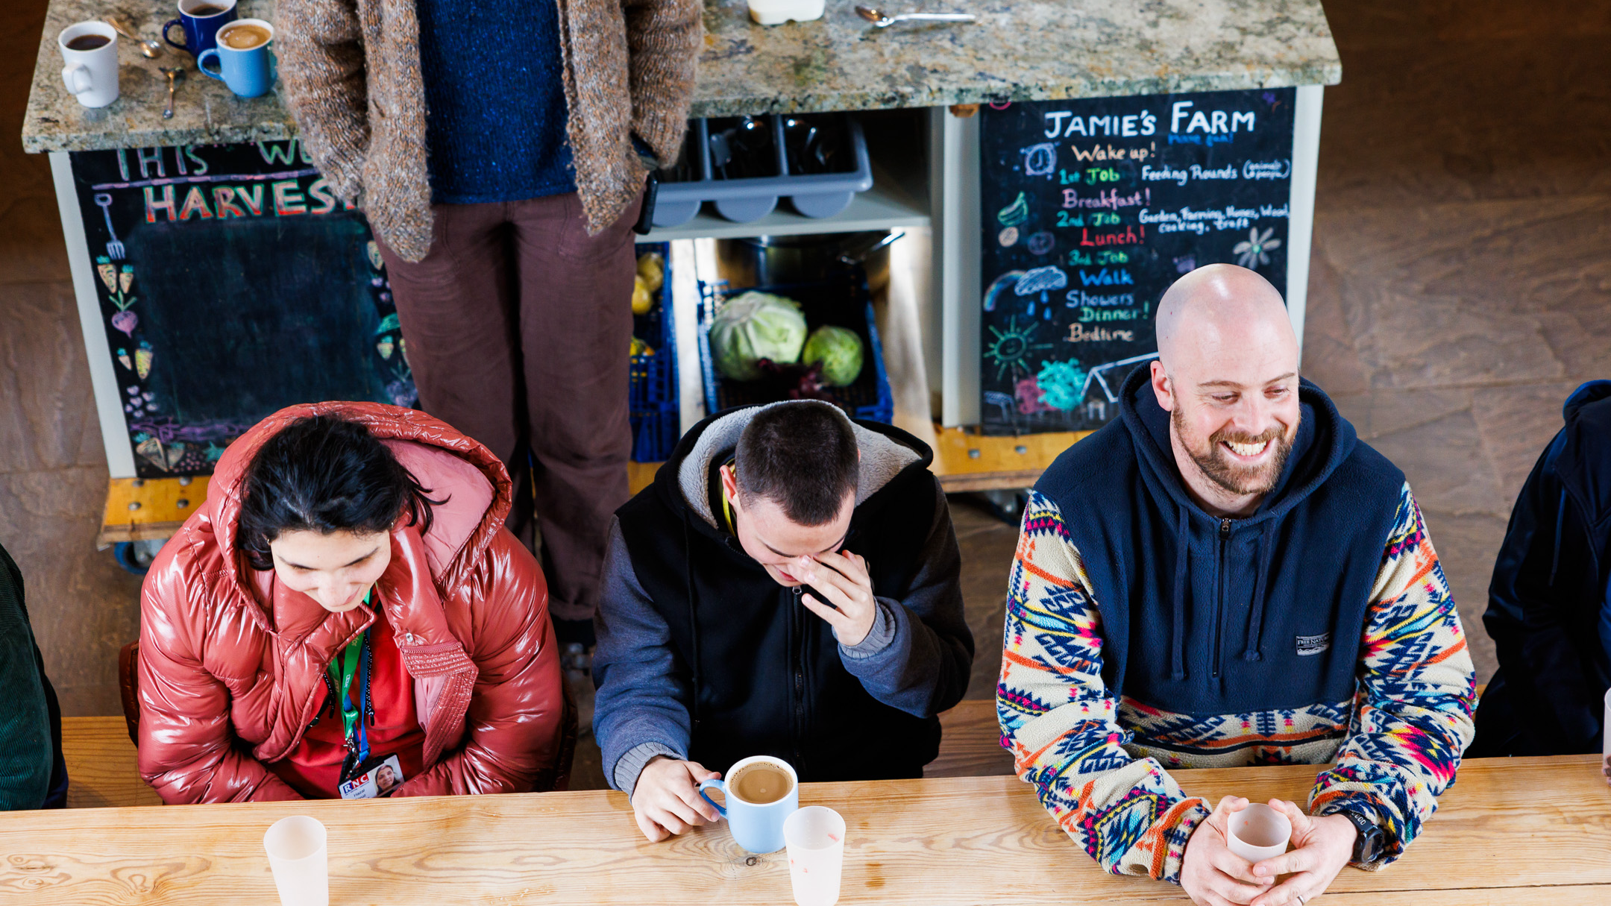
Outside: Blind and vision impaired people’s experiences of loneliness and isolation
1 in 3 people have experienced loneliness and isolation

Slide 6
“Preventing loneliness and isolation has always been a part of Henshaws’ work, and the organisation’s approach has changed in line with changes in our society and our communities. But the work of the organisation is as relevant today as it was 200 years ago when it was founded.“
Stephen Tongue

Slide 7
Further Information
More on Henshaws
Discover more about our social change funding
Find out more about the projects we fund
Find out more about the research which guided the funding: Outside: blind and vision impaired people’s experiences of loneliness and isolation
Check out what’s next on the Fight for Sight Presents programme

Slide 8
Fight for Sight Presents
Creating artificial corneas for transplantation
Thursday 22 May 2025 at 1-2pm
Register here
Millions of people worldwide are waiting for a cornea transplant, while their sight worsens. But with funding from Fight for Sight, Dr Hannah Levis and her team are developing an option which could help people get their eyesight back sooner.
Every year in the UK, 3,000 cornea transplants take place, using corneas donated by people after their death. But for many reasons, there is a shortage of willing donors. Globally, for every one corneal transplant that happens, there are 70 other people in need.
Sign up to this webinar here.

Slide 9

Thank you
www.fightforsight.org.uk
#FightforSightPresents

