Slide 1


Slide 2
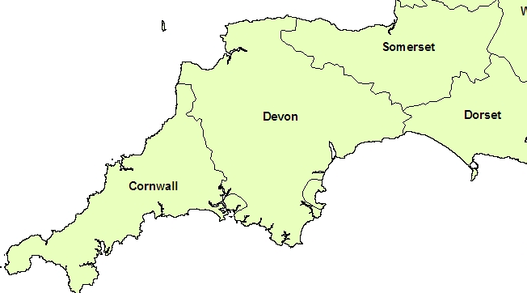


www.moorvision.org
info@moorvision.org

Slide 3

Services
Information, Advice, Support, Advocacy and Training across all aspects of Education, Health, Wellbeing, Benefits, Grant, Sports, Recreation, Leisure and Independent Living Skills
Activities and Residentials
Assessment Services

Slide 4
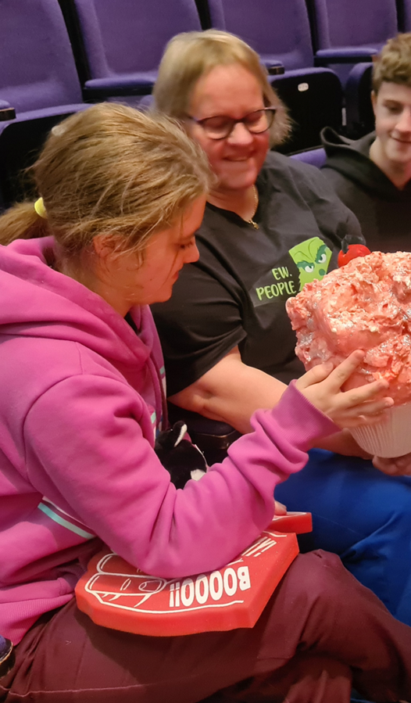

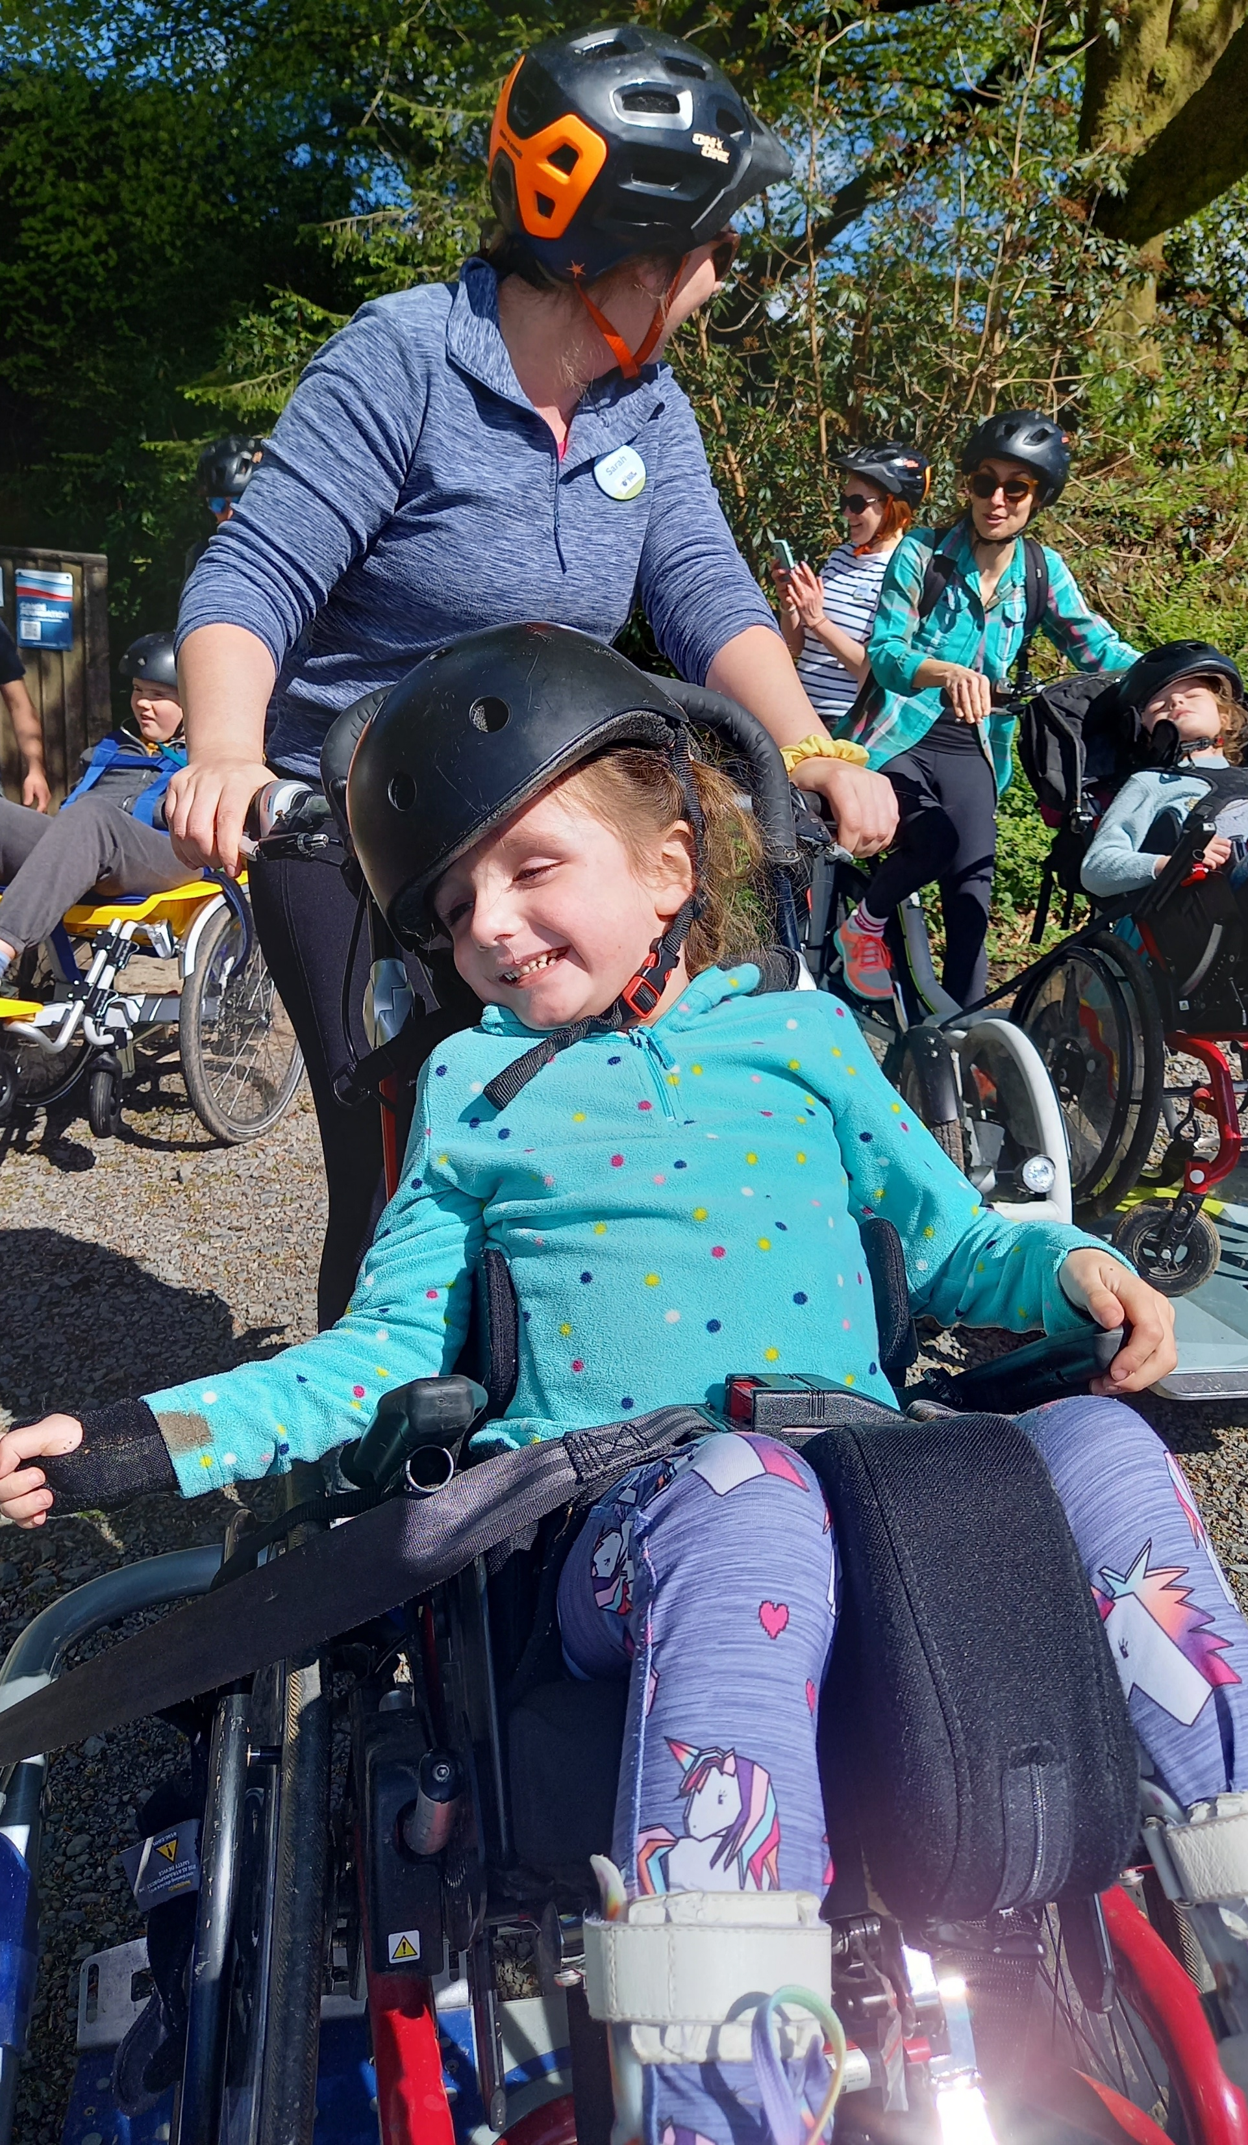


Slide 5


Slide 6

Educational
Advocacy
Our Educational Advocacy Service
Refusal to Assess
Refusal to Issue
Failure to Amend
Cross border issues
School Transport
Cease to Maintain
EOTAS, School Attendance, Reduced Timetables
Disability Discrimination

Slide 7

SEND Issues
A Brief Recap
In 2019, Education Select Committee SEND inquiry
The 2019 NAO report
The 2020 LA SEND Ofsted Inspections
The 2022 SEND Review Green Paper
The 2023/4 LA Ofsted SEND Inspections
The 2023 SEND and Alternative Provision Plan
The 2024 NAO report
The 2023/4/5 Safety Valve and SEND schemes
The 2025 PAC (public accounts committee) report
The 2025/2026 White Paper

Slide 8













Moving Forward

Slide 9
